Slide 1

Population Health Management
NHS England, NHS Digital and Public Health England
April 2019

Slide 2
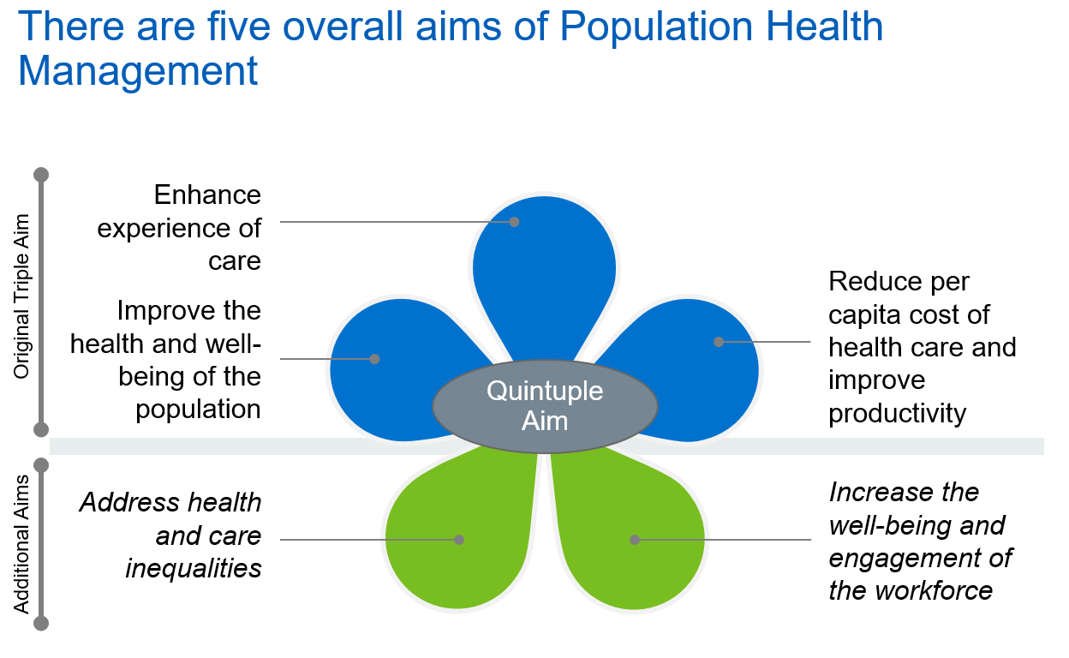
Setting a common purpose

Slide 3
A common definition for PHE & NHSE:
Population Health…
… is an approach aimed at improving the health of an entire population.
It is about improving the physical and mental health outcomes and wellbeing of people, whilst reducing health inequalities within and across a defined population. It includes action to reduce the occurrence of ill-health, including addressing wider determinants of health, and requires working with communities and partner agencies.
A common definition – PHE & NHSE:
Population Health Management…
…improves population health by data driven planning and delivery of proactive care to achieve maximum impact.
It includes segmentation, stratification and impactability modelling to identify local ‘at risk’ cohorts - and, in turn, designing and targeting interventions to prevent ill-health and to improve care and support for people with ongoing health conditions and reducing unwarranted variations in outcomes.

Slide 4
A common definition – PHE & NHSE (continued):
Population Health Management is about:
Using data-driven insights and evidence of best practice to inform targeted interventions to improve the health & wellbeing of specific populations & cohorts
The wider determinants of health, not just health & care
Making informed judgements, not just relying on the analytics
Prioritising the use of collective resources to have the best impact
Acting together – the NHS, local authorities, public services, the VCS, communities, activists & local people. Creating partnerships of equals
Achieving practical tangible improvements for people & communities, e.g. ‘Betty’ in Bristol

Slide 5
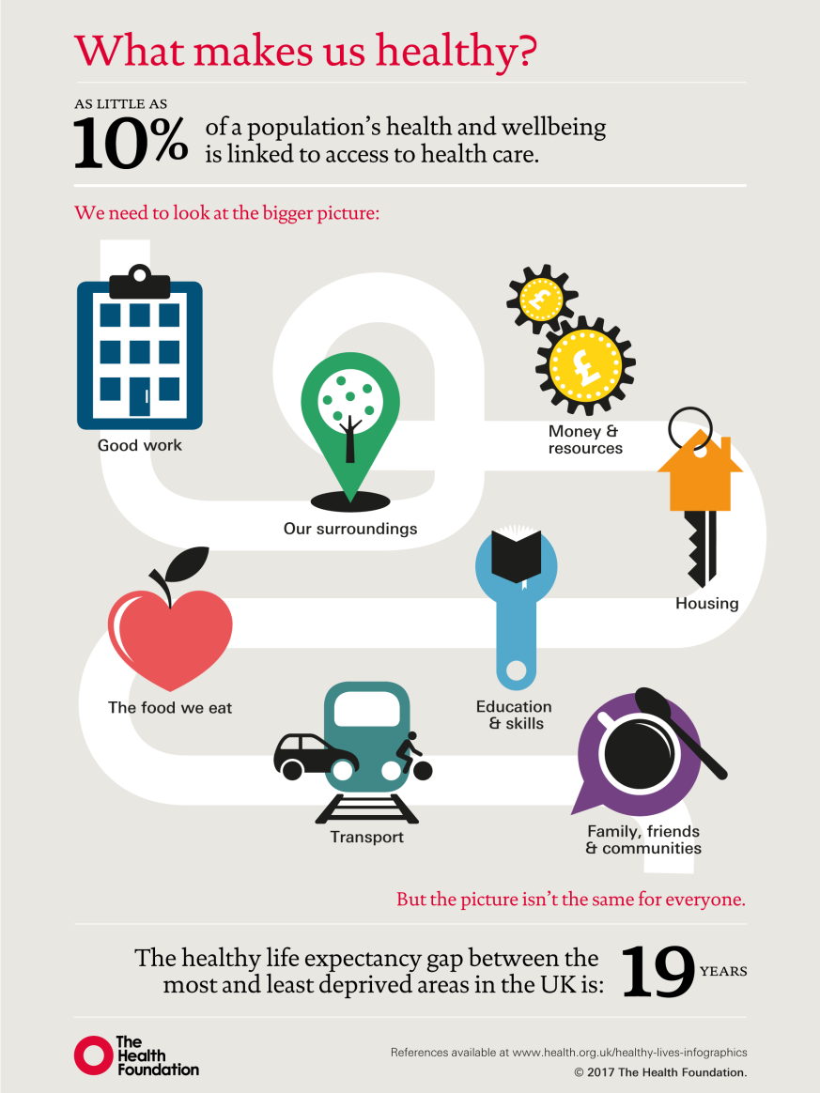
Population Health Management looks beyond the health system to consider wider determinants of health

Slide 6

All tiers of a system undertake PHM
More timely joined up data flows and automated analyses will offer insight to enable more responsive anticipatory care, but it will be crucial that systems look to release and streamline capacity and capability to more effectively support care coordination and delivery.
Individual having access to and being able to amend their own care record enabling self care.
Health and care professionals across settings having access to an individual’s care record to support personalised care, PHBs and targeted prevention.
Individual
Multi-disciplinary teams using real-time risk stratification to flag interventions for populations and individuals.
Using person level data for case identification and management and to optimise how people are directed through their pathway of care.
Neighbourhood
~50k
In-depth segmentation, risk stratification, and actuarial analysis to identify opportunities to redesign care and develop proactive interventions to prevent illness and reduce hospitalisation.
Integrated Care Providers building capability to track people and combine real-time workforce, bed capacity and activity data to identify productivity opportunities
Place
~250-500k
Population Health Strategy based on whole population health and care needs assessment and gap analysis to identify overall priorities.
Whole population profiling and system modelling to understand likely future health outcomes and where system wide action may be effective.
Commissioning of outcome based care.
System
1+m

Slide 7
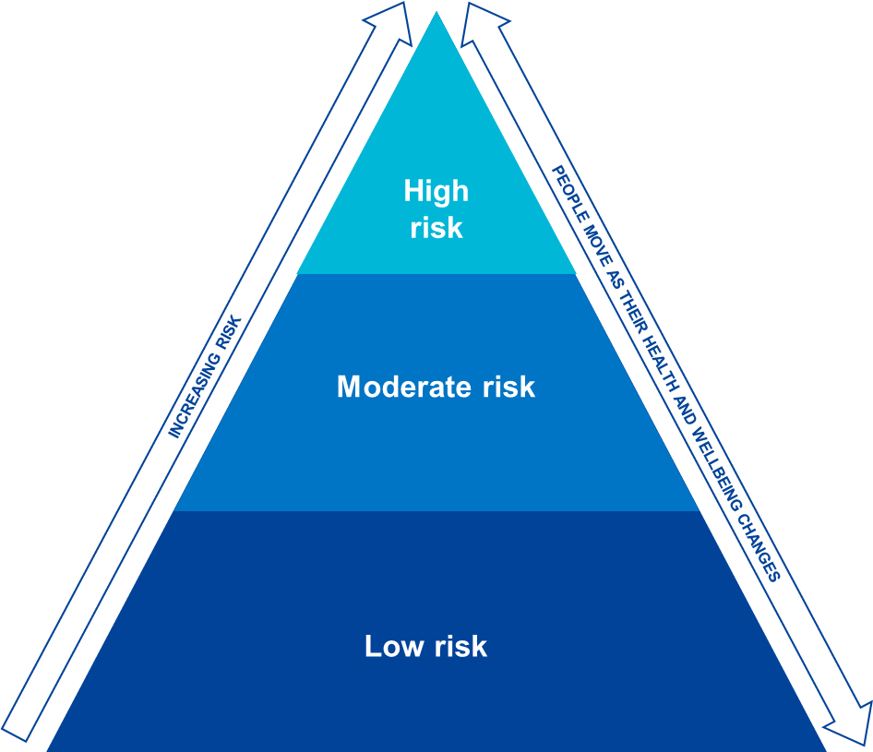
PHM involves exploring more advanced ways to target and tailor interventions
Segmentation and stratification identify the people most at risk of needing future care. Impactability goes a step further and aims to identify people who could benefit most from particular interventions, allowing for more effective personalisation of care plans.
Segmentation and stratification
Impactability
Tailored interventions
High risk
Complex care management programmes, intensive case management and supported and quicker transitions of care
Emerging risk
Proactive risk based case finding and management
Prevention programmes, social prescribing and community initiatives
Improving access to extended MDTs/ primary care teams
Long term condition complexity
Low risk
Wellness and self care programmes
More convenient access and digital tools
Wellness
Enriched integrated data comprising individual lifestyle factors (diet / exercise), social and community networks, genetics, money, education, housing, work / unemployment, pollution

Slide 8
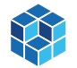
There are three core capabilities for Population Health Management ICS will need to invest in
      Infrastructure
      Intelligence
      Interventions
What are the basic building blocks that must be in place?
Organisational Factors such as dedicated system leadership and decision making on PHM
Digitised health & care providers and common health and care record
Integrated data architecture and a single version of the truth
Information Governance that ensures data is shared safely, securely and legally
Opportunities to improve care quality, efficiency and equity
Supporting capabilities such as advanced analytical tools and software and system wide multi-disciplinary analytical teams, supplemented by specialist skills
Analyses - to understand health and wellbeing needs of the population, opportunities to improve care, and manage risk
Interpretation of the data and analyses, to work with and advise providers and clinical teams
Care models focusing on proactive interventions to prevent illness, reduce the risk of hospitalisation and address inequalities
Care model design and delivery through` integrated personalised interventions tailored to population needs
Community well-being - asset based approach, social prescribing and social value projects
Workforce development - upskilling teams, realigning and creating new roles
Incentives alignment – value and outcome based contracting

Slide 9
Systematic learning is integral to effective PHM – ‘the PHM learning cycle’
Population segmentation to understand the specific needs of the local population and to explore gaps in care and unwarranted variation. Identification of key local assets such as voluntary groups for high need segments.
1
Understanding population health and care needs
Assess benefits against the five aims of PHM, considering impacts across organisational boundaries.
Power of the cycle increases as infrastructure develops
5
2
Active monitoring and rapid improvement
Opportunity analysis and targeting
Risk stratification and impactability models to identify those people who could benefit the most from interventions.
4
3
Design and implement interventions
Predictive system modelling
Modelling of expected outcomes under different scenarios using person level data. Consideration of impact on health, financial sustainability, equality and privacy.
Design and implementation
of multidisciplinary, cross-organisational interventions that are targeted at appropriate population segments

Slide 10
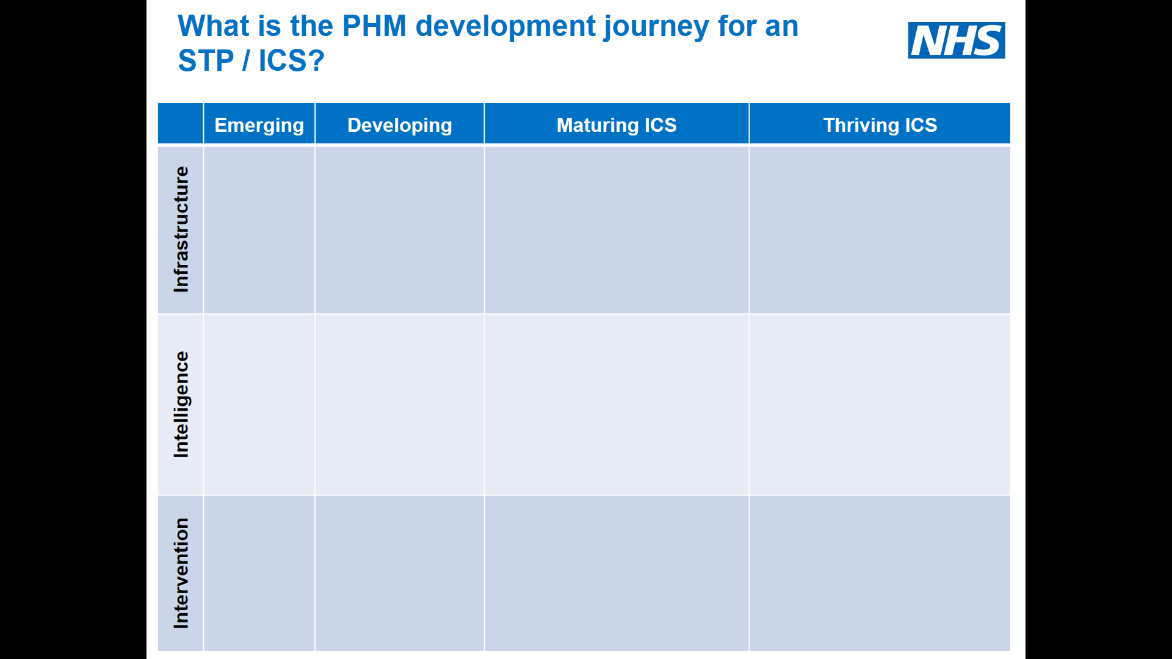
What is it?
The maturity matrix is a simple grid that describes what a basic, middle range and advanced system looks likes for each of the three capability areas of; infrastructure, intelligence and interventions
How should it be used?
The maturity matrix is intended to be tool to help systems explore where they think their major gaps are and agree where they want to shift to and by when

Slide 11
Our emerging support offer
1. National PHM delivery approach
2. Dedicated PHM Sponsor and support offer
3. Maturity Matrix and
Library of Good Practice
4. PHM Community of
Practice Forum
5. PHM ‘Flatpack’
6. Support to engage and source external accredited development partners
(HSSF)
7. PHM Localised Development Programme
8. How to guides and
model specifications for capabilities
9. Performance and Population Health Dashboard

Slide 12
PHM Local Development Programme
A 20 week, externally supported, locally tailored programme of dedicated embedded analytical capacity and a series of action learning sets where clinicians and system leaders act on insights generated from linked patient level data.
Strong primary care and public health participation from systems is a pre-requisite to help generate insight and build PHM capability across the three tiers of an integrated care system. Local priorities will inform the focus of the programme but the aim is to explore interventions for different risk groups of patients.

Slide 13
Progress and next steps in each system
Leeds
Dorset
Progress:
4 LCPs have been selected to take part.
Extensive stakeholder engagement across clinical, business intelligence, execs and third sector groups.
Well-attended exec kick-off meeting on 14th Dec with attendees from across local government and NHS.
Next steps:
First frailty clinical workshop on 9 Jan (400 clinical reps).
First business intelligence workshop on 21 January.
Progress:
Joint working with public health leads, Local Authorities, clinical leads and ICS leadership.
3 PCNs committed, with named clinical and programme management leads and outcome objectives aligned to work started in 2018.
Next steps:
Programme kick-off workshop 17 Jan – with execs, GP leads and representatives from all localities.
Lancashire and South Cumbria
West Berkshire
Progress:
Strong engagement from system and ICP leaders, with clear support.
Strong engagement from three neighbourhoods to date: Blackpool, Barrow and Blackburn w Darwen.
Next steps:
Calls scheduled with neighbourhood leads to confirm commitment and agree cohorts.
Programme kick-off session 18 Jan – with ICP and neighbourhood leads, ICS exec.
Progress:
Unified Executive gave formal approval to progress.
System executive leader soft kick-off on Dec 20, well attended by NHS and local govt leads.
Dedicated GP lead identified, with strong GP Alliance engagement underway (with focus on Reading).
Next steps:
Final PCN selection to take place in early Jan.
Programme kick-off workshop 17 Jan – with system and clinical leads.

Slide 14




PHM Flatpack
Approaches to Population Needs Assessment
Prospectus of best practice approaches, tools, techniques and interventions based on ICS, vanguard and international evidence.
Co-developed with and for you.
Tools to identify and
target those in need
Transformation using
effective interventions
Quantifying Impact
and Evaluation

Slide 15
Support available through the HSSF
The HSSF will provide ICS and STPs with access to experienced external development partners & coaches, innovative technologies and digital vendors to help develop and deliver population health management capabilities and drive forward the national system reform and IT strategies.
Infrastructure
Intelligence
Intervention
Transformation and Change Support
Patient pathway optimisation and care model design
Specialist advice on organisational redesign, governance and payment and contract reform
Communications and engagement
Workforce and leadership development support
Primary Care at scale support
1
4
6
Care setting agnostic EPR (Acute, MH)
LAUNCH 2019
Informatics, analytics and digital tools to support system planning, assurance, evaluation and research.
Actuarial analysis and intervention modelling
Supporting system financial management, quality and outcomes measurement
Planning and evaluation, needs assessment and opportunity analysis
Research tools
2
Local Health and Care Record solutions
7
Patient empowerment and activation
Support for implementing shared decision-making
Support for implementing Self-Care programmes (including social prescribing, innovative digital design, remote technologies and e-consultations)
Support for implementing Personal Health Budgets and Integrated Personalised Commissioning
A
Strategy / implementation support
5
Informatics, analytics and digital tools to support care co-ordination and management, risk and impactability models
Risk stratification and impactability modelling for early intervention and preventive care
Supporting systems for the development of individual care co-ordination and management
Services to support clinicians to make faster and better interventions at the point of care with a patient
B
Infrastructure
8
9
Demand management and capacity planning support
Services to support smooth transition of care into, out of and between organisations
Control Centres
System assurance support
Provider relationship management and supply chain support
Financial and quality measurement and assurance
Provider modernisation and waste minimisation
3
ICT infrastructure support and strategic ICT services, including Primary Care IT support and cyber security
10
Medicines optimisation support

Slide 16
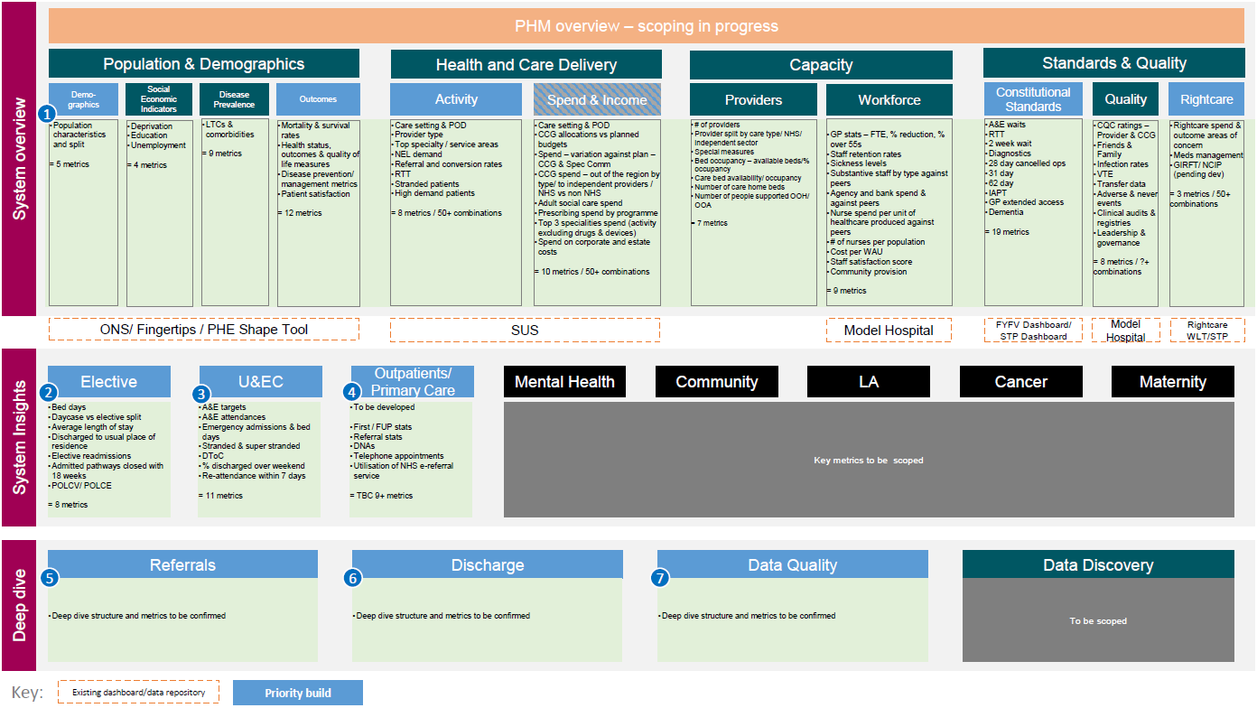
National Performance & Population Health Dashboard
A National Performance and Population Health Management Dashboard that allows NHS England, and all partners in an Integrated Care System to have a consistent view of benchmarks and other metrics.
This will enable all parties to compare and contrast variation and have a better understanding of the potential causes of variation.
The dashboard will provide a mechanism to support the national, regional and local teams to have a consistent view of ICSs, and to support discussions with ICSs.

Slide 17
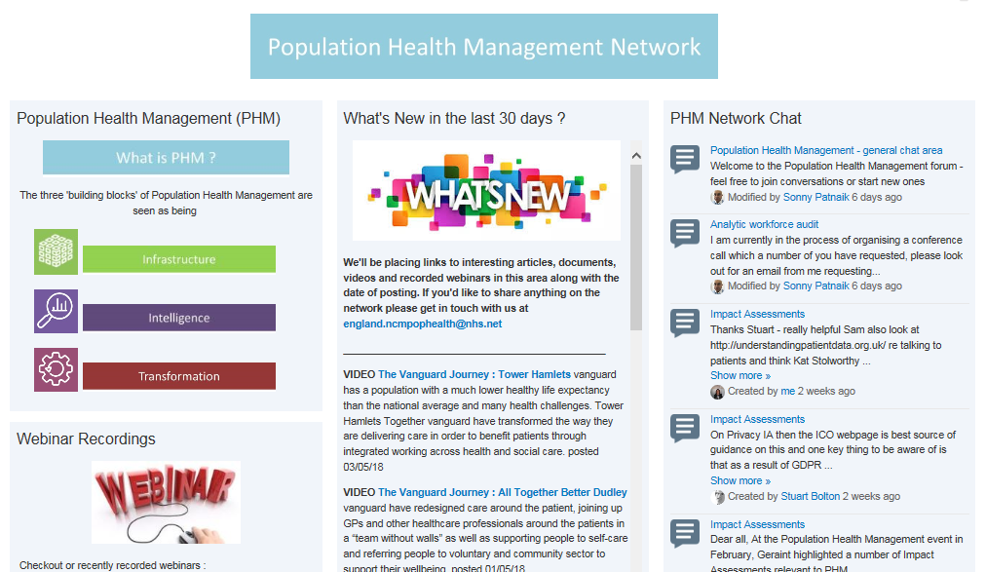
Population Health Management Network:
Join us!
Join our FutureNHS online community – for discussion forums, news, webinars, information exchange and helpful resources.
Email us and ask to join: england.STGPHM@nhs.net

Slide 18
PHM Making a Difference!
‘Betty’, 87, is a widow who lives alone. Her health and mobility had deteriorated in recent years and she had suffered numerous falls. She no longer drove her car as it wasn’t safe, and was reluctant to go out. She was housebound, had lost her independence and had become isolated and depressed.
Community Navigator Sarah visited Betty five times over 6 months. She helped her apply to the Bristol Community Transport Social Access scheme for help getting out and about. Betty decided to try the Shared Reading Group at the local Library. Betty loved discussing the short stories and poems and meeting other people. She keeps everything they’ve read as she sometimes reads it again later. Betty had been referred to Staying Steady classes by her GP, but she had given up attending. With transport now in place, Sarah encouraged Betty to revisit the classes.
Betty regularly attends the Shared Reading Group and Staying Steady. She has reduced the number of falls from 7 last year to 1 this year.

Slide 19
Surrey Air Alliance: Working in partnership to improve air quality
1
Surrey School’s Air Quality Programme
2
Detailed Air Quality Modelling
Focusing on 40 primary/ secondary schools the project, funded through a DEFRA Air Quality Grant, seeks to increase awareness, improve air quality and reduce local air pollution from vehicles idling at drop-off/ pick-up points at school gates to more sustainable options.
Key activity:
Theatre in education for students which looks at sustainable options to get to and from school
Support to pupils to measure air quality at the roadside and in the playground
Bikeability training – help pupils to learn to ride a bike safely with an advance level for cycling on busy roads
Encouraging walking and cycling to school to also support the Surrey Healthy Weight Strategy for Children Young People & Families 2017- 2022.
Through the Alliance partnership local authorities have commissioned detailed air quality modelling. The project aims to highlight areas where air quality levels may be approaching or exceeding the relevant national air quality objective; provide an understanding of PM2.5 levels across Surrey; inform policies and provide baseline to measure impact of interventions; and provide an indication of local health impacts.
The modelling project will provide the partnership with:
Surrey-wide air quality concentration maps of nitrogen dioxide (NO2), nitrogen oxide (NOx) and particulate air pollution (PM2.5 and PM10);
source sharing for selected locations across the county (for example broken down by traffic and non-traffic sources);
indicators of local health impact.

