Slide 1
Integrated care systems The journey so far
Alex Baylis,
Acting Director of Policy
The King’s Fund
April 29th 2019
Notes:
Will provide some context on ICSs, drawing on research we did last year

Slide 2
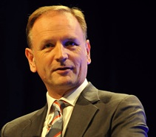
“ICSs are where the health and care sector is headed … there is no plan B”
Simon Stevens, 2018
“Our aim is to use the next several years to make the biggest national move to integrated care of any major western country”
Notes:
From a national policy point of view, integrated care systems are one of the biggest items on the agenda.
It might not seem that way because there hasn’t been any major top down restructuring as we’ve seen in previous NHS reforms, and ICSs don’t yet have a formal place in statute with formal powers or accountabilities
However, in recent years it’s been made very clear by Simon Stevens and other key national leaders that for the time being at least ICSs are the direction of travel.
Ambition set out in FYFV - 2017
And Simon says there is no plan B - 2018

Slide 3
Long-term plan: what does it mean for ICSs?
No blueprint but a transition year for local plans
Changes to funding flows and performance framework
New “Duty to collaborate”
No legislative change in short term
It’s an NHS plan
“By April 2021 ICSs will cover the whole country”
Notes:
This direction of travel was very clearly reinforced by the LTP. ICSs will play an increasingly role in planning and managing services
The LTP identifies some core requirements for ICSs – eg around governance arrangements – but still no blueprint on size/structure, providing welcome local flexibility
Plan introduced some changes to support system working (eg changes to funding flows and performance framework) and there is a new ‘duty to collaborate’ for providers and commissioners
The plan flags areas where legislation would be helpful – eg allowing joint provider/commissioner decisions, and reducing competition - but these are very unlikely to take place in the near future
LTP is very much an NHS plan
- However, many of the plan’s commitments – eg on inequalities and prevention – require the NHS to work with partners
- But plan says little on role of LAs and joint working
- There is also an important role for central government in delivering the plan’s commitments, for example on public health spending
- We are still waiting for many other policies etc that will have an influence on the delivery of the plan, in particular the spending review and the green papers on social care an prevention
The plan also hints at growing role for the NHS in public health commissioning, but we haven’t heard any more on this since

Slide 4
Opportunity to integrate care
And to act on wider determinants and improve population health
Not a magic bullet, but are an opportunity to work differently
Notes:
Before getting into the detail/progress – it’s helpful to remind ourselves about the case for these changes:
Opportunity to join up/integrate health and care services around the needs of local populations
If implemented in the right way to bring together a broad range of sectors and services – there is an opportunity to act on the wider determinants of heath and by doing that to improve population health.
ICSs not a magic bullet, but they do represent an opportunity to start to do things differently and to implement some of these principles in the way that health and care systems are organised locally.

Slide 5
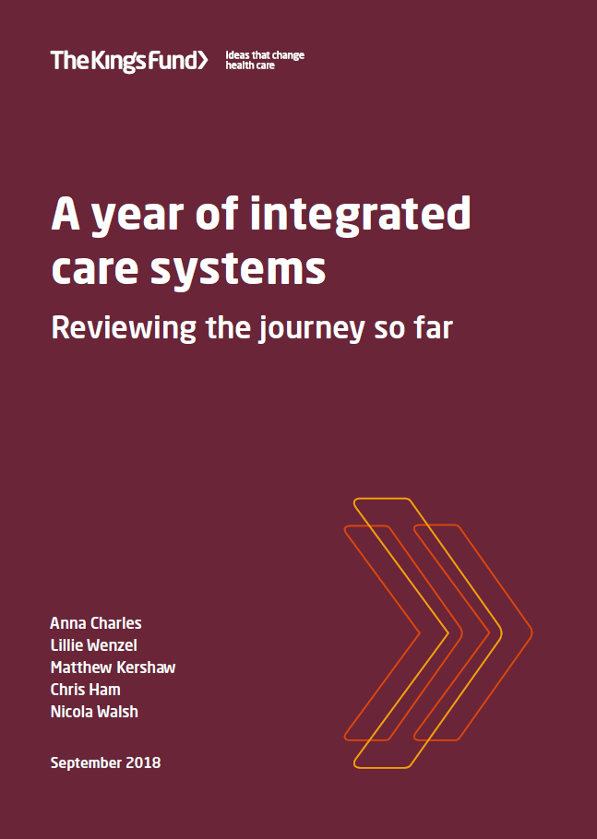
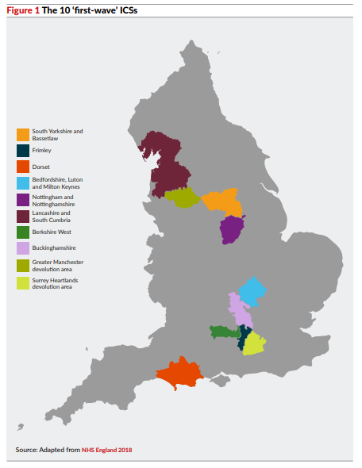
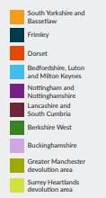
Notes:
Last year The King’s Fund decided to so some research looking at some of the first ICSs
The aim was to understand how they were developing and identify emerging lessons for local leaders and national policy makers.
Research involved interviews with 72 NHS and local government leaders and other key stakeholders from 8 of the 10 systems.
Will share some of our key findings with you

Slide 6
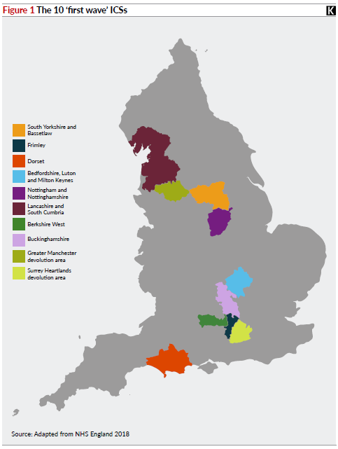
Emerging features: variation
SYB ICS population 1.5m, 23 members
Berks West ICS population c 500k, 7 members
Notes:
A key finding from our research was that there is significant variation across the ICSs
In terms of size and complexity (size of population, number of organisations involved, relationships outside of the ICS). The two examples highlighted show the range
Also variation in terms of longevity of relationships, performance etc
One reason for variation – first ICSs were developed on strength of local relationships and plans. However future move is towards greater consistency and larger ICSs. For example, the LTP talks about streamlining commissioning which will “typically involve a single CCG for each ICS area”

Slide 7
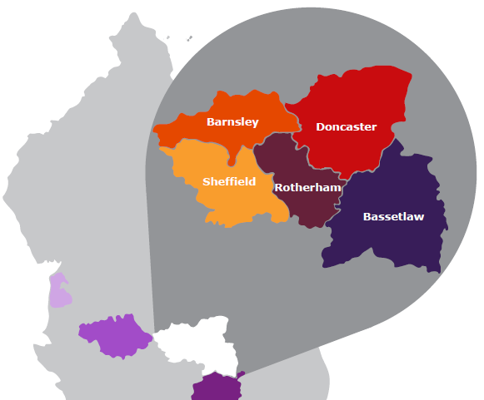
Emerging features: activity is taking place at multiple levels
Notes:
Another important finding is that integration is happening at different levels
Within systems – particularly the largest/most complex - neighbourhoods and places are important for the development of integrated care, not all about the system level
For example, in SYB there are 5 places, each with their own Integrated Care Partnership
This is where most of the activity to join up delivery is happening - interviewees (across ICSs) saw the place level as responsible for c 80% of work on integration
Places were often seen as more natural geographies, and more meaningful to local populations and staff
This leaves important question of what the systems themselves are doing..

Slide 8
Emerging functions: ‘system level’ activities
Planning for the future across local system
Aligning commissioning behind the plan
Taking responsibility for performance and resolving challenges
Providing overall system leadership
Notes:
The answer is that they are both facilitating and supporting the work that is taking place in places and neighbourhoods, and also taking responsibility for activities that are best done once across the system on a larger scale
Notwithstanding variations between sites, a number of functions emerging as the common activities that the systems are taking responsibility for (slide)
Planning – looking beyond health
Commissioning – carrying out strategic aspects, for example, ensuring that CCG and Local Authority activity is aligned
Performance – dealing with solutions within the system, rather than looking externally for support
Leadership – move away from an organisational to a system focus

Slide 9
Locally led change: there is no roadmap
Notes:
Really important to understand and very clear from our work that there is no one way of forming an ICS, and no roadmap/ guidebook for getting there. Each ICS is developed in each system by each system
This will be a challenge for the roll out of ICSs by April 2021 (as called for by the LTP). It isn’t possible to just lift and shift arrangements from the first and second waves, each place will need to go through a process of development
However, that's not to say you can’t learn from the experience of the first and second wave sites about what works in order to accelerate progress

Slide 10
ICS leadership
ICS leaders are drawn from a range of organisations and backgrounds
Collegiate approach – collective responsibility
ICSs are voluntary, they rely on the willingness and commitment of individual leaders
A shift in perspectives and leadership styles
Looking to the system, seeing the bigger picture
System leadership ≠ organisational leadership
System leaders are facilitative and enabling, not pace setting
Leaders are learning on the job
I’ve learnt more about how local authorities work in the past 18 months than I’ve done in the previous 42 years. I think we’ve got more of a genuine partnership than we’ve ever contemplated beforehand and that seems to be working… It’s been spending time with one another and understanding one another’s problems and issues.
Notes:
In term of the process of development, a key element has been putting in place new and different leadership arrangements
Leaders vary as ICSs have been able to build on strengths of local leadership

Slide 11
ICS governance
Governance arrangements are iterative and emergent
ICSs are using existing flexibilities – MOUs, partnerships boards, joint committees
System governance must work with organisational roles and accountabilities
We’ve done it, I won’t say on the fly, but we’ve done it where we’ve come up with an idea or come up with a service change or initiative and then worked out, with colleagues, how the governance or decision-making sits. That always takes longer, but I think we probably iron out more bumps in the road as we go along.
Notes:
As well as leadership, ICSs are putting in place governance need to make decisions and manage resources collectively
There are some detailed examples in our report (and site profiles on our website), but a couple of broad points:
There are some common features to the governance structures ICSs are putting in place, but it isn’t a cookie cutter exercise with single ICS governance structure
Arrangements are also iterative, emergent, will evolve as ICSs determine which arrangements support their objectives
A big challenge for ICSs is that they have no basis in law. No formal powers or accountabilities. Instead, they are using flexibilities within current framework to work around this
However, system governance must work with and alongside roles and accountabilities of statutory organisations. In practice this can be cumbersome and duplicative – was described to us as ‘walking through treacle’
ICSs are trying to address this by streamlining arrangements as much as possible. They are also trying to develop greater accountability by bringing in lay members, NEDs, elected councillors into governance structures
However, there is a limit to what can be done locally while legislation is as it is and organisational accountabilities are as they are. The proposals for legislative changes in LTP aren’t likely to be implemented in the short term

Slide 12
Building collaborative relationships
It’s relationships, relationships, relationships… All the governance structures and technical things in the world are great, but if people don’t have an aspirational intent to work together, it doesn’t really matter what you write down.
Notes:
Leadership and governance are of course important, however the most fundamental aspect of ICSs seems to be building collaborative relationships. During our research we were consistently told that this this the fundamental foundation on which everything rests
This can sound a bit motherhood and apple pie, but there are tangible examples of how local systems have done this
Built in time together – formal and informal, and ensuring some of it is face to face time
Focused work, collectively working through challenging issues – for example, arrangements for system control totals
Expressing disagreements openly and constructively
Developing shared vision and objectives which binds organisations together

Slide 13
Service change
This is the core rationale for ICSs and integrated care partnerships
Many are building on existing care models
Common features are emerging
And that’s really difficult, isn’t it? The bit around the left shift… I don’t think we’re seeing evidence of that yet
Integrated community teams
Primary care at scale
Information sharing
Some acute reconfigurations
Prevention and population health management (more aspiration than action)
Notes:
In terms of what the ICSs are doing…. There are also some early indications of ICSs driving changes in service model. This is core rationale – integrating health and heath and care services, and moving towards population health
Common features include [slide]
Integrated care teams – bringing together a range of health and care professionals, including GPs, community nurses, MH professionals etc
Primary care working at scale in networks or federations
Population health noted as an area where more progress was needed
ICSs are still in their early days, evidence of impact is limited. More time is needed to embed and determine impact
Now the ICSs have laid foundations for different ways of working, a key priority now is to translate that into tangible improvements and show what they can achieve. Sense amongst interviewees that its important systems deliver in order to demonstrate credibility

Slide 14
Who’s been involved in developing ICS?
Local Authority engagement varies
Staff engagement still strongest at senior levels
Importance of communicating a vision staff and patients can engage with
Need to do more to engage with the voluntary and community sector
Notes:
There are a range of groups ICSs should be engaging with, however this varies between areas
Local authority engagement
We think this is really important, particularly in terms of bigger prize on improving population health
However, the extent to which LAs are involved in ICSs varies – sometimes they are included within the governance structure of the ICS, but in other cases they are partners. Often LAs are more engaged at the place level.
The challenges in engaging LAs include differences in accountabilities and cultures
There is also a sense that ICSs are too NHS focussed
Staff engagement
Engagement still much better amongst most senior staff within ICS member organisations
This is partly about vision – articulating this in a way that all staff can relate to, and encouraging people to look beyond their teams or organisations
This was an area many identified as requiring further work
Patients and the public
Again, this varies, but overall sense is there is more to do
There can be a challenge around engaging patients in structures and concepts – in practice engagement in service changes at a place level often works better
VCS
VCS sometimes involved involved formally, but more often this is happening at a place level
Recognition that this was important but real sense more needed

Slide 15
Managing change
We can’t do any of this quickly. This is very big change for a lot of people across the system. I think that to do it any quicker we would have just fallen over. I think we need to give ourselves a very realistic timeframe going forward and give ourselves, as a system, the opportunity to realise those goals.
This is a big change – not to be underestimated
Takes longer than expected
Coping with ambiguity – changing roles
Notes:
In all ICSs, it’s clear that these developments represent a big change for many people and organisations across a system. Expects individuals and organisations to change decades of attitudes and behaviours
Theme from our research is that it takes time and can’t be rushed. Systems and organisations need to be able to handle a certain degree of ambiguity, changing roles, and the fact that the end state is not clear. For example, emergent changes on commissioning
What can we say about the journey so far?
Process not an event
Still at early stages
Signs of real progress in systems and there are reasons to be optimistic
However, there is lots more to do. ICSs need to be realistic about challenges and barriers

Slide 16
Challenges
The statutory framework does not make this work easy
Regulators are often slow to align behind ICSs
Leaders face competing demands
Local Authorities are key partners in some areas but not in all
Much hinges on relationships and trust – can’t be rushed
Notes:
The statutory framework does not make this work easy. The legislative framework/ system architecture are designed to promote organisational autonomy and competition. LTP hasn’t changed this in the short term
Regulators are often slow to align behind ICSs. ICSs can get different messages from the centre and the regions. Changes in the regional structures may present an opportunity to improve this.
Much hinges on relationships and trust. This is a key success factor, but it can’t be centrally mandated, can’t be rushed. It takes time and needs to be built locally
Leaders face competing demands. Doing ICS work on top of day job isn’t sustainable, likely to become more of a challenge if ICSs are to cover the country by 2021
Local Authorities are key partners but they are more engaged in some areas areas than others. We see joint working as key to improving population health

Slide 17
Thank you

