Slide 1
NW Public Health
Anti Racism Collaborative
Update: “One Year On”

Slide 2
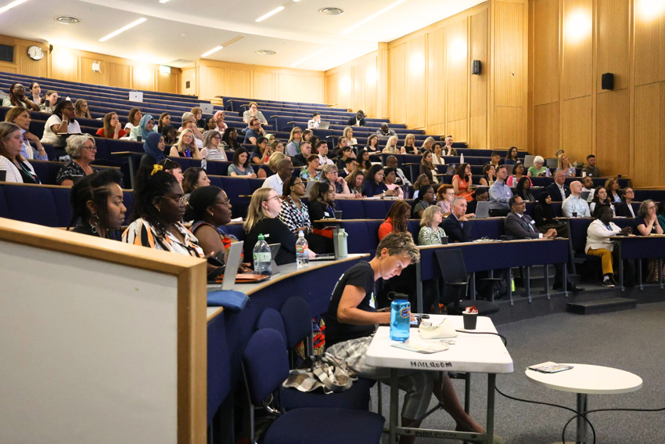
Anti Racism Conference- 14th May 2025
130 delegates
Rich programme of keynote speakers
Co-production of anti-racism statement using Slido
Dynamic panel discussion
3 workshops to equip participants with practical tools and strategies
Creative capturing of key themes using illustrations and a poem

Slide 3
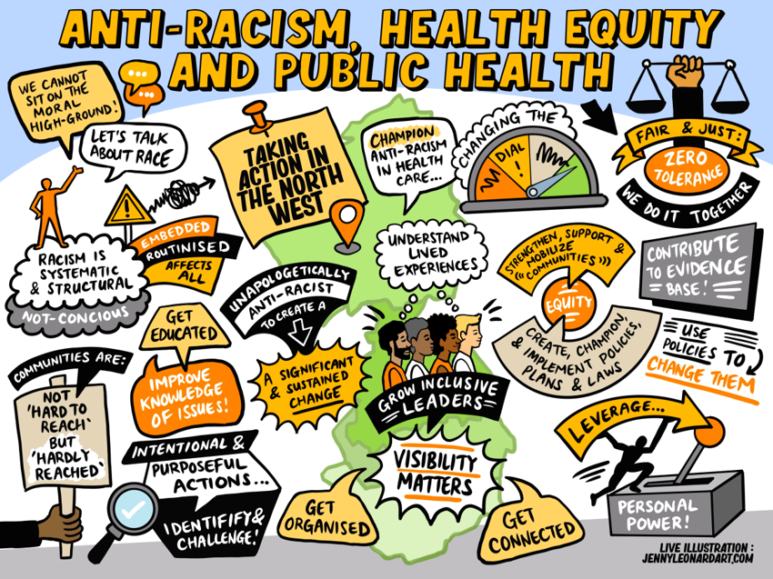
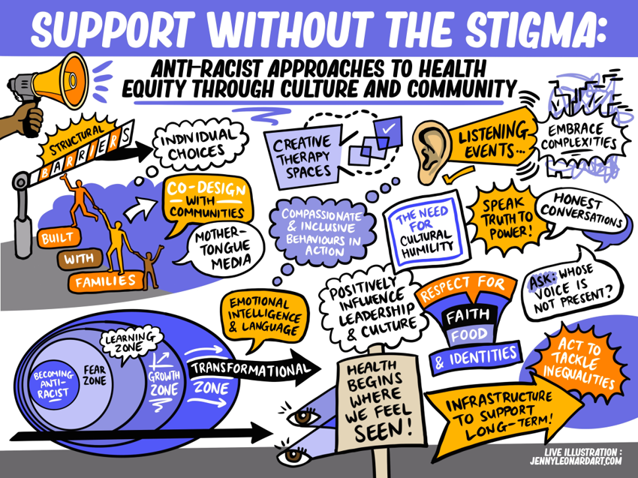
Post Conference Reflections

Slide 4
Post Conference Actions
North West Public Health Anti Racism Collaborative met post conference to agree a 3 point action plan:
Develop the North West Public Health Anti Racism Statement for publication
Co-ordinate follow up learning events on anti-racism
Build a Public Health leadership community of interest on anti-racism

Slide 5
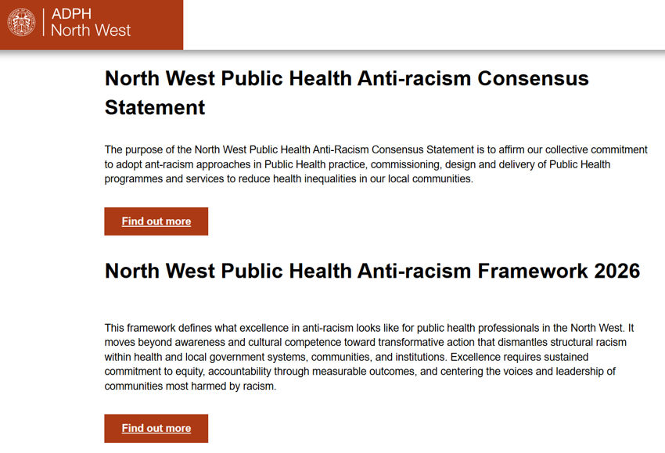
Develop the North West Public Health Anti Racism Statement for publication
Co – produced with NW ARC
Informed by learning at the conference
Shared with NW DsPH
Published on the ADPH Website, along with a “What Good Looks Like” document

Slide 6
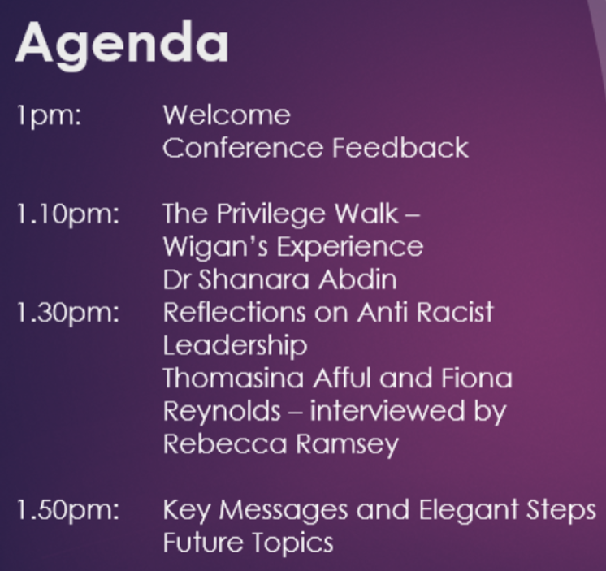
Co-ordinate follow up learning events on anti-racism
L&D Planning Group established post conference
24th February – Leadership reflections with Fiona Reynolds and Thomassina Afful
24th June 2026 – Keisha Thompson, history of racism and anti-racism tools (This session was oversubscribed and will be repeated)
Funding secured for future events

Slide 7
Build a Public Health leadership community of interest on anti-racism
Repository of useful information available online
NW ARC Meeting regularly
Regular updates/bulletins circulated widely
Views sought on engagement with L&D and more generally with the ARC

