Slide 1
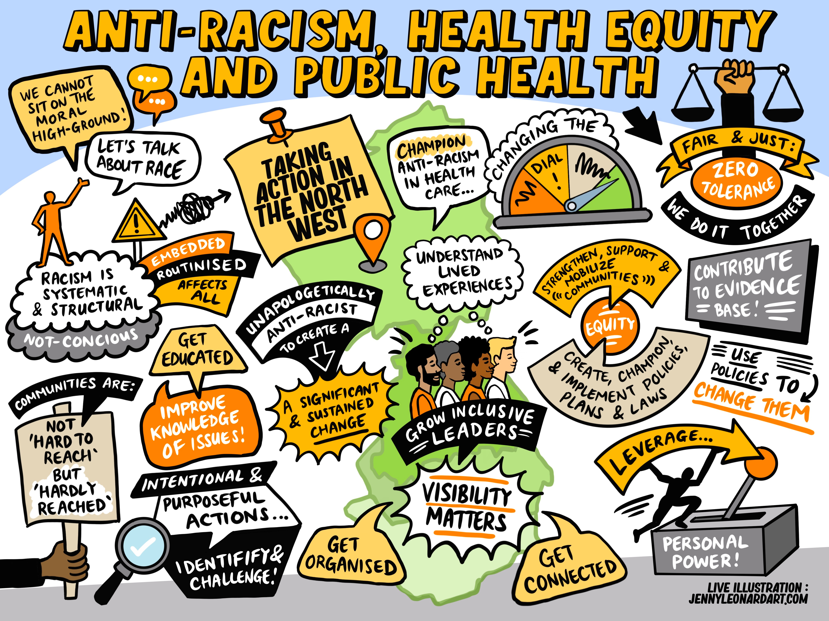
Key Messages from the North West Public Health Conference 2025
Exploring Anti-Racism, Health Equity and Public Health

Slide 2
Evaluation:
Overall the Conference was rated (by 49 attendees who completed evaluation forms) at 9.18/10. Almost 50% gave the event a score of 10/10. Comments are overwhelmingly positive.
When asked what people had enjoyed most about the conference, the response was overwhelmingly: speakers. 42% (19) of the respondents gave this answer. As for why the speakers were so popular – answers included: thought-provoking, insightful, powerful, inspiring, challenging, engaging, honest, thoughtful and amazing.
As for how to improve it… the results are more mixed in terms of specifics but… the overarching theme could be described as people seeking to engage meaningfully. A number of the responses describe a need for deeper engagement: more time for audience participation to engage with the speakers (a desire to see more questions answered and a request for an additional afternoon panel session with the workshop facilitators); sending pre-reading out to attendees; some variance in views around the workshops (some felt the option to attend more workshops was needed while others felt that the time within them should have been increased).

Slide 3

Impact
The following slides highlight the responses and “elegant steps” that attendees planned to take away.

Slide 4
Responses:
“Cultural humility… Cultural humility rather than competency, Conscious bias to Conscious inclusion.”
“Move from unconscious bias to intentional inclusion: The conference reinforced that anti-racism in public health requires intentional, systemic action—not just awareness.”
“Remembering that public health goes beyond equity and is about justice.”
“Value of collaboration on this wicked problem.”
“It is always good to have a reignition of that drive for change. As people of colour EDI can often feel like a chore and be physically and emotionally draining. The event was a great driver of focussed change, by starting locally, it helped me reset my mindset to focus on my circle of control.”
“I will think more about how I can influence not just the people I work with but my family and friends… Discuss with personal and professional circles. Think about practical steps to reduce inequalities linked to racism in the public health space.”
“Collaborating with other areas who are further behind on their journey - including those who felt they couldn't even bring up racism as a health determinant. Commitment to working with those areas and helping everyone to get to this baseline level and beyond.”

Slide 5
Responses:
“Be more confident in naming racism... The importance of building trustworthiness, and the difference between this and being trusted... We need to talk more about the issue of racism and what it means to be anti-racist. I will raise it much more at meetings, integrate it into strategic plans and generally begin to introduce it as I have conversations about strategic priorities within the population health programme I work in.”
“How much I need to do my own research on how to engage with racism.”
“The knowledge of racism emerging from slavery (as opposed to slavery emerging from racism), that the concept of "black" and "white" emerged in the 1660s... I've been talking to family, friends and colleagues about this.”
“How to be an effective antiracist leader - the set of criteria was presented in the practical tools workshop... The practical tools workshop and the ability to apply then in work/home life.”
For me - it is about 'intentionality'. Racism is and has been intentionally and deliberately part of systems and society - in my work I will 'intentionally' make sure how and what I am doing is 'anti-racist', the health interventions I commission, the evidence I look to, the organisations I work with.

Slide 6
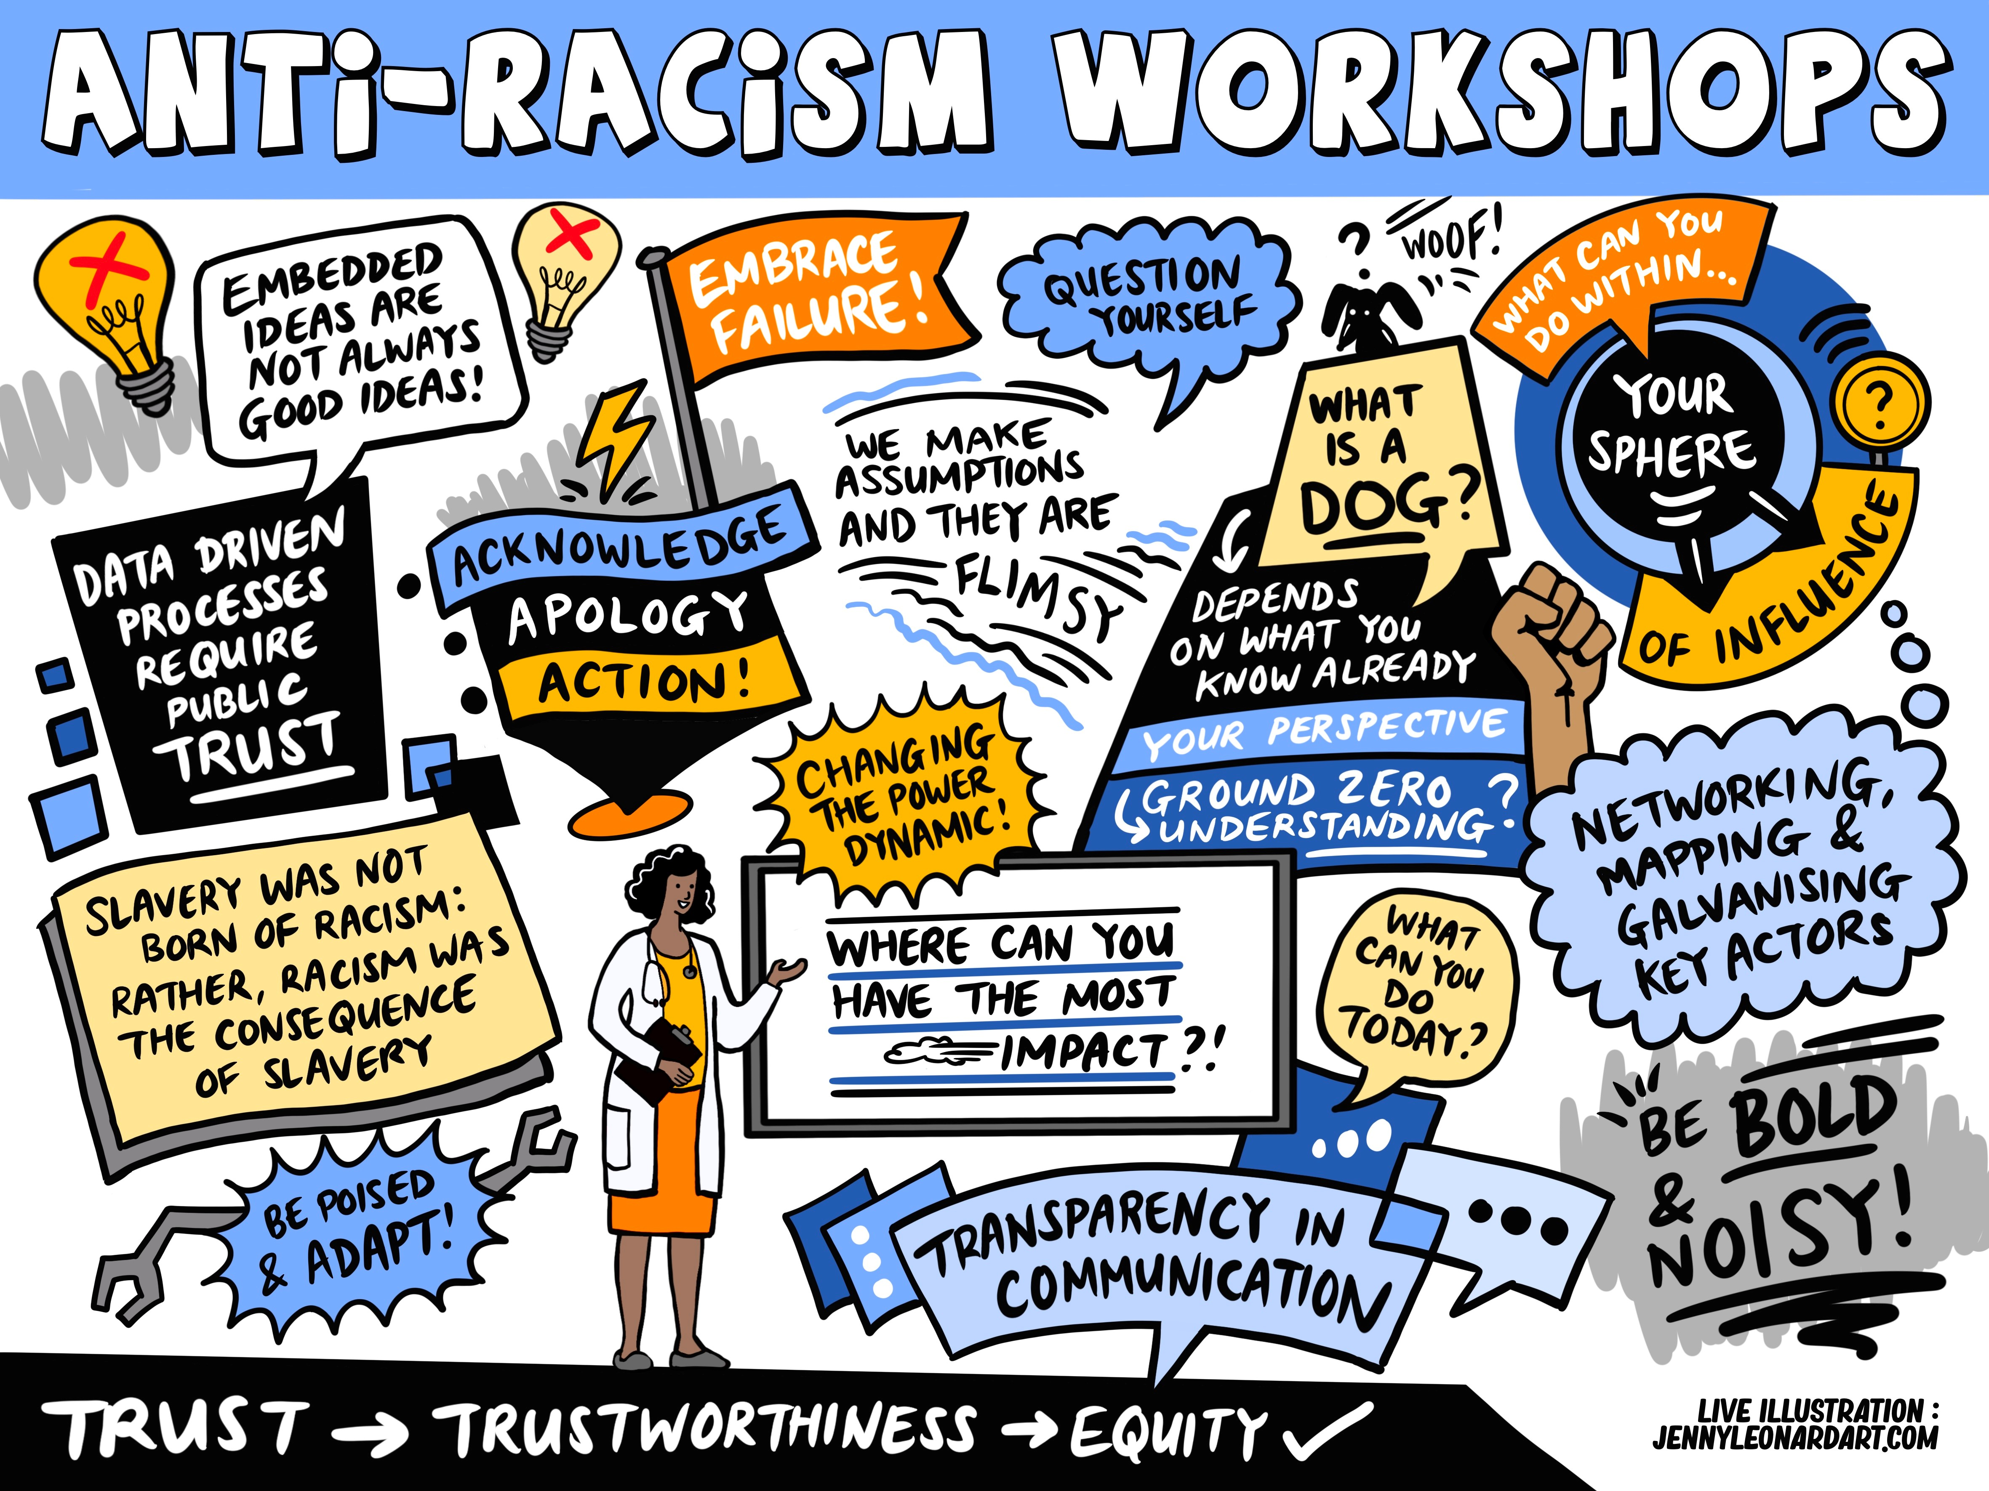
Next Steps:
The following slide summarises the next steps that attendees suggested.

Slide 7
Next Steps: Another Conference or a Series of Events?
Interactive Workshops: While the panel discussions were excellent, incorporating hands-on workshops (e.g., "Designing Anti-Racist Public Health Interventions" or "QI Tools for Equity") would allow attendees to apply frameworks in real time and leave with actionable plans.
Pre/post-Conference Resources: Sharing key readings, case studies, or self-assessment tools ahead of the event could help attendees engage more deeply with the content and hit the ground running during sessions.
Community Voices: Amplifying even more grassroots perspectives—especially from youth, frontline health workers, or service users impacted by inequities—would further enrich discussions. A "Community Spotlight" segment could highlight local initiatives.
Networking Opportunities: Structured networking breaks (e.g., themed small-group discussions or mentorship pairings) could foster deeper connections among attendees committed to similar goals.
Follow-Up Engagement: A post-conference webinar or online forum to share progress, challenges, and lessons learned from implementing anti-racist strategies could sustain momentum.
Accessibility: Consider hybrid options for future events to include those unable to attend in person, along with live captioning and translated materials where possible.
“An annual antiracism event.”
“Dedicated workshops across the NW either in individual organisations or joined up, annually, to give people an opportunity to understand the pertinent issues around racism and its impacts plus and update on yearly progress in the region.”
“Can we come back together as a group at some point to discuss what has happened since and share more learning?”

Slide 8
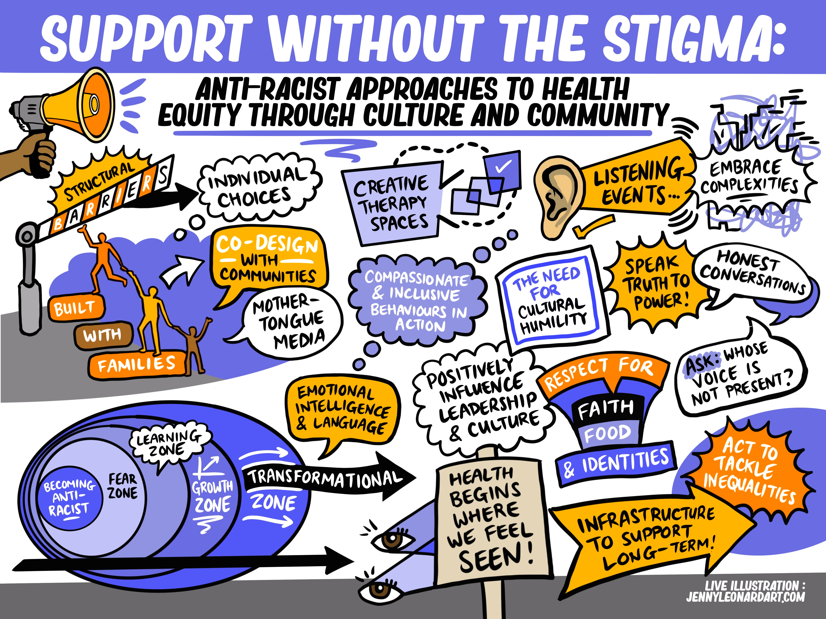
Reminder:
In order to be anti-racist leaders, we need to:
  Ask the “why”
  Learn AND unlearn
  Get comfortable with asking uncomfortable questions
  Allow ourselves to feel, but don’t get stuck in the feelings

