Slide 1
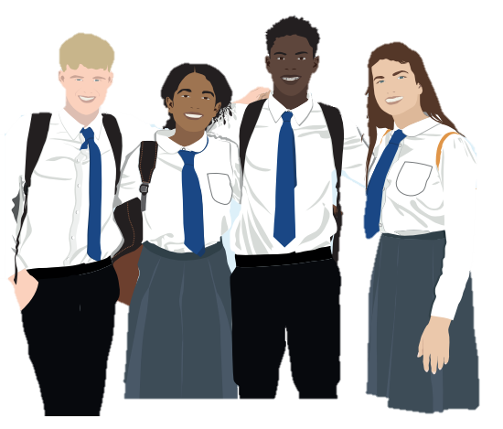
Vaccines & Me:
Meningitis &
3-in-1 Booster
Year 9 School Immunisation
Notes:
Facilitator introduces self & organisation (if external) and explains a little about their career trajectory/passions about the project.
Interesting & creates rapport

Slide 2


How much do you know about vaccines?
This is not a test!
Space to leave any comments
Space to ask any questions
Notes:
Ask them to complete the survey.
Keep the sheets together.
Anonymous, but can put initials on them to help identify, and this can be removed (or the surveys are pre-coded in advance to save time)
Not a test, doesn't matter if they don't know the answers, that's why we're here!
NOTES: For sessions being run by teachers in school, the surveys may not be required.

Slide 3

Today’s objectives
1
To understand what a vaccine is & how it works
To know why & how we get vaccines
2
To know which specific diseases the Meningitis vaccine and the 3-in-1 Booster relates to
3
4
To understand when & where to get medical advice
Notes:
Read through the objectives and what we hope to learn by the end of the session.
Read as they are on the slide, as it’s too confusing to listen on one thing and read another.

Slide 4
What are the pros & cons of vaccines?
Pros | Cons
Notes:
Key Words: pros & cons, side effects
Elicit meaning of ‘pro’ and ‘con’ from the group (previous lessons suggest some students are clear on their meaning)
Depending on classroom layout/time, activity can be:
Pair work
Small group task
Whole class discussion
Might need to start them off with some suggestions (judge based on group needs)
Can be done on mini whiteboards, tablets, paper, books
Provide whole class feedback at the end
Highly likely that something like ‘side effects’ will come up here as a con, so it is important to myth-bust this (will be addressed in more detail when medical advice & assistance is mentioned later)

Slide 5
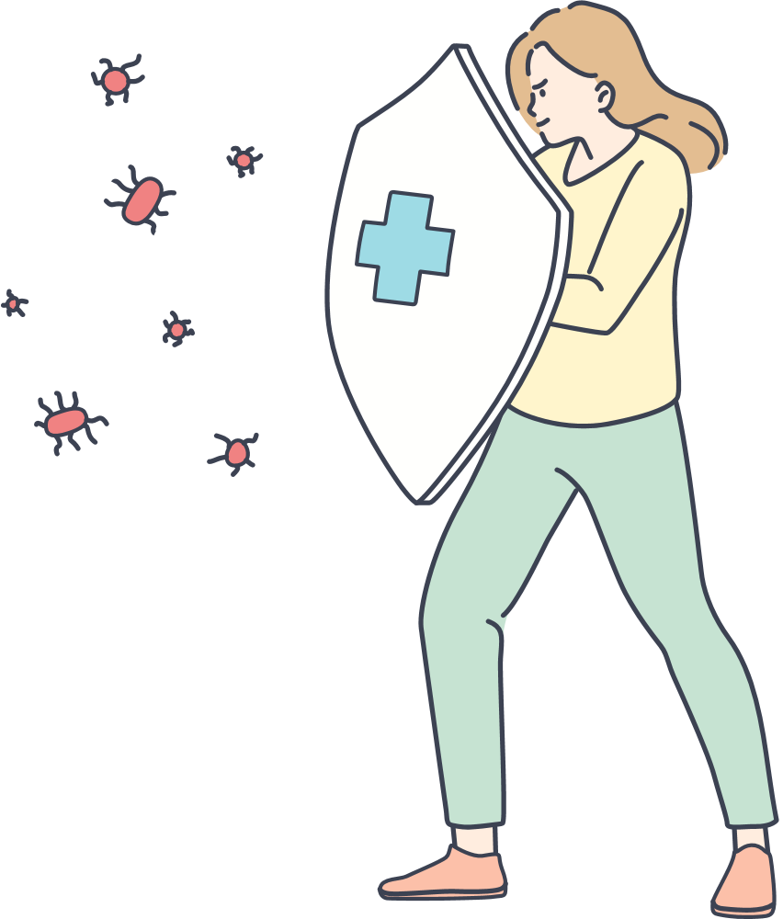
How do vaccines work?
1
What is our body’s defence system called?
2
What does it do?
3
Why do we need vaccines?
4
What happens to our ‘defence system’ when we get a vaccination?
Notes:
Read through the questions and let them know what to look out for as they watch the video
but reassure them that we’ll go through the answers together afterwards.

Slide 6
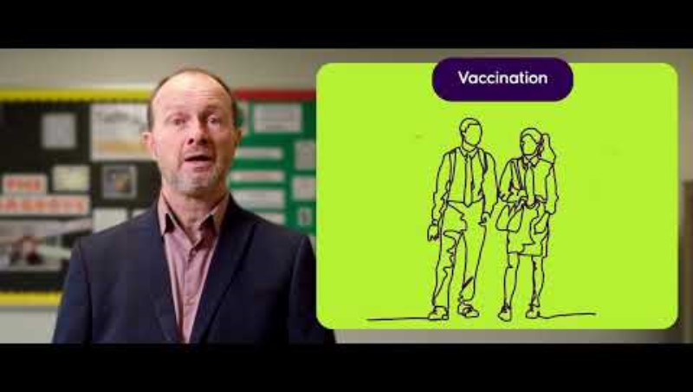
What is a vaccine?
Notes:
Key Words: vaccine, vaccination, immunisation, immune system, antibodies, virus, disease
Play video
Link to watch externally if it doesn't work:
https://www.youtube.com/watch?v=KxCS-zBCnJo
LO: I understand the importance of vaccines in protecting myself from illness and understand that I am protecting others from illness.
LO: I understand it's my responsibility to look after my own health and vaccines are an important way to maintain physical health.
LO: I understand that vaccines are to help reduce the risk of future illness.

Slide 7
How do vaccines work?
1
What is our body’s defence system called?
immune system
2
What does it do?
makes cells that attack and defend against diseases
3
Why do we need vaccines?
because sometimes our bodies need help to defend against more serious and rare diseases
4
What happens to our ‘defence system’ when we get a vaccination?
you are giving your body the know-how to defend you if you ever catch the disease in the future
Notes:
Key Words: vaccine, vaccination, immunisation, immune system, antibodies, virus, disease, know-how
Go through each question and elicit answers from the class. Green boxes with answers should appear on click.
Ask the bonus questions below:
What could happen if people don’t get vaccinated? – some of these diseases might start to spread in our communities again
What are the cells that our immune system makes to defend us called? – antibodies
How many deaths are prevented each year because of vaccinations? – 4 million worldwide
LO: I understand the importance of vaccines in protecting myself from illness and understand that I am protecting others from illness.
LO: I understand it's my responsibility to look after my own health and vaccines are an important way to maintain physical health.

Slide 8
Is this a trusted source of information?
Notes:
Key Words: misinformation
Ask:
Is this a trusted source of info?
Yes because ‘the council’ and the ‘NHS’ are trusted sources of information, as us Public Health and your school (hence why we’re here giving the lessons)
Ask:
What might not be trusted sources of information? Why?
This might not be a perfect solution, but if the lessons are going to meet this LO then there needs to be way to talk about it…
LO: I can identify misinformation that was online or on social media in relation to vaccines and how that links to my physical health.

Slide 9
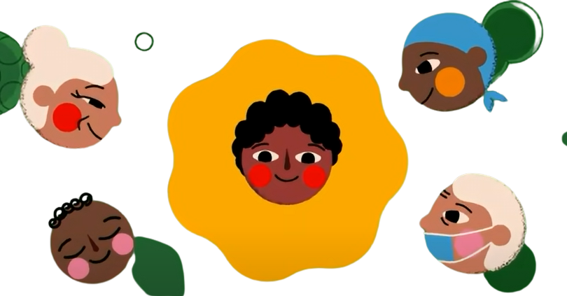
Reasons to get vaccinated...
Vaccines protect you from diseases!
Notes:
Key Words: protection
Summarise here. Ask: What’s the number 1/most important reason to get vaccinated?
LO: I understand the importance of vaccines to protect myself from illness and understand that I am protecting others from illness.
LO: I understand it's my responsibility to look after my own health and vaccines are an important way to maintain physical health.

Slide 10
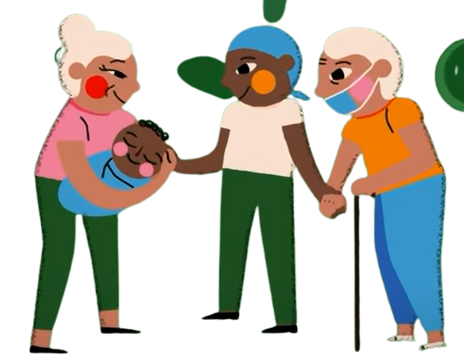
Reasons to get vaccinated...
Vaccines protect those around us too!
Not everyone can be vaccinated:
Young babies
Seriously ill people
People with an allergy
Notes:
Key Words: protection, herd immunity, eligible
Explain that yes, this is the no. 1 reason, but that vaccination isn’t just about us, it’s about others too, the people around us.
Refer back to the word ‘communities’ from the video – what does this mean? Who does our community include?
Why might some people not be able to get vaccinated (not be eligible)? Elicit answers/suggestions first.
Explain the concepts of community and of herd immunity here, as their understanding of this is part of the lesson outcomes.
LO: I understand the importance of vaccines to protect myself from illness and understand that I am protecting others from illness.
LO: I understand it's my responsibility to look after my own health and vaccines are an important way to maintain physical health.

Slide 11
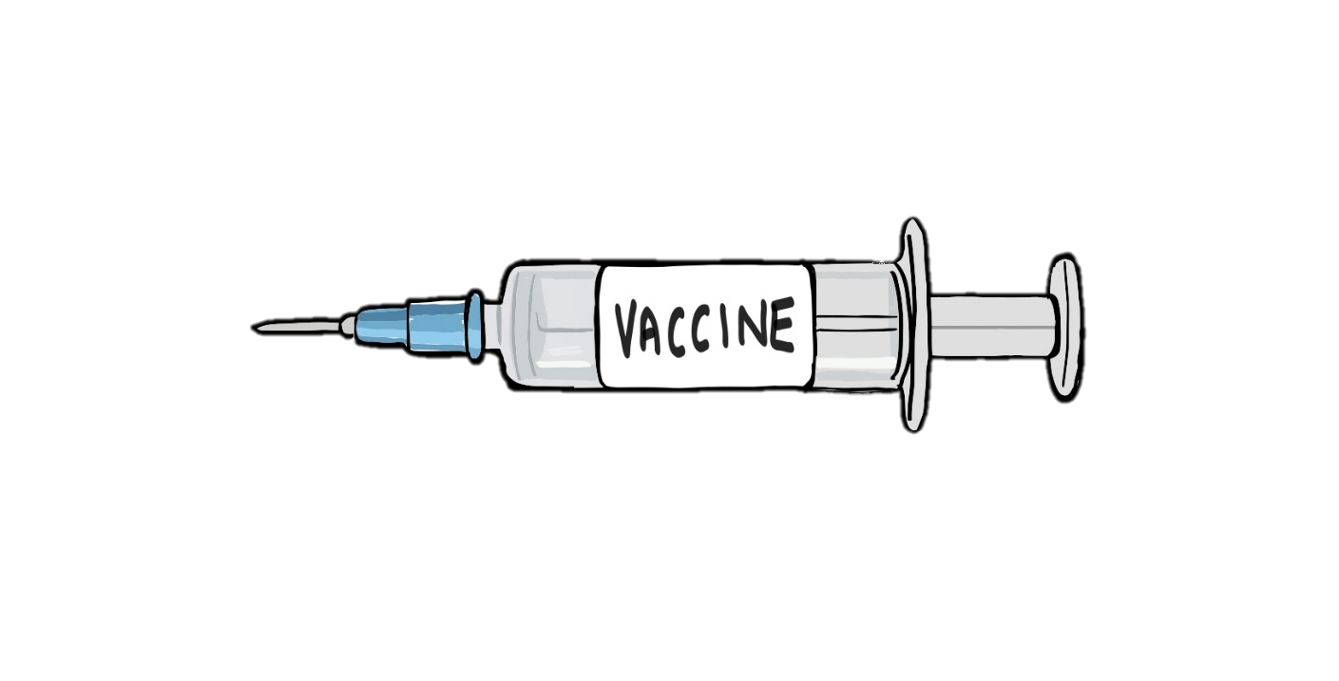
What is MenACWY?
This vaccine protects people against 4 types of Meningitis bacteria.
The MenACWY vaccine
protects you against Meningitis
A
C
W
Y
Meningitis symptoms can develop quickly and severely affect a person’s health.
Notes:
Key Words: meningitis
Talk through the slide and aim to include the below:
Transmitted from person to person very much like a cough or a cold, as we can store these droplets in the back of our throats. Coughing & sneezing can spread these droplets. Also spread by kissing.
Affects brain - damage to hearing, sight & general brain damage can be caused
Affects spinal cord - can lead to disabilities
Can cause your immune system to attack your body (sepsis), and then your immune system is not able to protect you from other diseases either (immunosuppressed)

Slide 12
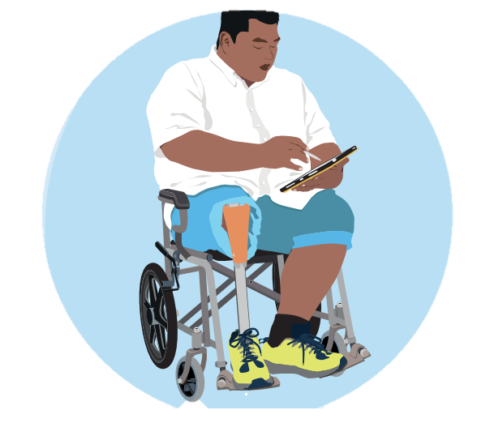
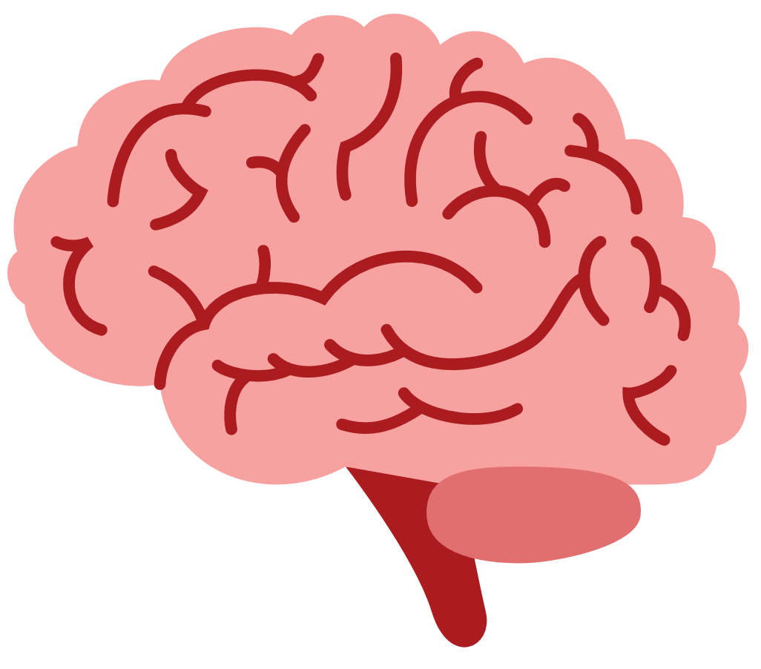
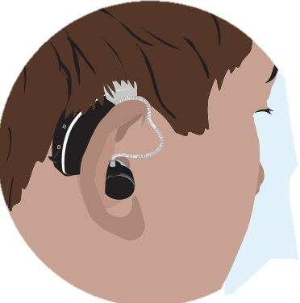
What is Meningitis?
Meningitis can cause a serious condition where your immune system attacks your body.
Meningitis is an infection that affects your brain which can cause hearing and sight loss and brain damage.
Meningitis can lead to life-changing disabilities like amputations.
Notes:
Key Words: meningitis, immune system
Talk through the slide and aim to include the below:
Affects brain - damage to hearing, sight & general brain damage can be caused
Affects spinal cord - can lead to disabilities
Can cause your immune system to attack your body (sepsis), and then your immune system is not able to protect you from other diseases either (immunosuppressed)

Slide 13


What is the 3-in-1 Booster?
You may have already had 4 doses of 3-in-1 booster as a child - this 5th dose helps boost your protection for life. ​
The 3-in-1 vaccine ​vaccinates you against Tetanus, Diphtheria & Polio.​
You can die from these diseases. The best protection is the vaccine.
Notes:
Key Words: booster, tetanus, diphtheria, polio, bacteria
Talk through the slide and aim to include the below:
Tetanus - can affect the brain, spine and nerves leading to breathing problems. We get this from cutting ourselves and getting infected by a certain type pf bacteria that lives in the environment – rusty nails, animals etc.
Diphtheria - can damage heart, brain, spine and nerves too, and can cause breathing problems. It's spread by coughs and sneezes, or through close contact with someone who is infected.
You can also get it by sharing items such as cups, cutlery, clothing or bedding with an infected person
Polio - can also affect your heart, brain, spine and nerves leading to permanent paralysis. It is transmitted easily through contact with the faeces (poo) of an infected person or less commonly through droplets when they cough or sneeze.

Slide 14
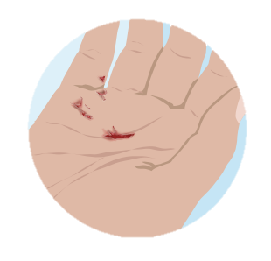
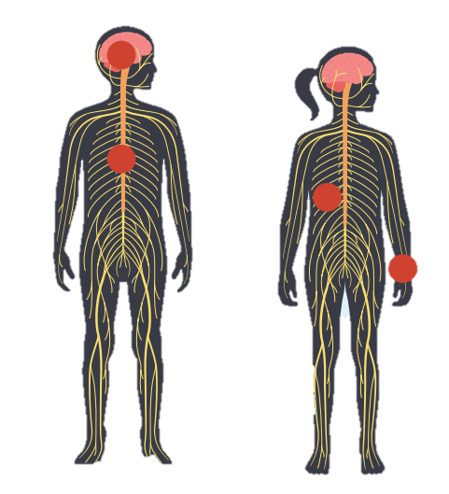
What are Tetanus/Diphtheria/Polio?
Polio can affect your heart, brain, spine and nerves, which can lead to permanent paralysis.
Diphtheria can damage the heart, brain, spine and nerves, and can also cause breathing problems.
Tetanus affects the brain, spine and nerves and can cause breathing problems.​
Notes:
Key Words: booster, tetanus, diphtheria, polio, bacteria
Talk through the slide and aim to include the below:
Tetanus - can affect the brain, spine and nerves leading to breathing problems. We get this from cutting ourselves and getting infected by a certain type pf bacteria that lives in the environment – rusty nails, animals etc.
Diphtheria - can damage heart, brain, spine and nerves too, and can cause breathing problems. It is transmitted the same as Meningitis, through droplets (stored in the back of the throat, passed on via coughing and sneezing) if we come into close contact with someone else.
Polio - can also affect your heart, brain, spine and nerves leading to permanent paralysis. It is transmitted through feces, so is particularly prevalent in sewers etc.

Slide 15
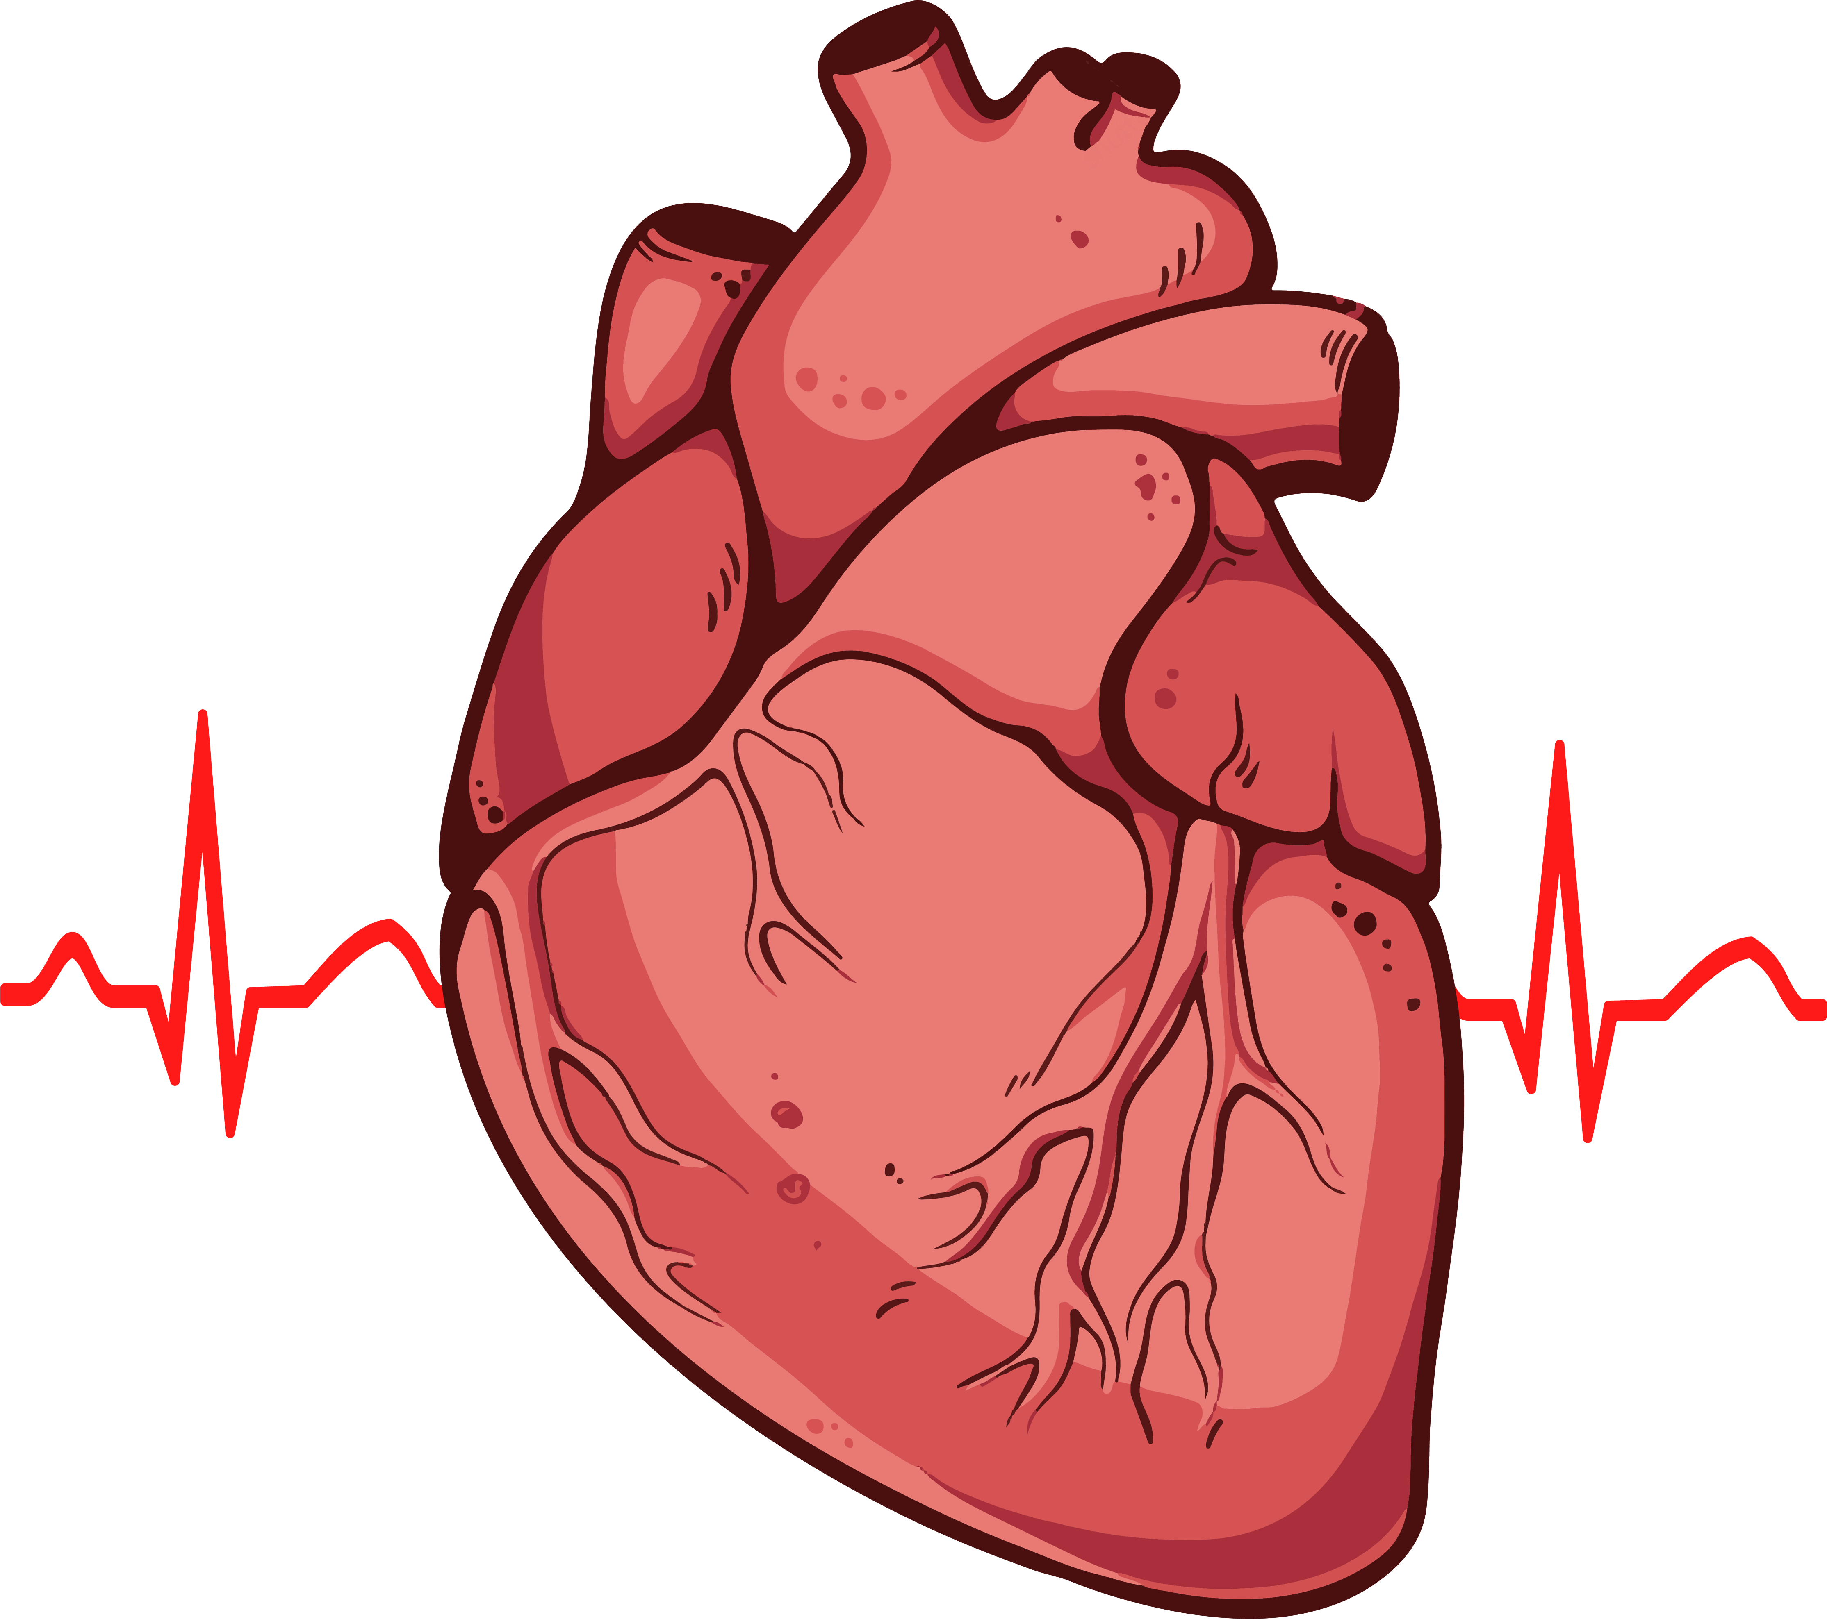
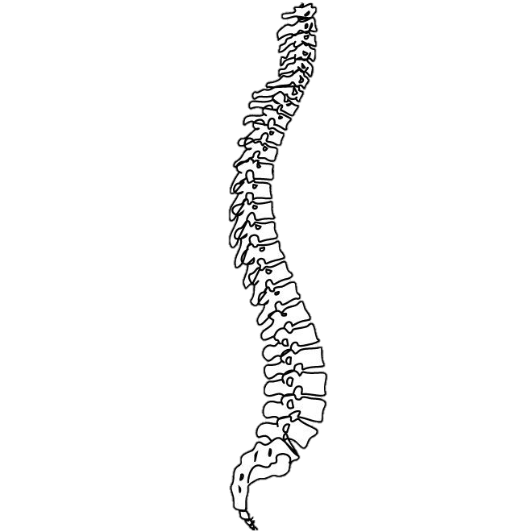
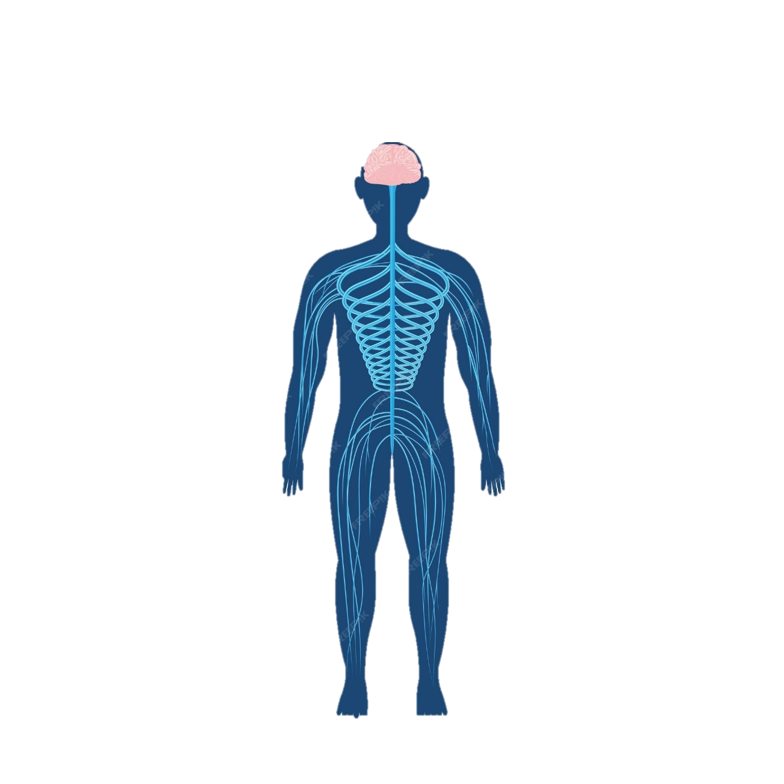
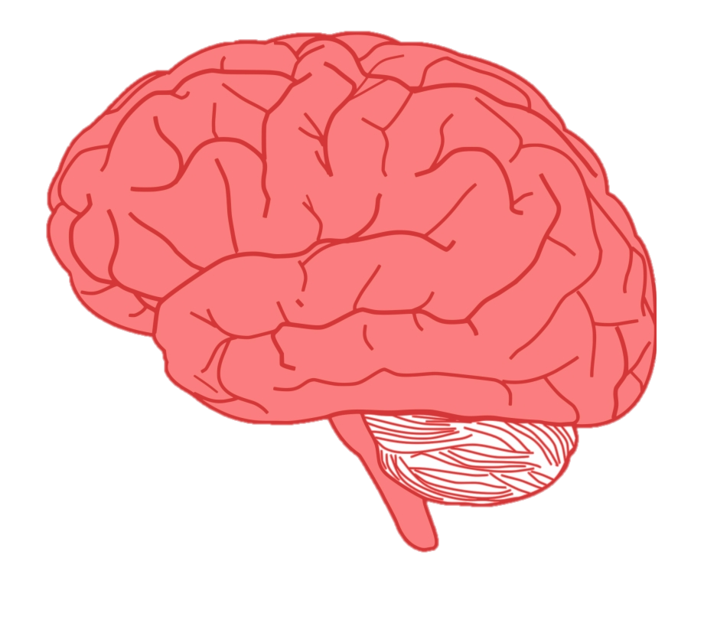
How could these illnesses affect you?
All of these diseases can cause damage to your brain – damage to your brain could significantly impact your quality of life
Diphtheria, Polio and Tetanus can damage your nerves. Your nervous system is what keeps you moving and breathing
Diphtheria and Polio can damage your heart - Polio causes muscle weakness and this includes the muscles in your heart
Notes:
Key Words: tetanus, diphtheria, polio
Check understanding:
Ask pupils to explain which of the 3 viruses/diseases can cause harm to each organ, and then ask them how the virus/disease affects it?
Answers/boxes will appear on click
If there’s time, ask each group/pair to take one organ, draw it on their mini whiteboard, and label how it can be affected by the viruses.

Slide 16
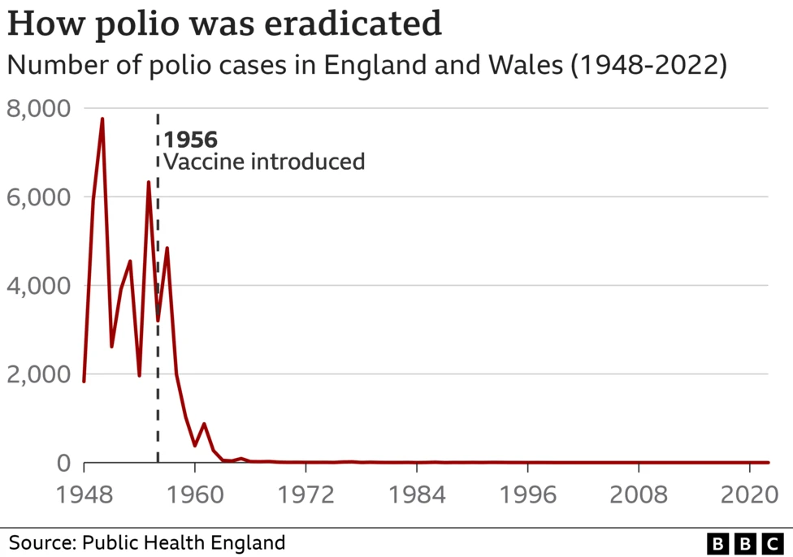
We know it works!
Notes:
Key Words: herd immunity, protection, vaccination programme
Explain that when the polio vaccine was introduced in 1956 we can see how rapidly the number of cases of polio in England & Wales dropped.
This was largely due to the number of people that got vaccinated creating herd immunity

Slide 17
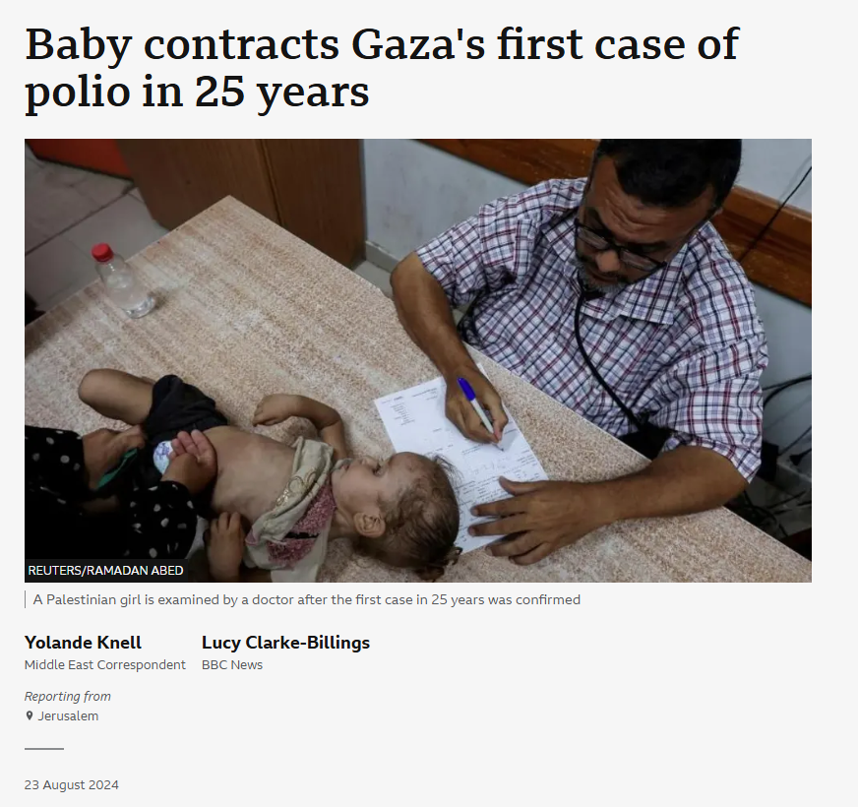
Your vaccine is free and available…
Other countries are not so lucky. Due to the war in Gaza, they haven’t been able to get vaccines and polio has returned.
Notes:
Key Words: herd immunity, protection, eligible, vaccination programme
Explain that people in other countries are not necessarily as fortunate as we are here in the UK
LO: I understand that vaccines are to help reduce the risk of future illness.

Slide 18
Is the vaccination safe?
Yes. The vaccines are very safe!
Vaccines go through a very strict testing process before you get them
They have been tested thoroughly before being given to humans.
Millions of doses have been given to people worldwide.
Notes:
Key Words: dose,
Reiterate its safety here.
LO: I understand that vaccines are medications that are tested and safe to be given, like all medications are tested.

Slide 19

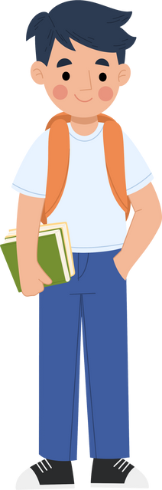


Getting the vaccine
Vaccines are specific to different diseases, so you need to get them all to be as protected as possible.
The vaccine is usually given to boys and girls between 13 and 15, in year 9.​
A nurse will come to your school to give you the vaccine, or you can attend a catch-up clinic.​
Notes:
Key Words: vaccine, vaccination, nurse, catch-up clinic
Suggest moving this slide so you can give them the info before asking the following checking questions.

Slide 20


If you miss your vaccination in school, there are no other ways to get it.
True!
False!
Notes:
Key Words: vaccination, catch-up clinic
LO: I understand it's my responsibility to look after my own health and vaccines are an important way to maintain physical health

Slide 21

Only babies can get meningitis.
True!
False!
Notes:
Key Words: meningitis

Slide 22

One vaccination can protect me against all diseases.
True!
False!
Notes:
Key Words: vaccination, vaccine, disease
LO: I understand it's my responsibility to look after my own health and vaccines are an important way to maintain physical health

Slide 23

If I get vaccinated, I can help stop the spread of disease to others.
True!
False!
Notes:
Key Words: vaccine, vaccination, herd immunity
LO: I understand the importance of vaccines in protecting myself from illness and understand that I am protecting others from illness.

Slide 24

It is safer to get vaccinated than to get the disease itself.
True!
False!
Notes:
Key Words: disease, virus
The vaccination vaccinates you against the virus, so you don’t end up developing the disease.
LO: I understand the importance of vaccines in protecting myself from illness and understand that I am protecting others from illness.

Slide 25

Vaccinations are tested for safety before they are given to us.
True!
False!
Notes:
LO: I understand that vaccines are medications that are tested and safe to be given, like all medications are tested.

Slide 26
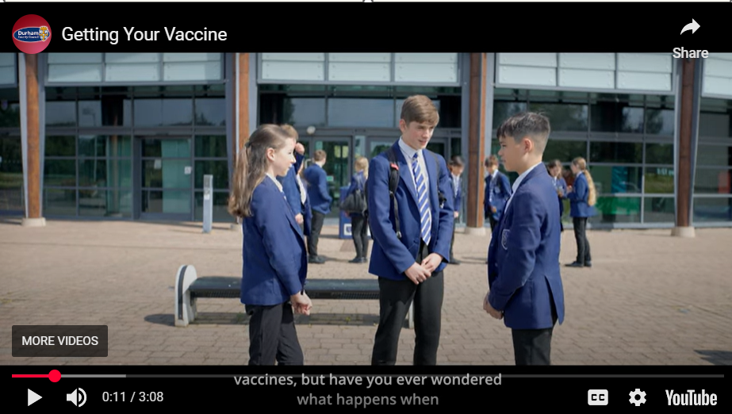
Getting the vaccine
Notes:
Key Words: walkthrough, side effects(?), misinformation(?)
Explain that this was filmed up the road in Kings Academy, so this is going to very similar to your experience.
TRIGGER WARNING – the girl is going to get the vaccine in the video, so if you are a bit scared of needles, then feel free to look away.
LO: I can identify misinformation that was online or on social media in relation to vaccines and how that links to my physical health.

Slide 27
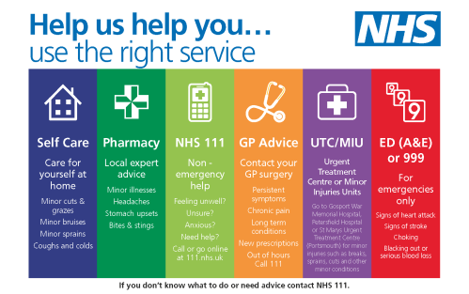
Getting medical help:
Notes:
Key Words: side effects, advice
Make sure that students understand the difference between common side effects, which are normal for most people, but if they continue to feel unwell, then they must seek medical advice from the appropriate service.
Elicit from the pupils – the image will come in on click, but give pupils some time to come up with answers themselves (much more likely to remember this way if they have to recall the info)
GP
Dr
NHS 111
Emergency Services – 999
Pharmacies
Trusted adult at home (parent, carer, grandparent)
Trusted adult at school (teacher, teaching assistant, School Nurse)
LO: I know how to access the right services when I need medical help. I know when I need to contact health services.

Slide 28


Giving consent
Your school will send the online consent link to your parents/carers
The form can be filled out online, remind your parents/carers to check their school emails/texts or app
It only takes a minute to complete, so please remind your parent/carer to
complete it
Notes:
Key Words: consent, eligible,
Explain that it is necessary that your parents and carers consent, where possible, for you to have the vaccination in advance of vaccination day, so that we can be sure you’ll be asked to go along and get it
Explain how it’s done in their school – find out in advance

Slide 29
Giving consent
If your parent or carer doesn’t agree to the vaccine or forgets to complete the consent form, you can still choose to have it if you understand what it’s for—talking openly with your family is a good idea, but the final choice can be yours.
You can consent for yourself and make your own medical decisions if you understand:
  What the decision is about
  The risks and benefits
  How it affects you
The nurse will check this to see if you can decide without a parent. You might hear this called ‘Gillick Competence’.
Notes:
Key Words: consent, (Gillick) competence
Explain that it is possible to give consent for yourself, if they meet the criteria
However, reiterate that it is best/better, where possible, to have these conversations with parent, carer or guardian.
Remind them that they won’t ever be forced to have the vaccine if they really don’t want it, but if they’re not sure it can be a good ideas to consent anyway, as this will give them the opportunity to talk it through the nurse themselves, and ask any questions they may have.
LO: I understand it's my responsibility to look after my own health and vaccines are an important way to maintain physical health

Slide 30
How much do you know about vaccines now?
This is not a test!
Space to leave any comments
Space to ask any questions
Notes:
Ask students to complete the post-session survey
Explain that this is an opportunity to show how much they have learned about vaccines this lesson.
NOTES: For sessions being run by teachers in school, the surveys may not be required.

Slide 31
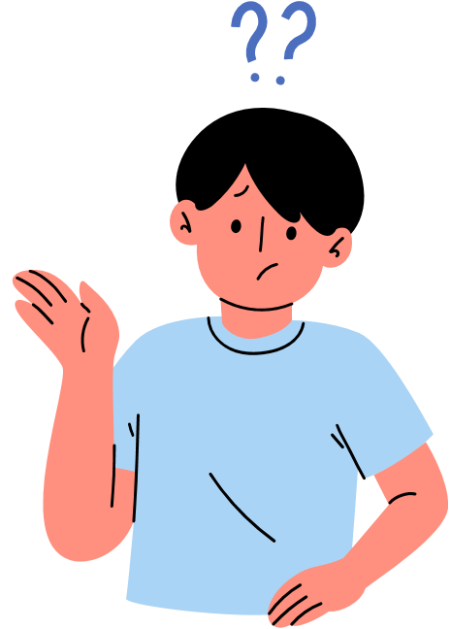
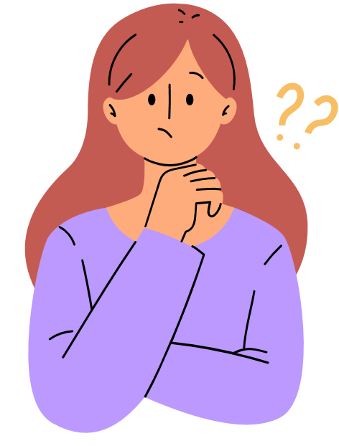
Are there any questions?
You can ask us at the end...
You can make a note and leave it on your desk...
If we don’t know the answer, we’ll find out and let your teacher know...
Notes:
Ask if pupils have any questions, remind them that they can also leave and questions/comments in the last section on their survey and we’ll do our best to get the answers back to then anonymously.
Extra task if needed to fill time/final check of understanding:
Get students to write down one question each on their whiteboards. It can be about anything we’ve learned so far this lesson.
Ask for volunteers to ask their question to the class
Ask for hands up to answer it - person who answers, then asks their question to the class, and so on and so forth.
Continue until bell goes/all are stood up behind chairs.

Slide 32

If you would like to know more about the Meningitis vaccine or the 3-in-1 booster...
Go to the NHS website at the following links:​
​
https://www.nhs.uk/vaccinations/menacwy-vaccine/
https://www.nhs.uk/vaccinations/td-ipv-vaccine-3-in-1-teenage-booster/
Notes:
Key Words: NHS, trusted sources, misinformation
Remind students that it’s important to use trusted sources to ensure you are getting accurate and up to date information.
Include BBC bitesize, charity websites, WHO… here too?
LO: I can identify misinformation that was online or on social media in relation to vaccines and how that links to my physical health.

Slide 33
Thanks for listening!

Slide 34
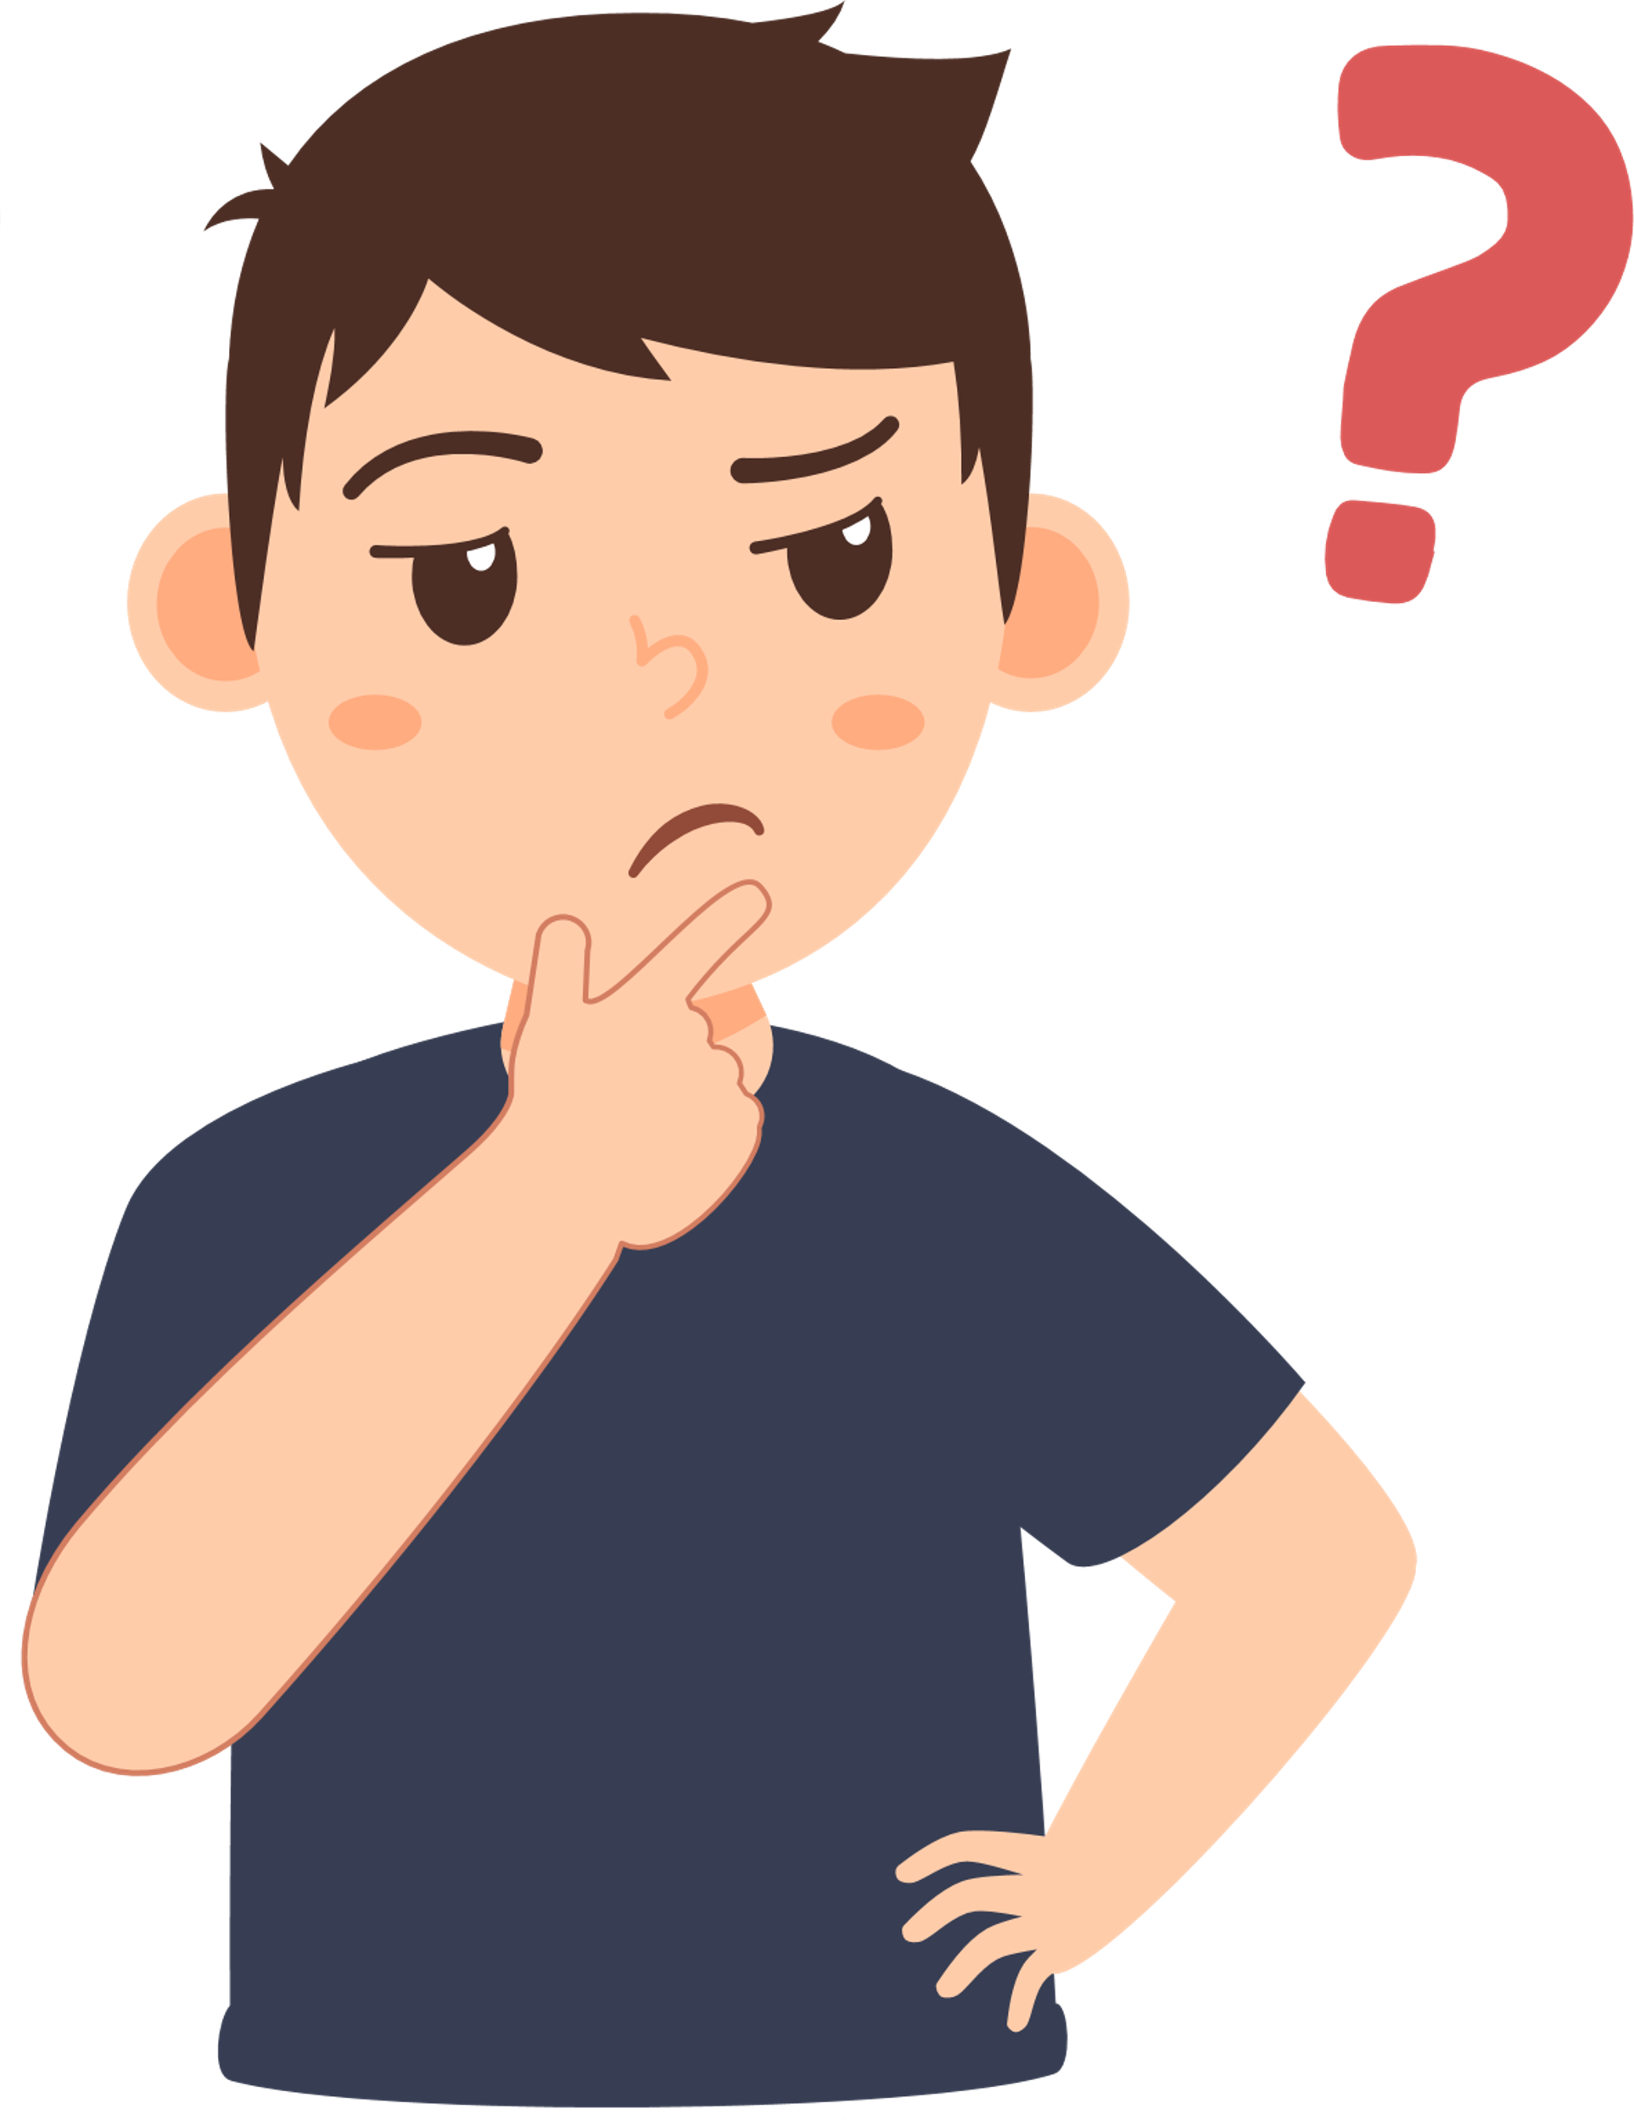
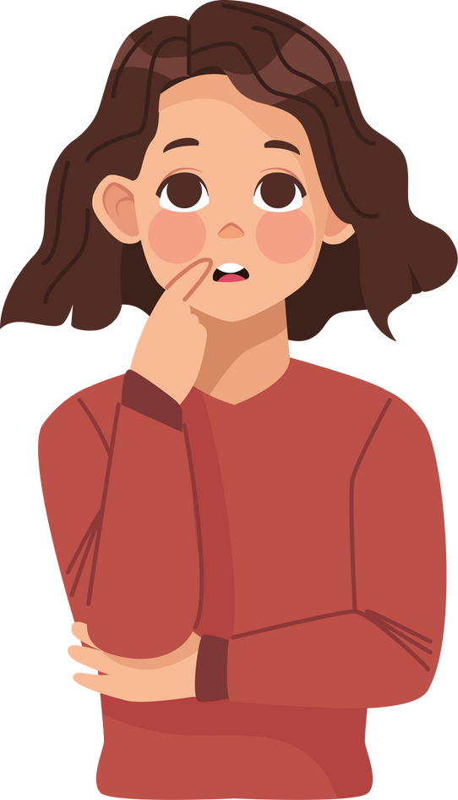
Word on the street...?
Read the statements.
Have you heard any of these before?
Could any of them be true?
Notes:
Suggest to cut
Work in their groups
Explain that they have some comments in their packs/can read from the board as a whole class activity
Read the coloured speech bubbles and answer the questions on the slide.
LO: I can identify misinformation that was online or on social media in relation to vaccines and how that links to my physical health.

Slide 35


‘‘Someone told me that the needles are really big and it really, really hurts’’
You will feel a sharp scratch, a little bit like if you catch yourself with your fingernail, you may also feel a cool sensation and feel a little pressure like someone pressing on your arm as the vaccine goes in.
Notes:
Key Words: misinformation
Suggest to cut
LO: I can identify misinformation that was online or on social media in relation to vaccines and how that links to my physical health.

Slide 36



‘‘Some people say when you get vaccinated, you are getting implanted with a micro-chip’’
‘‘I saw online that vaccines are a way for us all to be controlled’’
This is impossible! Absolutely no vaccines contain any microchips; they are not part of a conspiracy theory; and they are not a way for us to be controlled.​
‘‘I overheard that it’s all part of a conspiracy theory, like in ‘The Matrix’’’
Notes:
Key Words: misinformation
Suggest to cut
LO: I can identify misinformation that was online or on social media in relation to vaccines and how that links to my physical health.

Slide 37

‘‘I’ve heard that vaccinations can cause other things like disabilities or autism’’
There is no evidence of a link between vaccines and autism. A doctor faked his research to pretend there was for fame and money but was fired and not allowed to be a doctor anymore because of this.​
Notes:
Key Words: misinformation
Suggest to cut
LO: I can identify misinformation that was online or on social media in relation to vaccines and how that links to my physical health.

Slide 38

We know exactly what ingredients are in vaccines, and the ingredients they use to make them. They are tested before being given to us and are safe for us to have.
‘‘I saw on TikTok that vaccines are not safe because we have no idea what’s in them’’
Notes:
Key Words: misinformation
Suggest to cut
Go through together as a whole class and ask if anyone wants to share any thoughts about this.
Remind them of the white text and how this is the correct information.
LO: I can identify misinformation that was online or on social media in relation to vaccines and how that links to my physical health.

