Slide 1
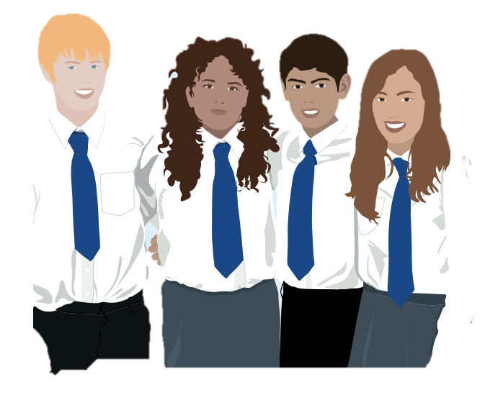
Vaccines & Me:
HPV
Year 8 School Immunisation
Notes:
Facilitator introduces self & organisation (if external) and explains a little about their career trajectory/passions about the project.
Interesting & creates rapport

Slide 2


How much do you know about vaccines?
This is not a test!
Space to leave any comments
Space to ask any questions
Notes:
Ask them to complete the survey.
Keep the sheets together.
Anonymous, but can put initials on them to help identify, and this can be removed (or the surveys are pre-coded in advance to save time)
Not a test, doesn't matter if they don't know the answers, that's why we're here!
Explain what their postcode is and what their initials are
NOTES: For sessions being run by teachers in school, the surveys may not be required.

Slide 3
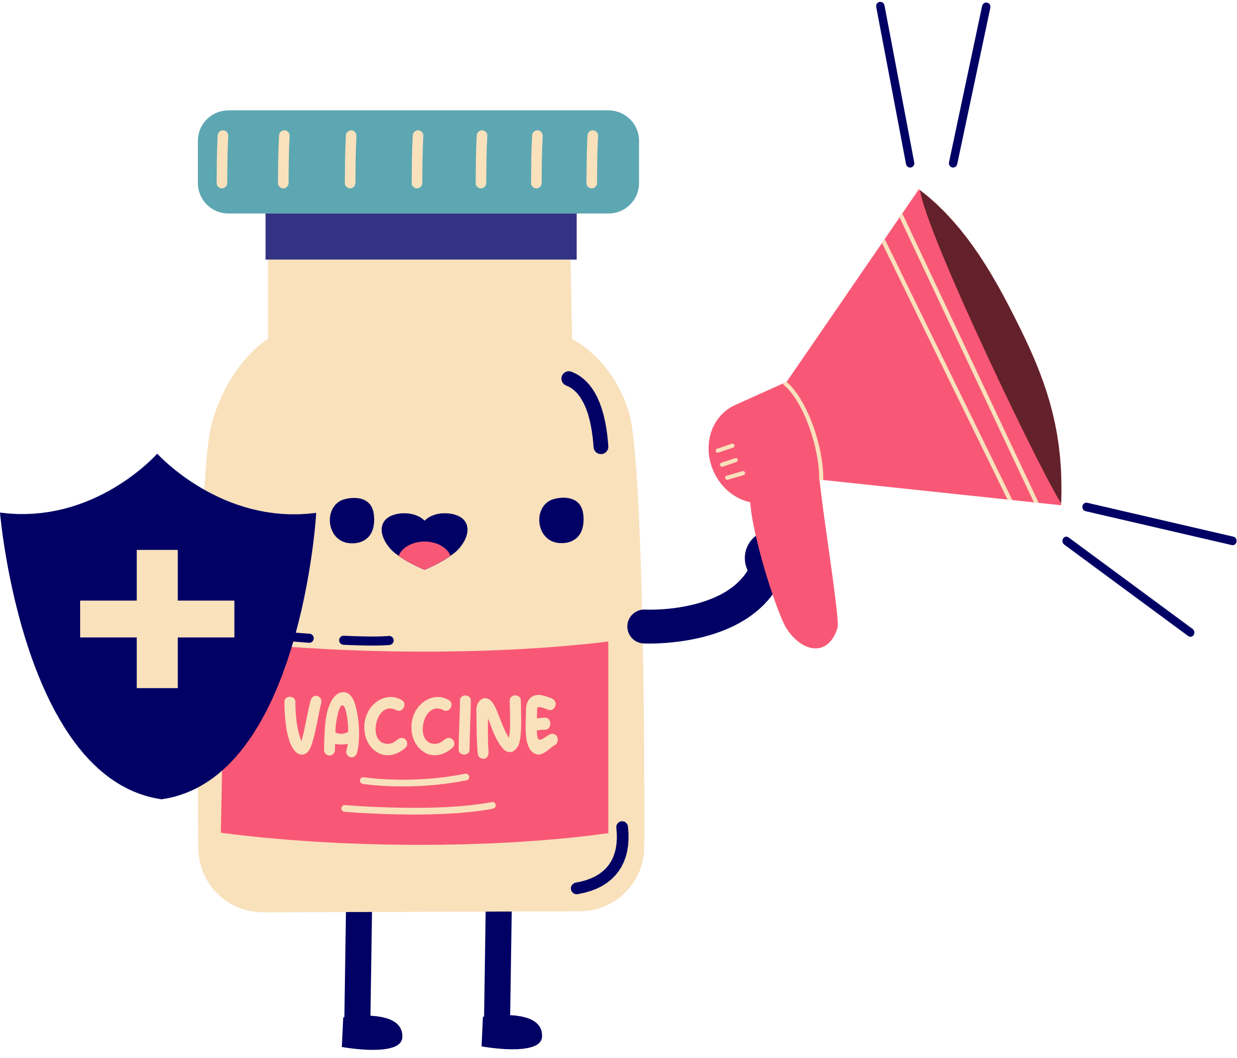
Today’s objectives
1
To understand what a vaccine is & how it works
2
To understand why & how we get vaccines
To know which specific diseases the HPV vaccine relates to & its link to sexual contact
3
4
To understand when & where to get medical advice
Notes:
Read through the objectives and what we hope to learn by the end of the session.
Read as they are on the slide, as it’s too confusing to listen on one thing and read another.

Slide 4

We will listen to each other
Questions are welcome
We will respect what other people say
If we don't know the correct words to use, we will ask
We won’t share our own, or our friends’, personal experiences, or share what has been said outside of the classroom*
Class
Group Agreement
Notes:
Key Words: STI/STD/HPV, Human Papilloma Virus, skin-to-skin contact
*except if you are concerned about yourself or someone else – tell a trusted adult, whether at home or at school
Make this following points clear to everyone in the room.
Ask if anyone has any questions.

Slide 5
What are the pros & cons of vaccines?
Pros | Cons
Notes:
Key Words: pros & cons, side effects
Elicit meaning of ‘pro’ and ‘con’ from the group (previous lessons suggest some students are clear on their meaning)
Depending on classroom layout/time, activity can be:
Pair work
Small group task
Whole class discussion
Might need to start them off with some suggestions (judge based on group needs)
Can be done on mini whiteboards, tablets, paper, books
Provide whole class feedback at the end
Highly likely that something like ‘side effects’ will come up here as a con, so it is important to myth-bust this (will be addressed in more detail when medical advice & assistance is mentioned later)

Slide 6
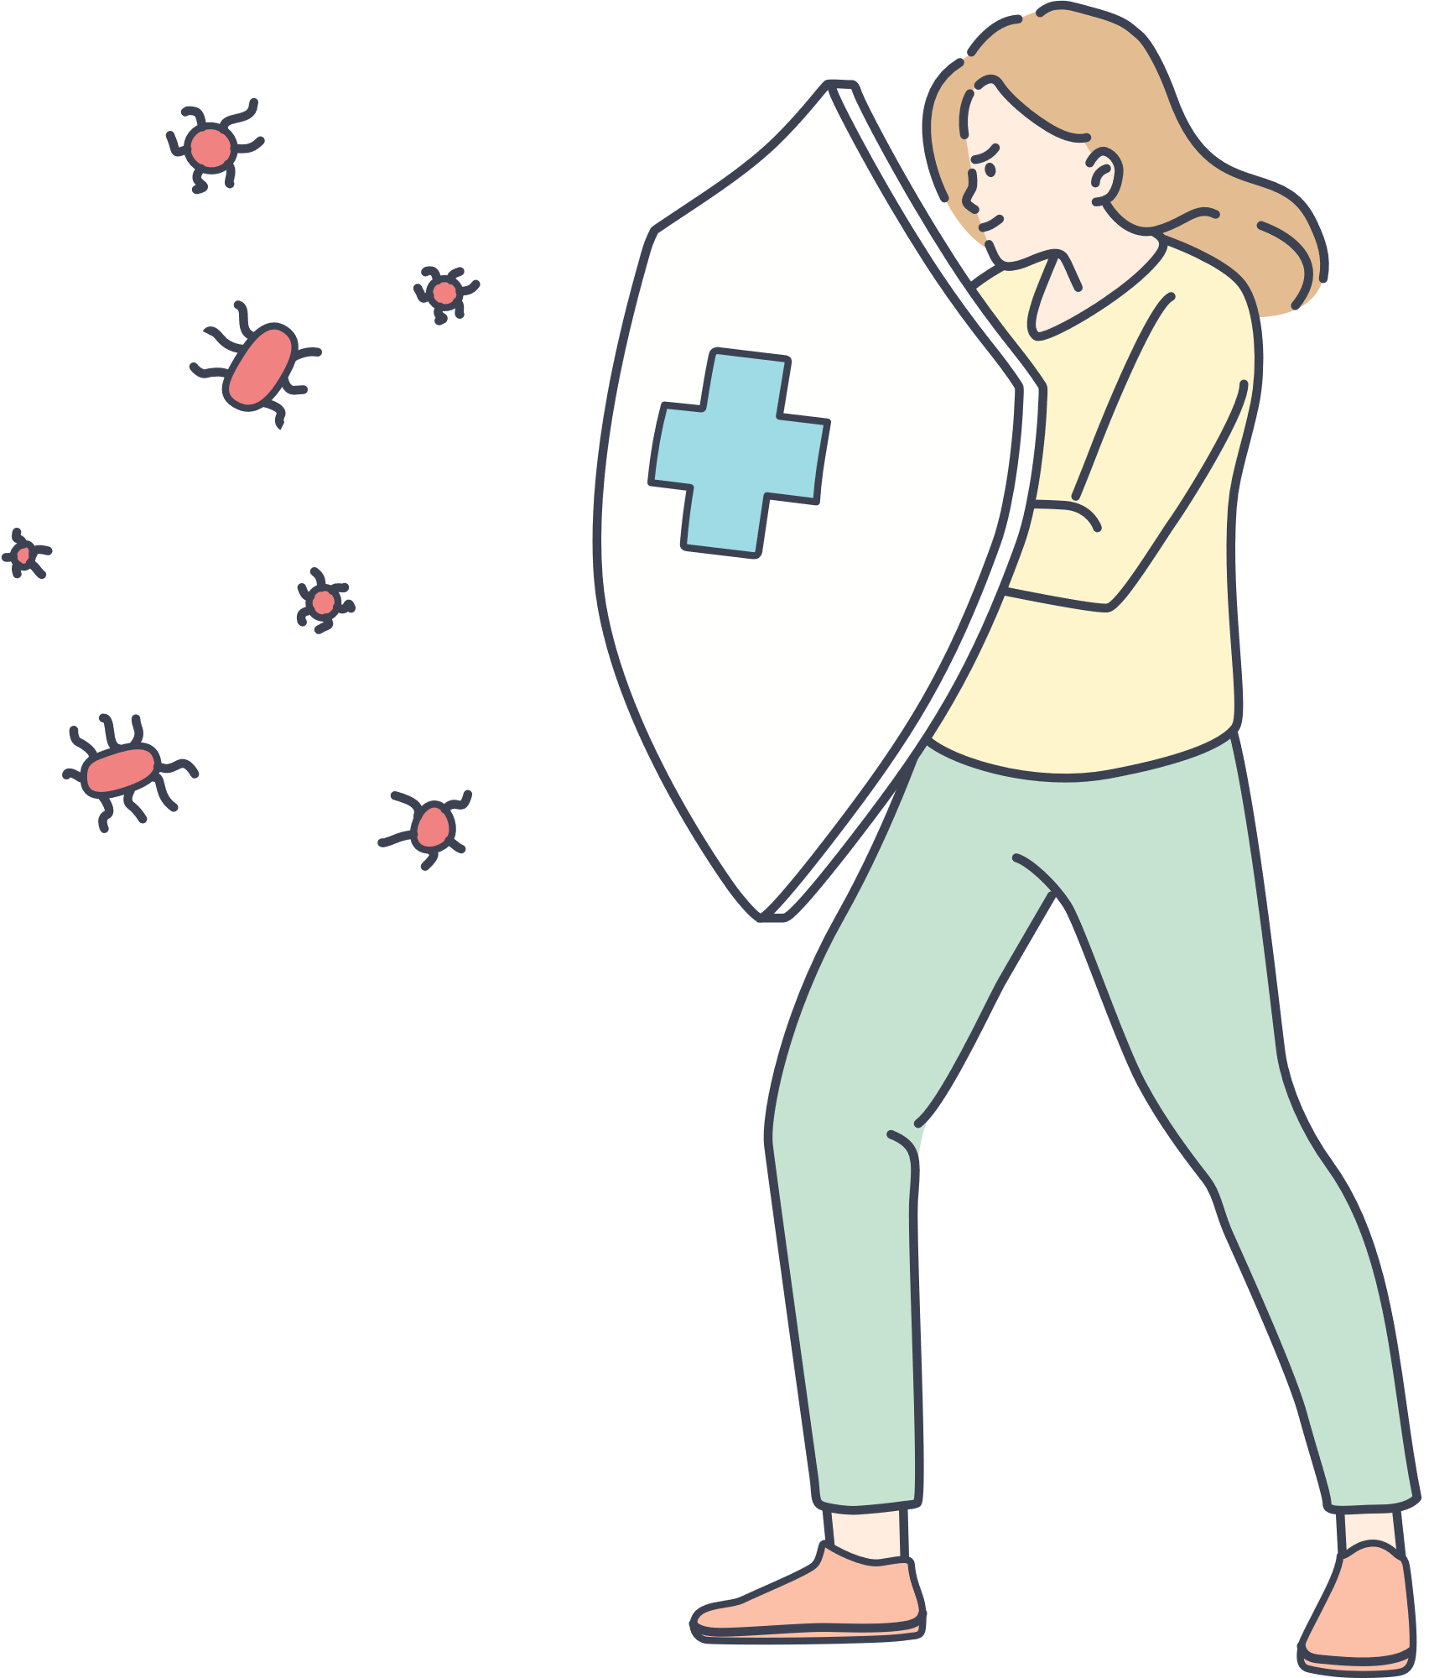
How do vaccines work?
1
What is our body’s defence system called?
2
What does it do?
3
Why do we need vaccines?
4
What happens to our ‘defence system’ when we get a vaccination?
Notes:
Read through the questions and let them know what to look out for as they watch the video
but reassure them that we’ll go through the answers together afterwards.

Slide 7
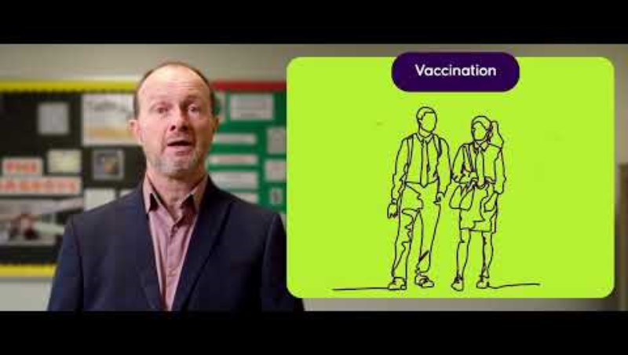
What is a vaccine?
Notes:
Key Words: vaccine, vaccination, immunisation, immune system, antibodies, virus, disease
Play video
Link to watch externally if it doesn't work:
https://www.youtube.com/watch?v=KxCS-zBCnJo
LO: I understand the importance of vaccines in protecting myself from illness and understand that I am protecting others from illness.
LO: I understand it's my responsibility to look after my own health and vaccines are an important way to maintain physical health.
LO: I understand that vaccines are to help reduce the risk of future illness.

Slide 8
How do vaccines work?
1
What is our body’s defence system called?
immune system
2
What does it do?
makes cells that attack and defend against diseases
3
Why do we need vaccines?
because sometimes our bodies need help to defend against more serious and rare diseases
4
What happens to our ‘defence system’ when we get a vaccination?
you are giving your body the know-how to defend you if you ever catch the disease in the future
Notes:
Key Words: vaccine, vaccination, immunisation, immune system, antibodies, virus, disease, know-how
Go through each question and elicit answers from the class. Green boxes with answers should appear on click.
Ask the bonus questions below:
What could happen if people don’t get vaccinated? – some of these diseases might start to spread in our communities again
What are the cells that our immune system makes to defend us called? – antibodies
How many deaths are prevented each year because of vaccinations? – 4 million worldwide
LO: I understand the importance of vaccines in protecting myself from illness and understand that I am protecting others from illness.
LO: I understand it's my responsibility to look after my own health and vaccines are an important way to maintain physical health.

Slide 9
Is this a trusted source of information?
Notes:
Key Words: misinformation
Suggest that, in order to meet the previous LO: I can identify misinformation that was online or on social media in relation to vaccines and how that links to my physical health, this video is used as a prompt to talk about this
Ask:
Ithis a trusted source of info?
Yes because ‘the council’ and the ‘NHS’ are trusted sources of information, as us Public Health and your school (hence why we’re here giving the lessons)
Ask:
What might not be trusted sources of information? Why?
This might not be a perfect solution, but if the lessons are going to meet this LO then there needs to be way to talk about it…
LO: I can identify misinformation that was online or on social media in relation to vaccines and how that links to my physical health.

Slide 10
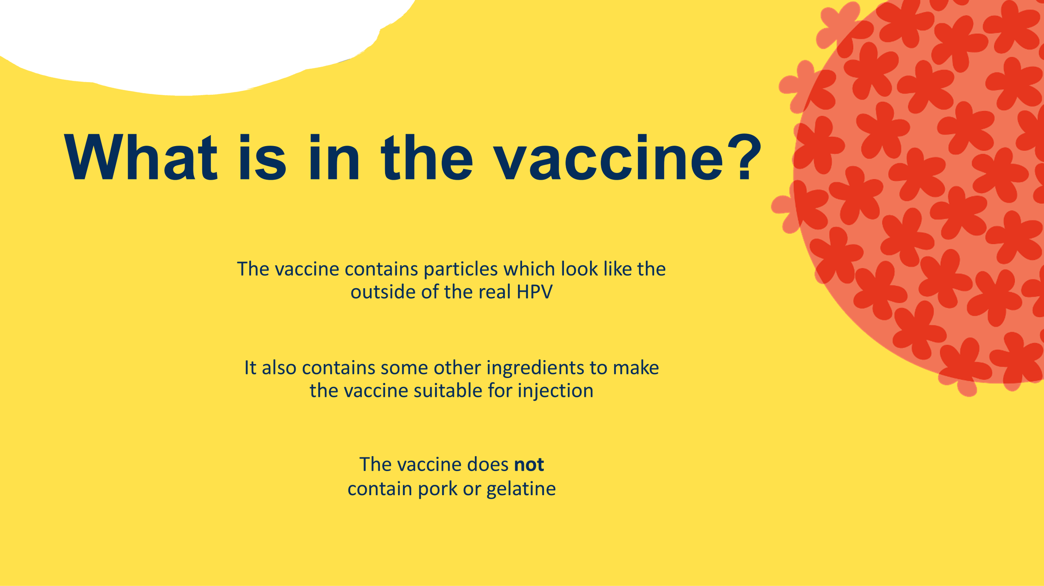
Notes:
Key Words: gelatine
Run through this info – will need to explain what we what we mean by gelatine here, as they likely won’t know what it is.
Explain some that people might want to know for dietary and/or religious reasons

Slide 11
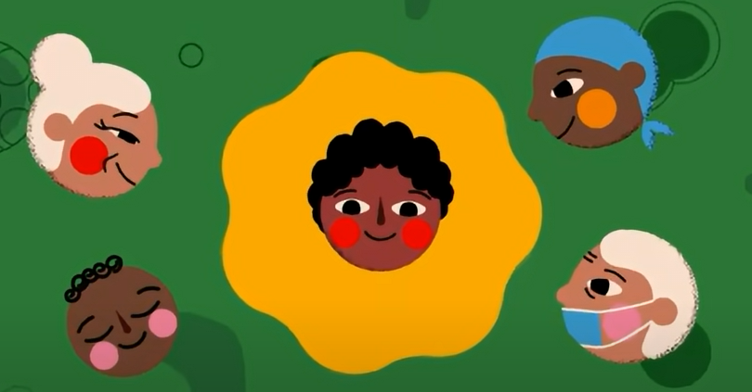
Reasons to get vaccinated...
Vaccines protect you from diseases!
Notes:
Key Words: protection
Summarise here. Ask: What’s the number 1/most important reason to get vaccinated?
LO: I understand the importance of vaccines to protect myself from illness and understand that I am protecting others from illness.
LO: I understand it's my responsibility to look after my own health and vaccines are an important way to maintain physical health.

Slide 12
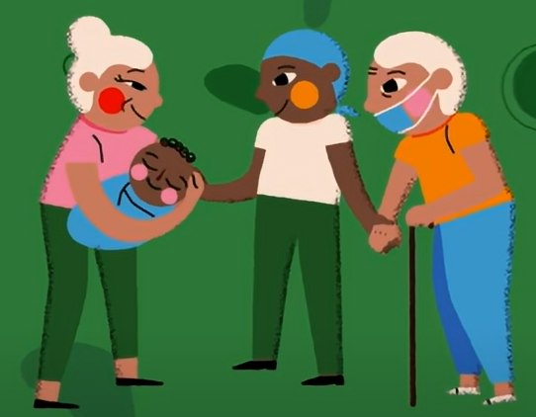
Reasons to get vaccinated...
Vaccines protect those around us too!
Not everyone can be vaccinated:
Young babies
Seriously ill people
People with an allergy
Notes:
Key Words: protection, herd immunity, eligible
Explain that yes, this is the no. 1 reason, but that vaccination isn’t just about us, it’s about others too, the people around us.
Refer back to the word ‘communities’ from the video – what does this mean? Who does our community include?
Why might some people not be able to get vaccinated (not be eligible)? Elicit answers/suggestions first.
Explain the concepts of community and of herd immunity here, as their understanding of this is part of the lesson outcomes.
LO: I understand the importance of vaccines to protect myself from illness and understand that I am protecting others from illness.
LO: I understand it's my responsibility to look after my own health and vaccines are an important way to maintain physical health.

Slide 13
How much do you know about HPV?
Read the statements and decide which is the most surprising…
1
2
3
4
5
6
7
8
Notes:
Key Words: HPV
Explain to students that you are going to hand out 8 different statements about HPV (virus and vaccine). All are true.
They need to rank them in the order of the most surprising to the least surprising, using the pyramid shape on the slide.

Slide 14
HPV doesn’t usually have any symptoms
Notes:
Key Words: HPV, symptoms
Ask students where abouts they places this statement/fact on their pyramids. Why/why not?

Slide 15
There are over 200 different types of HPV virus
Notes:
Key Words: HPV, virus, types/strains
Ask students where abouts they places this statement/fact on their pyramids. Why/why not?

Slide 16
Both boys and girls can get HPV
Notes:
Key Words: HPV
Ask students where abouts they places this statement/fact on their pyramids. Why/why not?

Slide 17
HPV can cause painless growths or lumps around your genital area; these are known as genital warts
Notes:
Key Words: genitals/genitalia, warts
Ask students where abouts they places this statement/fact on their pyramids. Why/why not?

Slide 18
HPV can cause cancers of the mouth, throat and/or genital area​
Notes:
Key Words: cancer, genitals/genitalia
Ask students where abouts they places this statement/fact on their pyramids. Why/why not?

Slide 19
Cervical cancer rates were reduced by almost 90% in women in their 20s in England, who had the HPV vaccine aged 12-13
Notes:
Key Words: HPV, cervix(cervical)
They likely won’t know what the cervix is/where it is in the body, so it will likely be a good idea to show them on the diagram.
Reference one of the slides here - cervical cancer is the most commonly occurring HPV related cancer.
The vaccine protects against 90% of cervical cancer (and 90% of cases of genital warts). It's not a 100%, but most/almost all
Ask students where abouts they places this statement/fact on their pyramids. Why/why not?

Slide 20
To get the HPV vaccine privately, costs can start from around £185
Notes:
Key Words: HPV, private (as opposed to public)
They will likely not know the difference between private and public healthcare, so explain this here.
About the cost here for the HPV vaccine -highlighting that it's not actually free for the general public over 25, but it is free for them as they are the right age.
This will be a good surprising fact I think and will be good for them to share opinions on a more neutral topic.
Ask students where abouts they places this statement/fact on their pyramids. Why/why not?

Slide 21
Without a vaccination programme,
4 in 5 people will be infected with HPV over their lifetime
Notes:
Key Words: HPV, vaccination programme
They will likely not know what we mean by this, so they will need it explained
Ask students where abouts they places this statement/fact on their pyramids. Why/why not?

Slide 22

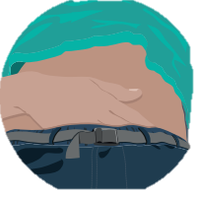
What is HPV?
There's no cure for the HPV infection. The best protection is prevention. ​
HPV is a virus that can cause genital warts and HPV-related cancers.​
HPV has no symptoms, so you may not know if you have it.​
HPV is spread by skin-to-skin contact, usually in the genital area. ​
Notes:
Key Words: HPV, warts, cancer, cure, protection, symptoms, skin-to-skin contact, genitals/genitalia
There's no cure for HPV - but your body can fight the virus and recover on its own, but it is safer to get the vaccine as when the body doesn’t cure it itself it can develop into warts/cancer.
LO: I understand that there are infections which can be spread through sexual activity and the consequence of unsafe sexual activity.

Slide 23
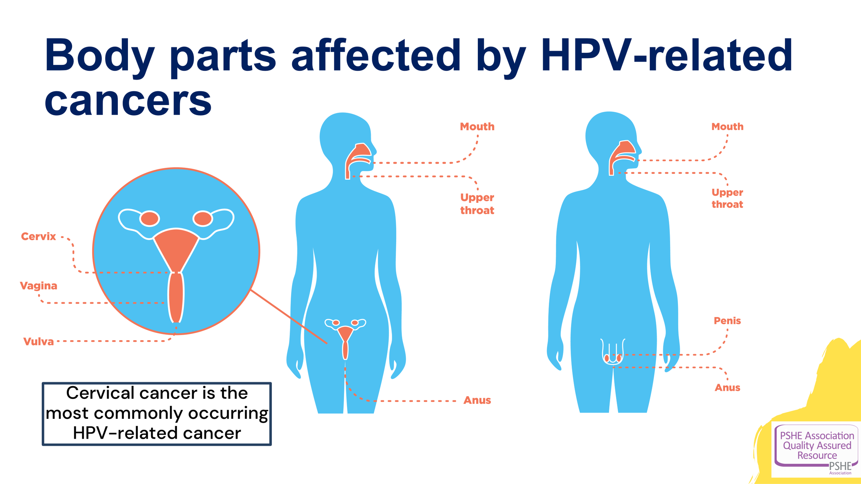
Notes:
Bring up the point about cervical cancer at the bottom.
HPV vaccine is successful at preventing 90% of cases of cervical cancer and 90% of genital warts.

Slide 24

HPV can cause these cancers:
cervical ​
anal ​
penis ​
vulva ​
vaginal ​
head and neck​
The best way to protect against HPV is to get the vaccine and use condoms when sexually active.
You need both for effective protection against HPV.​
Notes:
Key Words: HPV, cancer, cervix(cervical), condoms, barrier method/protection, protection
Make point that this might not concern you right now, but it could do in the future.
LO: I understand that vaccines are to help reduce the risk of future illness.
LO: I understand that there are infections which can be spread through sexual activity and the consequence of unsafe sexual activity.
LO: I know what effective barrier methods for sexual activity are.

Slide 25
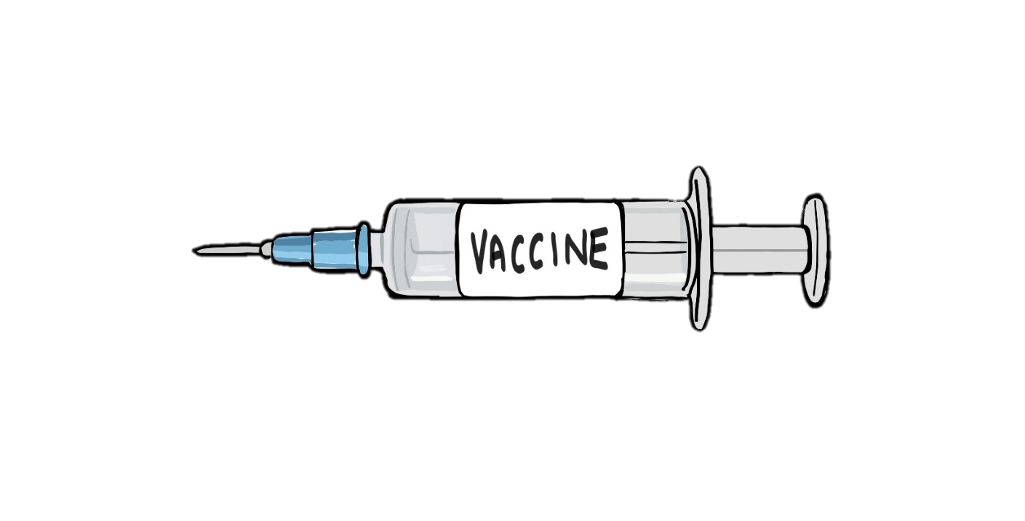

Is the vaccination safe?
Yes. The vaccine is very safe!
HPV is a virus and stands for:
Human
Papilloma
Virus
It has been tested thoroughly before being given to humans.
Millions of doses have been given to people worldwide since the vaccine was introduced in 2008.
Notes:
Key Words: HPV, Human Papilloma Virus
Reiterate its safety.
LO: I understand that vaccines are medications that are tested and safe to be given, like all medications are tested.

Slide 26

Read the statement & choose the correct answer:
HPV stands for...
Human Papilloma Virus
Human Paloma Virus
Human Papilloma Vaccine
Notes:
Key Words: Human Papilloma Virus, HPV
Ask students to put hands up for each answer, then reveal on click.

Slide 27
Read the statement & choose the correct answer:
The HPV vaccine is tested thoroughly before its given to us.
No
Only on some people
Yes
Notes:
Key Words: HPV, vaccine, vaccination
Ask students to put hands up for each answer, then reveal on click.

Slide 28
Read the statement & choose the correct answer:
Getting the HPV vaccine will only protect me from getting genital warts.
Maybe...
No
Yes
Notes:
Key Words: HPV, warts, cancer
Ask students to put hands up for each answer, then reveal on click.

Slide 29
Read the statement & choose the correct answer:
Having the HPV vaccine will protect me from all infections related to sexual contact.
Yes
No, only from human papilloma virus
No, none
Notes:
Key Words: HPV, vaccine, STI/STD, Human Papilloma Virus
Ask students to put hands up for each answer, then reveal on click.

Slide 30
Read the statement & choose the correct answer:
Condoms are all I need to protect me from getting HPV.
Yes
No, I just need the HPV vaccine
No, I need condoms and the HPV vaccine
Notes:
Key Words: condoms, HPV, barrier method/protection, vaccine
Ask students to put hands up for each answer, then reveal on click.
LO: I know what effective barrier methods for sexual activity are.

Slide 31
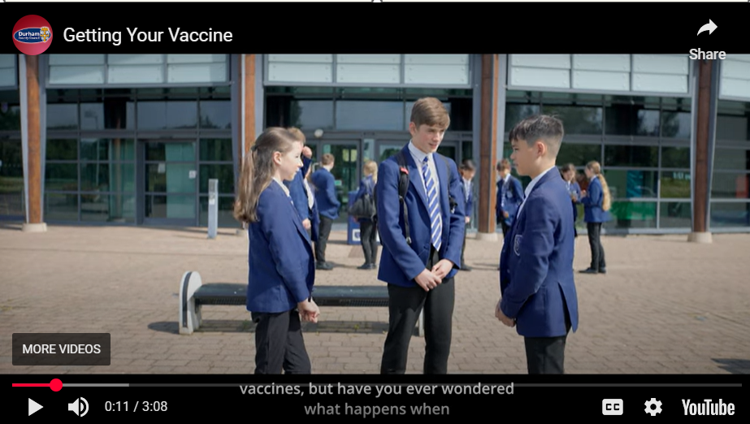
Getting the vaccine
Notes:
Key Words: walkthrough, side effects(?), misinformation(?)
Explain that this was filmed up the road in Kings Academy, so this is going to very similar to your experience.
TRIGGER WARNING – the girl is going to get the vaccine in the video, so if you are a bit scared of needles, then feel free to look away.
LO: I can identify misinformation that was online or on social media in relation to vaccines and how that links to my physical health.

Slide 32
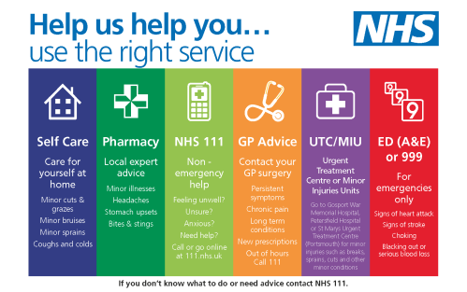
Getting medical help:
Notes:
Key Words: side effects, advice
Make sure that students understand the difference between common side effects, which are normal for most people, but if they continue to feel unwell, then they must seek medical advice from the appropriate service.
Elicit from the pupils – the image will come in on click, but give pupils some time to come up with answers themselves (much more likely to remember this way if they have to recall the info)
GP
Dr
NHS 111
Emergency Services – 999
Pharmacies
Trusted adult at home (parent, carer, grandparent)
Trusted adult at school (teacher, teaching assistant, School Nurse)
LO: I know how to access the right services when I need medical help. I know when I need to contact health services.

Slide 33

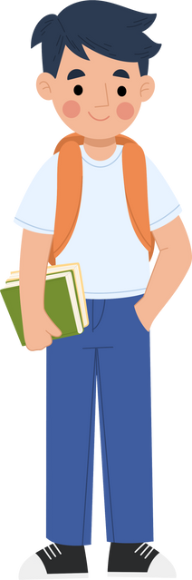
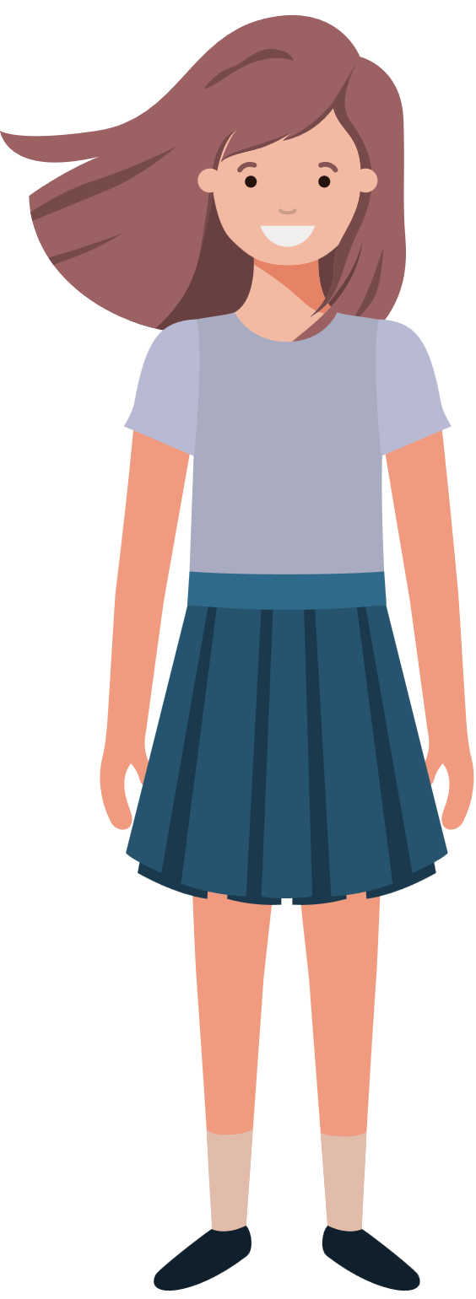
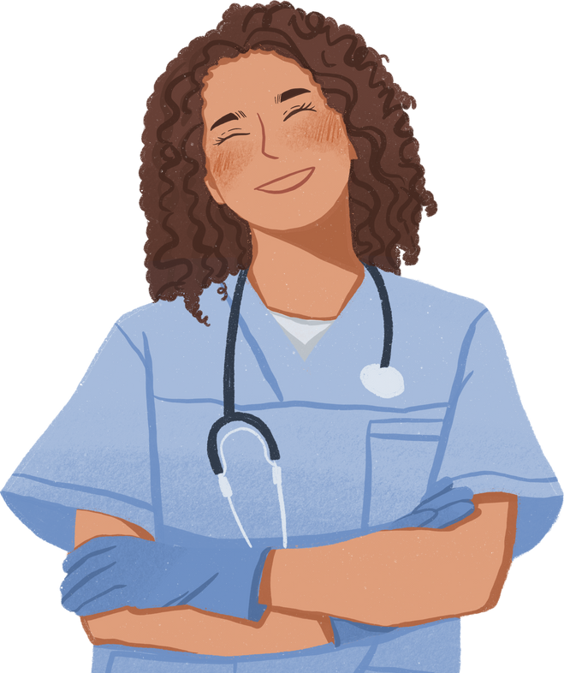
Getting the vaccine
Vaccines are specific to different diseases, so you need to get them all to be as protected as possible.
The vaccine is usually given to boys and girls between 13 and 15, in year 9.​
A nurse will come to your school to give you the vaccine, or you can attend a catch-up clinic.​
Notes:
Key Words: vaccine, vaccination, nurse, catch-up clinic

Slide 34


Giving consent
Your school will send the online consent link to your parents/carers
The form can be filled out online, remind your parents/carers to check their school emails/texts or app
It only takes a minute to complete, so please remind your parent/carer to
complete it
Notes:
Key Words: consent, eligible,
Explain that it is necessary that your parents and carers consent, where possible, for you to have the vaccination in advance of vaccination day, so that we can be sure you’ll be asked to go along and get it
Explain how it’s done in their school – find out in advance

Slide 35
Giving consent
If your parent or carer doesn’t agree to the vaccine or forgets to complete the consent form, you can still choose to have it if you understand what it’s for. Talking openly with your family is a good idea, but the final choice can be yours.
You can consent for yourself and make your own medical decisions if you understand:
What the decision is about
The risks and benefits
How it affects you
The nurse will check this to see if you can decide without a parent. You might hear this called ‘Gillick Competence’.
Notes:
Key Words: consent, (Gillick) competence
Explain that it is possible to give consent for yourself, if they meet the criteria
However, reiterate that it is best/better, where possible, to have these conversations with parent, carer or guardian.
Remind them that they won’t ever be forced to have the vaccine if they really don’t want it, but if they’re not sure it can be a good ideas to consent anyway, as this will give them the opportunity to talk it through the nurse themselves, and ask any questions they may have.
LO: I understand it's my responsibility to look after my own health and vaccines are an important way to maintain physical health

Slide 36
Video in separate attachment
Notes:
Key Words:
Watch this video to leave lasting positive impressions.

Slide 37
How much do you know about vaccines now?
This is not a test!
Space to leave any comments
Space to ask any questions
Notes:
Ask students to complete the post-session survey
Explain that this is an opportunity to show how much they have learned about vaccines this lesson.
NOTES: For sessions being run by teachers in school, the surveys may not be required.

Slide 38
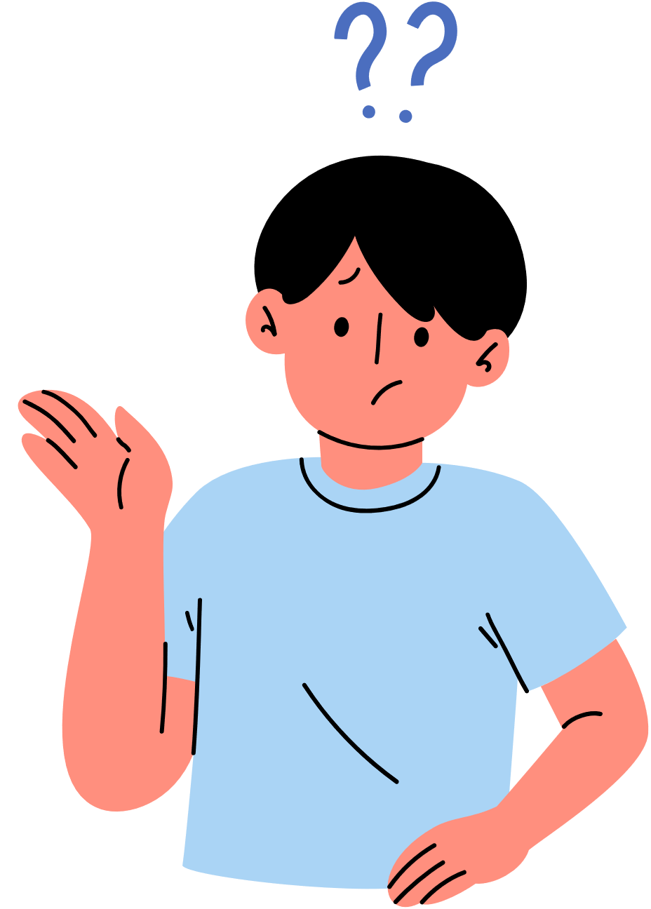
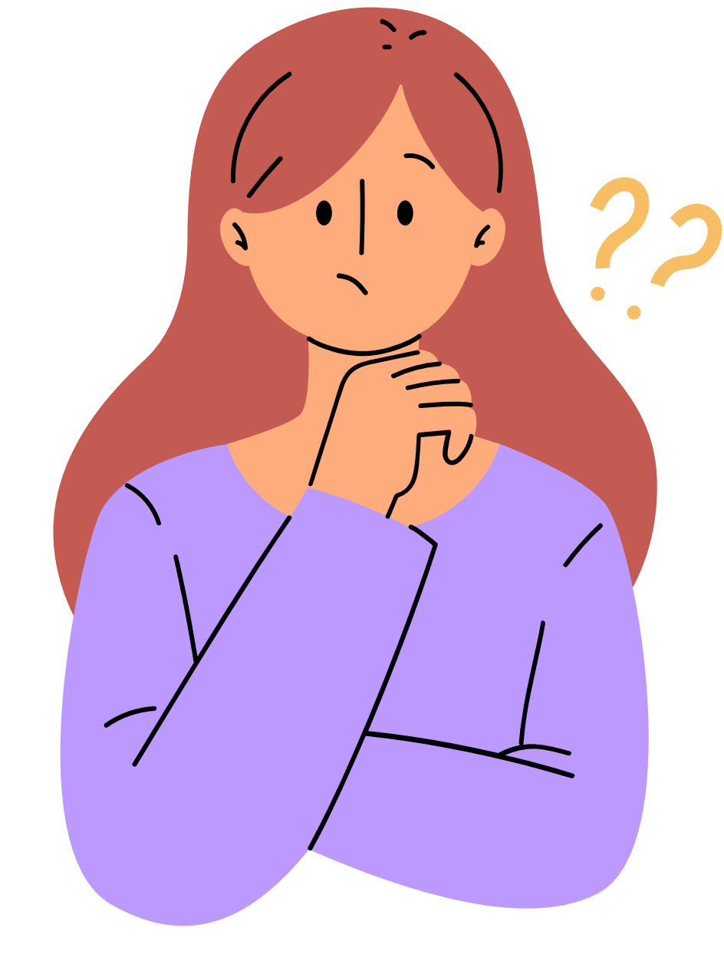
Are there any questions?
You can ask us at the end...
You can make a note and leave it on your desk...
If we don’t know the answer, we’ll find out and let your teacher know...
Notes:
Ask if pupils have any questions, remind them that they can also leave and questions/comments in the last section on their survey and we’ll do our best to get the answers back to then anonymously.
Extra task if needed to fill time/final check of understanding:
Get students to write down one question each on their whiteboards. It can be about anything we’ve learned so far this lesson.
Ask for volunteers to ask their question to the class
Ask for hands up to answer it - person who answers, then asks their question to the class, and so on and so forth.
Continue until bell goes/all are stood up behind chairs.

Slide 39

If you would like to know more about the HPV vaccine...
Go to the NHS website at the following link:​
​
https://www.nhs.uk/vaccinations/hpv-vaccine/
Notes:
Key Words: NHS, trusted sources, misinformation
Remind students that it’s important to use trusted sources to ensure you are getting accurate and up to date information.
Include BBC bitesize, charity websites, WHO
LO: I can identify misinformation that was online or on social media in relation to vaccines and how that links to my physical health.

Slide 40
Thanks for listening!

Slide 41
HPV doesn’t usually have any symptoms
There are over 200 different types of HPV virus
Both boys and girls can get HPV
HPV can cause painless growths or lumps around your genital area; these are known as genital warts
Notes:
Resource slide to print

Slide 42
HPV can cause cancers of the mouth, throat and/or genital area​
Cervical cancer rates were reduced by almost 90% in women in their 20s in England, who had the HPV vaccine aged 12-13
To get the HPV vaccine privately, costs can start from around £185
Without a vaccination programme,
4 in 5 people will be infected with HPV over their lifetime
Notes:
Resource slide to print

