Slide 1
Winter vaccines communications plan
Eligible public
Front Line Health and Social Care Workers
June 2026
Notes:
Standard title slide

Slide 2
Eligible public communications plan
Notes:
Standard title slide

Slide 3
Roles and responsibilities
The flu vaccine campaign is delivered through the tripartite, which includes NHSE, UKHSA and DHSC. Each organisation’s roles work towards a single coordinated and insight based communications and marketing approach and we meet regularly to ensure we are fully aligned and using our channels to amplify reach.
DHSC: Deliver the paid for marketing campaign for flu, focusing on pregnant women, parents of children and those aged 16-65 with long term health conditions. This will be informed by UKHSA and NHSE insight. The campaign will involve a new creative that is aligned to all vaccine marketing activity planned for the financial year.
UKHSA: Supplement the DHSC marketing campaign through low/no cost and stakeholder activity that aims to increase awareness of disease risk, knowledge of eligibility and how to access vaccines and maintain confidence
NHSE: Responsible for operational communications activity – including anything related to delivery/access innovations and key uptake statistics as well as supporting UKHSA’s low/no cost activity and amplifying DHSC’s paid for marketing campaign through NHS channels and providers. Also responsible for delivering the staff vaccination campaign.

Slide 4

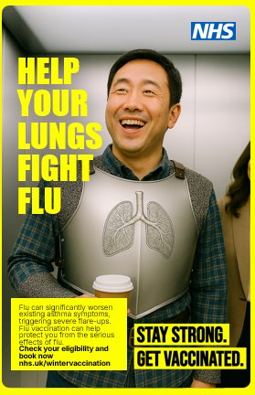
Paid for marketing activity – DHSC led
We still do not have the media plan or timings from DHSC marketing team who are responsible for the paid for section of the campaign. All we know is that the creative will be the same as last year with a similar approach which will focus on:
  At risk adults (flu specific)
  Maternal (flu as part of wider vaccine messaging)
  Childhood (flu as part of wider vaccine messaging)
  Diverse publications & media channels (flu as part of wider vaccine messaging)
And will include:
  TV advert across live TV, streaming platforms and on demand services
  Out of home advertising in regions with low vaccine take up
  National radio and podcast advertising
  Boosted content on social media channels
  Mainstream media paid for advertorials
  Multicultural media, weighted towards black and ethnic minority communities with lowest vaccine uptake
  Work with websites, apps and brands who are aimed at our key cohorts so that we can reach them
  Social influencers, who will produce a wide range of creative content supporting the campaign messages.

Slide 5
Organic communications activity – eligible public
This season we will:
Hold a kick off call in collaboration with UKHSA with communications colleagues working in providers/relevant external organisations to give them an overview of the campaign approach in August
Deliver consistent drumbeat of public media moments and around data and operational milestones
Create stakeholder messaging toolkit including resources and work with representative bodies, patient organisations, 3rd and voluntary sector organisations and others to support engagement and share messages
- particularly with a focus on homelessness and expanded pharmacy offer – and offering to co-create content where requested.
Keep key stakeholders updated and provide relevant information by attending regular forums such as the Royal Colleges Communications and Presidents call and regular email reminders of developments in the campaign
Create bespoke organic resources that complement the paid for marketing campaign. Our focus will be on assets for:
  the new childhood vaccine offer (focusing on 2-3s in September, the community pharmacy offer for 2-3 year olds and at risk children in October and the expansion of the community offer to all school aged children in December), newly eligible cohort of those experiencing homelessness, older adults (to include wider vaccine messaging), general eligibility and translated content, school aged flu consent assets (fulfilled as part of childhood vax brief, not winter vaccines)
  Send over 50 million invitations and reminders over the course of the campaign
Co-create and disseminate a stakeholder toolkit with UKHSA incl. scripts, key messages and social copy
Film clinical spokespeople (including CMO) on importance of getting the flu vaccine
Case studies ready for filming via regional colleagues (e.g. nurseries/ vaccine buses/ new pharmacy offer) and offered to broadcast
Work with our social media team to get messaging on winter vaccination through the GOV.UK WhatsApp channel, TikTok and regular corporate social channels
Equalities team will provide content tailored for specific communities and channels including: winter community newsletter, Affinity Xtra podcasts, radio content, editorials, videos, featuring trusted clinical voices, translated and easy read posters and leaflets, translated symptom flyer and explainer on child vaccine porcine content
Contribute to the ‘Stay Well this Winter’ leaflet that will go to all households of over 65s alongside winter fuel payment letters (over 2 million letters)
Update NHS.UK regularly to reflect current offer – particularly signposting local activity
Regularly update on campaign through relevant bulletins including major communications to the system, such as the 3 year ambitions letter
Notes:
2025/26 we created 212 pieces of national coverage in national titles

Slide 6
Winter / Flu assets for eligible public
NHSE:
Older adults (flu & COVID-19 & RSV)
  Digital screens (9:16 & 16:9)
  Posters (A4, A3 & empty belly)
  Social media (1:1, 16:9 & 9:16)
  General eligibility for older adult vaccines poster (shingles, pneumo, RSV, flu, COVID)
School aged flu consent assets (to be ready by August for September start)
  Digital screens (9:16 & 16:9)
  Posters (A4 & A3)
  Social media (1:1, 16:9 & 9:16)
Community Pharmacy expansion
Translated resources (Hindi, Gujarati, Urdu, Romanian, Polish, Bengali, Pashto, Dari, Albanian, Somali) in A4 & 16:9:
  Winter vaccine eligibility
  Maternal vaccines (flu, RSV, pertussis)
  Childhood
  Older adults (flu, RSV & COVID)
  At-risk
  HCW
Flu and Pneumococcal Homeless people/people living in housing shelters (working with Shelter)
At risk children
UKHSA:
Flu checklist
Flu & COVID eligibility – including fact sheet, digital screen, posters and social media
Additional translated languages/resources (Hindi, Gujarati, Urdu, Romanian, Polish, Bengali, Pashto, Dari, Albanian, Somali
  2-3 year olds & Children’s school aged flu
  Homeless people/people living in housing shelters (NEW) Nicole & UKHSA work together
  Community Pharmacy expansion
Easy reads
  Top 3 (TBC)
DHSC:
Refresh marketing assets where needed, including digital screens, posters, social media for the cohorts below -
Pregnancy (flu, RSV, pertussis)
LTHC (flu, COVID-19)
2-3 year olds & Children’s school aged flu (to be ready by August for September start)
Adolescent/routine imms. CHIMMS as per last year. Adolescent to be developed for launch in Jan.

Slide 7
Key deliverables and milestones – eligible public comms plan | July | Aug | Sept | Oct | Nov | Dec | Jan | Feb | March
Kick off call with communicators in the health system | Late July
Stakeholder toolkit and assets launched (to include homelessness and pharmacy expansion) |  | Early Aug
NBS opens for: - pregnant people to book an appointment from 1 September - over 65s, at risk adults, at risk children and children aged 2-3 years old to book an appointment from 1 October |  | 17-Aug
Press release, social and stakeholder content on opening of NBS earlier than ever |  | 17-Aug
Press release, social and stakeholder content on first vaccines being given to pregnant women and 2-3 year olds in GP surgeries. Broadcast piece to feature a child that was unwell with flu and video of children getting vaccinated. Trail that invitations will be coming to parents imminently |  | 01-Sep
Call/recall starts (letters, texts, emails) for 2-3 year olds |  |  | Late Sept
Press release, social and stakeholder content on first appointments for older adults, at risk adults and children and first NBS pharmacy appointments for 2-3 year olds. Trail upcoming invitation campaign |  |  | 01-Oct
Flu vaccination event in Westminster |  |  | 15-Oct
Call/recall starts for all other eligible cohorts |  |  |  | October to December
NBS opens for: - school aged catch up to book an appointment from 1 December |  |  |  |  | 30-Nov
Stay Well this Winter leaflet delivered to 2 million households |  |  |  |  | Nov
Press release, social and stakeholder content on children coming forward to community pharmacies to get their vaccine |  |  |  |  | 30-Nov or 01-Dec
Xmas/NY vaccine countdown drive |  |  |  |  | Late Nov/early Dec - month to go
Data/operational comms opportunities |  |  | Throughout the season with timing and content dependent on what the uptake/hospital data shows
Social media via NHS and partners channels to include case studies and clinical spokespeople |  | Always on' social media' throughout the season nationally, regionally and locally
Continue to keep stakeholders updated and engaged through regular touchpoints such as Royal Colleges call |  | Throughout the season
Diverse audience outreach thorugh community update letters, podcast interviews, radio interviews and translated materials |  | Throughout the season

Slide 8
Frontline health and social care workers communications plan
Notes:
Standard title slide

Slide 9
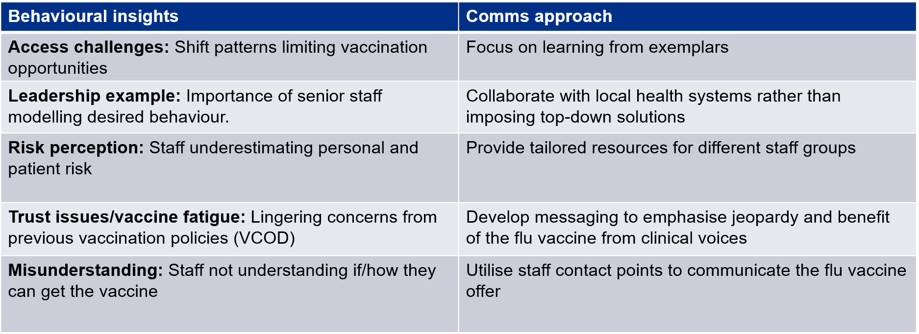
Communications approach
Build on the success of last year which saw:
Uptake of staff improved by an average of 7% compared to 2024/25 which exceeded the 5% target that was set at the startof the campaign. 47.7% of frontline healthcare workers were vaccinated this year, compared to 40.4% last year ​
Over 75,000 more staff were vaccinated this year, offering onward protection to their patients and colleagues​
Seven Trusts managed to improve their uptake compared to last year by over 20%, with the most improved Trust improvingby 48%​

Slide 10
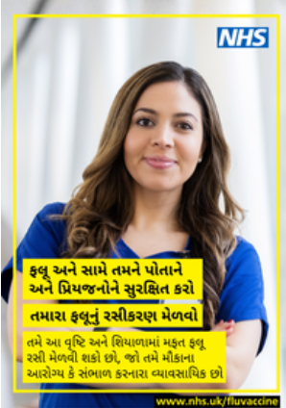


Organic communications activity - staff
This season we will:
Update the operational top tips and communications checklist through consultation with regional senior leaders
Frontline HCW system letter encouraging staff uptake and explaining new targets - signed by CMO/CNO/Medical Director/C-Mid-O/etc
Share learning from exemplar trusts by sharing best practice through ongoing Bitesize sessions throughout the campaign featuring highest uptake/most improved Trusts (first meeting scheduled for 17 July)
Hold a kick off call with Trust colleagues talking through national assets and approach in August
Take new staff photography for FHCW including low uptake staff groups (to include porters, students, staff in hijabs/kippahs)
Update the communications toolkit to include updated messaging and assets (195 items in total including stickers, adaptable assets and scripts), to include translations in the top 10 languages used by staff to be ready by the end of August for Trusts to use.
Cover DHSC's social care brief to create and disseminate assets to social care providers
Include messaging on staff payslips and ESR, regular NHSE bulletin staff vaccine content (Primary Care, Nursing and Midwifery, UEC – seasonal launch and regularly flagging profession uptake) and shared via staff networks
Gain external stakeholder support via Social Partnership Forum and regular call with the Royal Colleges including updates/articles from national leaders
Collaborate with NHSE social media colleagues to create an organic ‘show and tell’ content schedule, profiling well performing Trusts and senior leaders getting their vaccines in a clinical setting on LinkedIn and corporate channels
Continue to profile the best performing Trusts in The Week each week to publicly praise well performing Trusts
Check the weekly uptake data to adapt plans/ focus based on staff vaccine uptake with potential for some good news media stories
Draft and share flu HCW leadership script for ongoing system webinars and meetings
Social media videos from CMO/CNO/MD/CMidO – self filmed talking heads shared on their own forums and amplified by national channels. We provide key points and filming tips. DHSC to film CMO.
Notes:
Bitesize sessions held in 2025/26 had over 500 NHS Comms professionals attending with a chance to ask questions.
The most popular items downloaded are the toolkit, posters, leaflets and stickers – followed by social care worker posters
Internally we sent a vaccine reminder on over 400,000 NHSE employee pay cheques, used ESR to display vaccine reminder and included in regular bulletins.

Slide 11
Winter / Flu assets for frontline HSCWs
NHS Staff and Care Campaign Assets (over 180 items)
Toolkit
A5 Leaflet
Posters
Empty belly posters
Social media assets
Digital Screens
Email signatures
Sticker sheet
Translated healthcare posters
Editable files in PowerPoint and Canva (for Trusts to add in photography of own staff)

Slide 12
Key deliverables and milestones – staff flu campaign comms plan | June | July | Aug | Sept | Oct | Nov | Dec | Jan | Feb | March
Frontline HCW system letter encouraging staff uptake and explaining new targets - signed by CMO/CNO/Medical Director/C-Mid-O/etc |  | July
Staff Vaccination Campaign 2026 Preparations webinar - Best practice webinar with presentation on best performing trusts to support communications planning |  | 09-Jul
Launch toolkit: includes +100 staff facing assets for Trusts (across range of staff groups), messaging document for key leaders, an operational and communications top tips list (co-created with senior leaders) and translations |  |  | Early Aug
Communicating Staff Vaccination Campaign - Kick off webinar running through toolkit and comms checklist with further best practce shared |  |  |  | 10-Sep
Staff vaccinations begin |  |  |  |  | 01-Oct
Continue to profile the best performing Trusts in The Week each week to publicly praise well performing Trusts​ |  |  |  |  | Throughout campaign
Ongoing NHS comms leaders Bitesize sessions to share in season learning and best practice |  |  |  |  | Throughout campaign
Social media videos from CMO/CNO/MD/CMidO – self filmed talking heads shared on their own forums and amplified by national channels. We provide key points and filming tips. DHSC to film CMO. |  |  |  |  | Throughout campaign
Gain external stakeholder support via Social Partnership Forum and regular call with the Royal Colleges including updates/articles from national leaders ​ |  |  |  |  | Throughout campaign
Check the weekly uptake data to adapt plans/ focus based on staff vaccine uptake with potential for some good news media stories ​ |  |  |  |  | Throughout campaign

