Slide 1
Walking & Wheeling Action Plan
London Healthy Places Network
Elsa Robinson – GLA group Public Health Unit
Friday 4 June

Slide 2
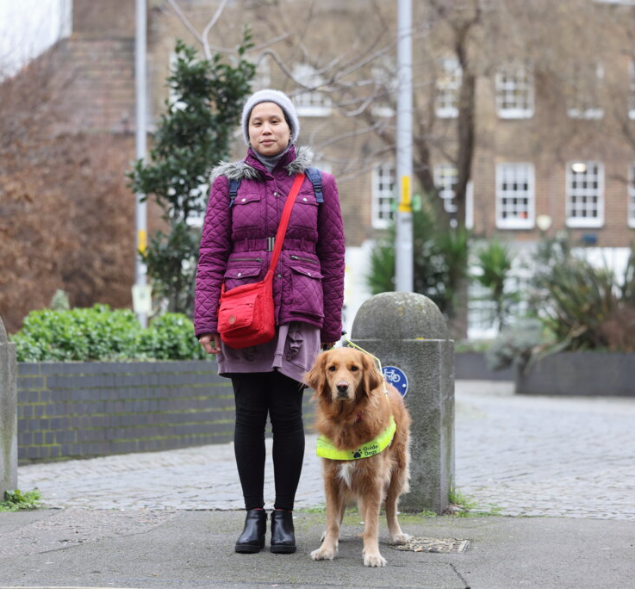
Walking to achieve the Mayor’s Transport Strategy
A key objective of the Mayors Transport strategy is for 80% of all trips in London to be taken by walking, wheeling, cycling, or public transport by 2041.
Every public transport journey involves walking or wheeling
The Walking Action Plan was published in 2018 to help achieve the Mayor's Transport Strategy.
Notes:
Maryam
Active travel, especially walking and wheeling, is critical in helping us to achieve the Mayor's ambition that by 2041, 80% of all journeys will be made by walking, wheeling, cycling or public transport.
This is because every transport journey involves walking or wheeling – whether that's the whole journey or getting from your doorstep to a stop or station.
This is why it's important we have a plan for walking and wheeling, so that we can set ambitious actions to help us achieve the Mayor’s Transport Strategy and improve walking and wheeling in London.

Slide 3

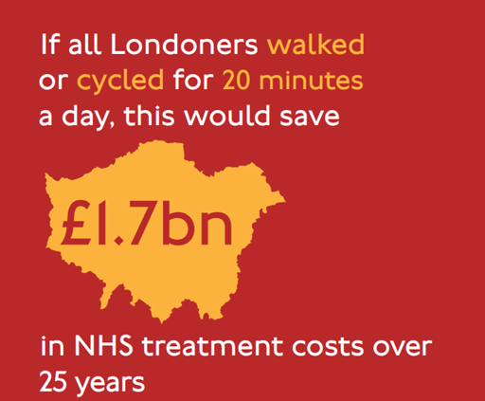
Supporting the shift from sickness to prevention
Improving walking infrastructure and increasing walking levels can:
Improve air quality
Reduce road danger
Improve physical and mental health

Slide 4
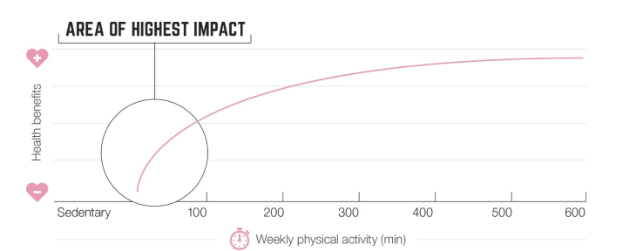
Helping inactive people to do some activity has the greatest impact
Reference: UK Chief Medical Officers' Physical Activity Guidelines. 2019.
Notes:
Regular physical activity helps to prevent and manage over 20 chronic conditions and diseases, including some cancers, heart disease, type 2 diabetes and depression
The benefits from increased physical activity are especially significant for those currently inactive (less than 30 minutes per week)
Walking or wheeling for daily travel is often the easiest way to get physically active, for those who are currently inactive

Slide 5
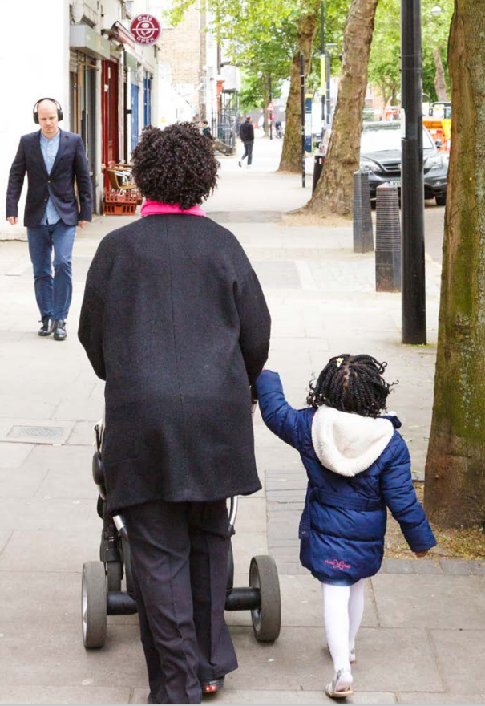
New Walking and Wheeling Action Plan
The original 2018 Plan set out objectives and actions to improve walking and wheeling
The new Plan will be called the Walking and Wheeling Action Plan (WWAP)
Wheeling: the use of pushchairs (buggies), kick-scooters, wheelchairs, mobility scooters, and other wheeled mobility/carrying aids
It has been developed to work alongside other policies including Vision Zero Action Plan 2 and Cycling Action Plan 2
Boroughs will help to deliver the actions as they manage 95 per cent of London's roads
Notes:
TfL developed the first Walking Action Plan in 2018 to set out objectives and actions to help improve and increase the number of people walking and wheeling in London.
Because of the change in Londoner’s walking/wheeling habits, the delivery of most of the actions, and the refreshing of Vision Zero, it’s time to update the Walking Action Plan and explore new ways to meet Londoner's evolving needs.
The refreshed plan will include ‘Wheeling’ in the title, so it will be known as the Walking and Wheeling Action Plan. As a reminder, wheeling encompasses the use of pushchairs (buggies), kick-scooters, wheelchairs, mobility scooters, and other wheeled mobility or carrying aids.
The Plan will work alongside other policies including Vision Zero Action Plan 2 and Cycling Action Plan 2. It's important to note the Plan does not include cycling, which is covered in the cycling action plan, but they do work alongside each other to deliver improvements for active travel.
Actions relating to road safety are included in the Vision Zero Action Plan. TfL is currently getting ready to publish the next iteration of the Vision Zero Action Plan.
Please keep in mind that the Plan is affected by finite funding and limited resources, so we are doing our best to develop actions that can be implemented by boroughs, who control 95% of London’s roads.

Slide 6
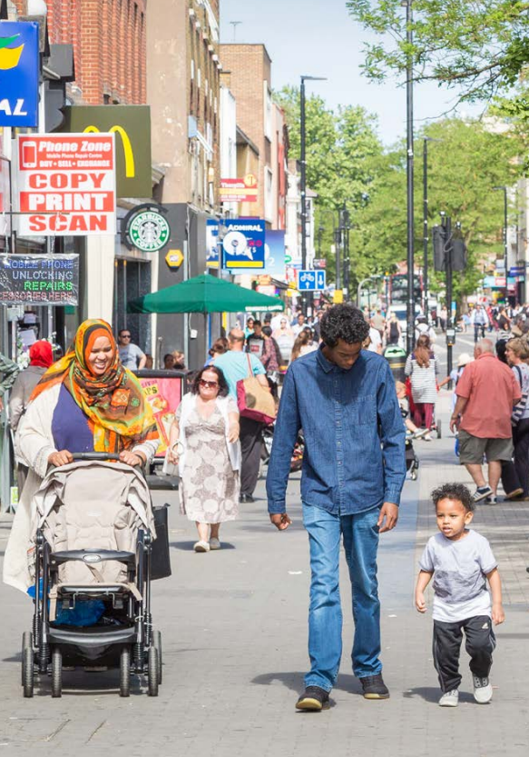
The objectives
TfL DRAFT - RESTRICTED
The new Plan builds on the approach and actions we set out in the first plan and identifies challenges/ opportunities we face now and in the future.
The Plan aims to achieve the following objectives:
  Promote health and wellbeing
  Support high streets to thrive and enable economic growth
  Enable the benefits of walking and wheeling to be enjoyed more equally
We have worked closely with our GLA Public Health colleagues to ensure health and wellbeing are effectively centred in the plan.
Notes:
The new plan will focus on meeting the following objectives:
Promoting health & wellbeing,
Driving high streets & wider economic growth, and
Ensuring the benefits of walking and wheeling are enjoyed more equally.
These objectives underpin all of the work we have done so far including drafting focus areas, actions and deliverables.

Slide 7
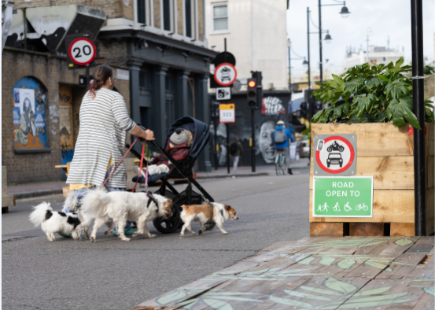
Engagement with stakeholders
TfL DRAFT - RESTRICTED
We met with different organisations to learn about their experiences of walking and wheeling in London.
Groups engaged with include:
Borough Transport & Public Health officers
TfL's Youth Panel
Accessibility groups
London TravelWatch and active travel groups
Business stakeholders
NHS
Have Your Say survey sent to walking and cycling grant recipients
London Physical Activity for Health Strategic Advisory Group
Notes:
We have been engaging with a range of stakeholders to find out about the barriers people face when walking and wheeling in London, and what further action could be taken to encourage Londoners to walk and wheel more.
We have with boroughs to understand their priorities and how we can support them in delivering meaningful change in your communities.
We have run two borough workshops –
The October 2025 workshop set out the context for walking in London, and held space for discussion around opportunities and barriers for increasing walking trips, how walking factored into wider priorities beyond transport, and what actions boroughs would like to see in a London-wide plan to support/address walking.
Following the workshop we also launched a digital survey – the first time we trialled something like this – where we had an open call for evidence from boroughs
The January 2026 workshop shared the draft areas for action we had developed following the initial rounds of engagement, asked for feedback and to highlight if anything was missing.

Slide 8
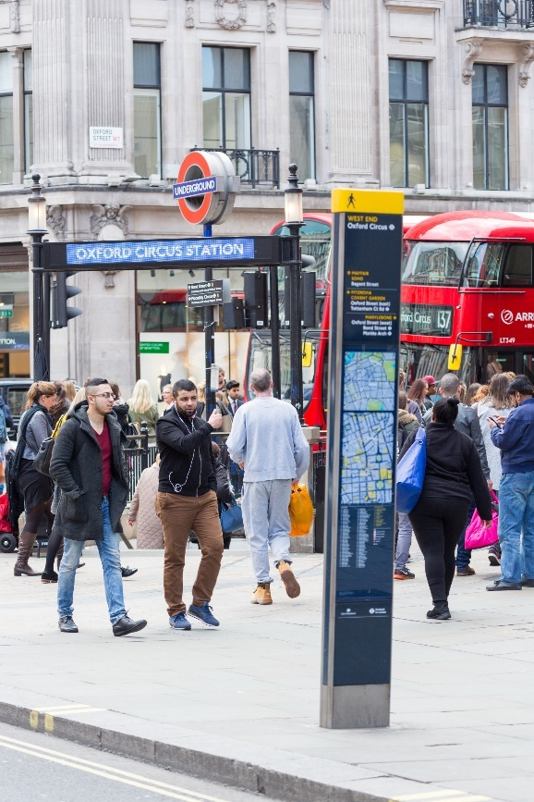
Shaping the refresh
TfL DRAFT - RESTRICTED
Key focus areas that emerged:
Hostile pedestrian environments: infrastructure quality, street clutter - dockless e-bikes, signs, A-boards, commercial waste
Safety: cyclist behaviour, walking at night, accessibility, motor traffic
Whole journey challenges: time constraints, convenience, distance, facilities
School run: safety of walking to school, parental time constraints
Health: potential for health system collaboration
Wayfinding
Education/behaviour change
Notes:
Several common themes emerged from our engagement, with two coming through strongly:
The first is the need to address hostile pedestrian environments which includes things like poor infrastructure and street clutter caused by dockless e-bikes, signage and waste.
And the second is the need to address things that cause pedestrians to feel unsafe preventing them from walking or wheeling including walking and wheeling at night, accessibility, cyclist behaviour and motor traffic.
We also heard about whole journey challenges, concerns about the school run, ideas on how to collaborate with the NHS, and suggestions on how to improve wayfinding and implement education and behaviour change initiatives.

Slide 9
Actions and deliverables overview
TfL DRAFT - RESTRICTED
Notes:
Winsome

Slide 10
WWAP Themes
TfL DRAFT - RESTRICTED
A series of actions attributable to each of the themes have been developed and are centred around core principles:
Transforming London’s places and neighbourhoods by making the walking and wheeling environment safer and more attractive
Improving high streets and town centres to create high quality walking and wheeling environments
Reducing severance and improving connectivity
Reducing severance for those wanting to cross the road and improving connections between walking, wheeling and other modes of public transport
Making walking and wheeling more inclusive so that everyone can enjoy the benefits
Removing barriers to walking and wheeling and designing safe and inclusive streets
Getting even more of London’s children and young people walking
Creating behaviour change and promoting walking as the top transport mode for school travel
Enabling walking and wheeling for leisure – connecting green spaces
Creating new pedestrian routes which connect London's waterways and green spaces
Being ready for the future
Providing a series of measures that will improve biodiversity, address climate change adaptation needs and reduce the risk of flooding on London's streets
Notes:
To achieve our three objectives, we’ve created six focus areas that our actions and deliverables will sit under. These build on the approach and actions we set out in the first plan and help us to identify the challenges and opportunities we face now and in the coming decade.
Our six focus areas:
Transforming London’s places and neighbourhoods by making the walking and wheeling environment safer and more attractive
The actions here cover consulting on Oxford Street pedestrianisation, helping boroughs to transform town centres and high streets to support local economies, and supporting boroughs to create projects and schemes that encourage people to walk and wheel more
Improving connectivity
Actions here cover providing safe and convenient crossings,
supporting safer crossings at side roads,
Integrating walking and wheeling and public transport
And making London easier to navigate through clear and efficient wayfinding
Making walking and wheeling more inclusive so that everyone can enjoy the benefits
Actions include embedding inclusive design principles,
removing clutter from footways,
interventions to address concerns for personal safety,
And finally, ensuring streets are well maintained
Getting even more of London’s children and young people walking
We will support boroughs to deliver more school streets, and are considering different programmes and partnerships for school behaviour change initiatives
Walking for leisure – connecting green spaces
We’ll improve walking and wheeling access to green spaces and waterways by creating a route that links several waterways, and highlight leisure walking and wheeling opportunities for local communities
The final focus area is being ready for the future
We will collect and share more data, and ensure our streets are resilient to climate change through shade and SuDS.

Slide 11
Themes 1 and 2
TfL DRAFT - RESTRICTED
1. Transforming London's places and neighbourhoods
2. Reducing severance and improving connectivity
Develop a central London movement strategy
Pedestrianise Oxford Street
Help boroughs to transform town centres and high streets to support local economies. Including piloting timed, safety restrictions in cultural and hospitality districts to support the nighttime economy
Support boroughs to create projects and schemes that encourage people to walk and wheel more
Provide safe and convenient crossings
Support safer crossings at side roads by raising awareness of the Highway Code rules and exploring design interventions, including piloting side road zebra crossings on the TfL road network
Ensure that walking and wheeling integrate with public transport (tube, rail and buses) as part of a whole journey experience
Make London easier to navigate through clear and efficient wayfinding including improved signage and online information
Notes:
In this section, the first focus area we’re looking at is transforming London’s places and neighbourhoods by making the walking and wheeling environment safer and more attractive.
We are looking to address the fact that high streets are struggling economically. People are also tending to walk and wheel less for shopping.
Given that all transport journeys start or finish on foot or by cycle, and half of all walking and wheeling in London is done to or from public transport stations or stops, we asked ourselves: what can we do to increase walking and wheeling to and around high streets?
We have drafted the following key areas for action:
Develop a central London movement strategy – with the focus on creating a more pedestrian-friendly central London.
Oxford Street pedestrianisation, which some of you may be familiar with, and involves delivering interventions to create a unique and attractive space for all.
Helping boroughs to transform town centres and high streets to support local economies. This includes piloting timed, safety restrictions in cultural and hospitality districts to support the nighttime economy.
And, supporting boroughs to create projects and schemes that encourage people to walk and wheel more.
The next focus area is how to improve connectivity. For this, we're looking at how to reduce things that cause a division or disconnect when someone is travelling. For example, when busy roads or railways, or motorised traffic, create a physical or psychological barrier that stop someone travelling.
Stakeholders have told us that hostile pedestrian environments, including street clutter, pavement conditions, and motor traffic, can make some people feel unsafe, stopping them from walking and wheeling.
We have drafted the following key areas for action:
Providing safe and convenient crossings
Supporting safer crossings at side roads, by raising awareness of the Highway Code Rules and exploring design interventions, including piloting side road zebra crossings on the TfL road network.
We are also looking to integrate walking and public transport to provide an attractive whole journey experience. We want to help boroughs to deliver walking infrastructure that complements major tube and rail investment, for example, the Piccadilly Line upgrade and the Step Free Access programme.
And the final area for action is to make London easier to navigate through clear and efficient wayfinding including improved signage and online information.

Slide 12
Themes 3 and 4
TfL DRAFT - RESTRICTED
3. Making walking and wheeling more inclusive
4. Getting more children and young people walking and wheeling
Deliver interventions to address concerns for personal safety when walking/wheeling
Ensure streets are well designed by embedding inclusive design principles through training and guidance
Ensure streets are well maintained and free from clutter, taking steps to improve pavement quality and provide designated parking for rental e-bikes
Address barriers to walking and wheeling, especially for the most inactive
Work with the health system to recommend active travel for physical activity across London.
Make walking and wheeling the first choice for travelling to school by increasing the number of School Streets
Promote walking and wheeling through school behaviour change initiatives
Encourage child-friendly streets by publishing a ‘streets for children’ toolkit
Notes:
The third focus areas is how to make walking and wheeling more inclusive. Inclusivity is considered in all the actions and deliverables we draft, but we also have some specific actions for this area to ensure everyone can enjoy the benefits of walking and wheeling.
Stakeholders have told us they have concerns about personal security, particularly for women and girls, and they identified aspects of streets and public transport interchanges that can create barriers for people walking and wheeling, including disabled people.
The key areas for action are:
Ensuring streets are well designed by embedding inclusive design principles, some of the things we’re exploring are rolling out inclusive design training across TfL and publishing guidance for construction contractors and highway authorities.
Removing clutter from footways, including providing designated parking for rental e-bikes and enforcing against operators for problematic parking.
Addressing barriers to walking and wheeling, especially for the most inactive.
Delivering interventions to address concerns for personal safety when walking and wheeling.
And finally we will ensure streets are well maintained, taking steps to improve pavement quality.
Child obesity rates in London are higher than the national average, and post pandemic, while we saw the biggest increases in walking amongst Londoners over 65, the biggest decreases were those aged 17-24. We are therefore focusing on how we can get even more of London’s children and young people walking.
To help do this, we have drafted the follow key action areas:
We would like to make walking the first choice for travelling to school, and will likely set a target to increase the number of School Streets, and develop a toolkit for routes to school.
Another area for action is to promote walking through school behaviour change initiatives and are considering different programmes and partnerships to do so.

Slide 13
Themes 5 and 6
TfL DRAFT - RESTRICTED
5. Walking and wheeling for leisure - connecting green spaces
6. Being ready for the future
Improve walking/wheeling access to green spaces and waterways including creating a new walking/wheeling route that links several waterways and improving connectivity
Enable boroughs to remove access barriers through LIP funding
Support the London Walking Festival
Ensure London's streets are resilient to climate change by creating suitable shade and drainage
Collect and share the data needed to plan and make the case for walking infrastructure
Relaunch the London Walking Forum to include new representation
Notes:
The fifth focus area is walking for leisure, which includes connecting people to green spaces. Data shows that 29% of Londoners visit natural spaces weekly, but those from lower-income backgrounds (20%) and Black (16%) or Asian (21%) communities are less likely to do so, which we would like to address in the plan.
The key draft areas for action are:
To improve walking access to green spaces and waterways including creating a walking route that links several walkways.
The other area for action is to promote the benefits of walking and nearby leisure walking opportunities to all communities by highlighting nearby routes and encouraging people to walk or wheel more.
The final focus area we have is to be ready for the future. As you know, the climate crisis is increasing heat and unpredictable weather, making temperatures more uncomfortable and increasing flooding, making walking and wheeling less appealing or even dangerous.
To help us prepare for the future, we have drafted two key areas for action:
The first is to collect and share the data needed to plan and evidence why we need certain walking and wheeling infrastructure. We are exploring a number of deliverables in this area, including leveraging modern sources of data collection and improving our understanding of walking in London using a suite of measurements and indicators.
The second is to ensure London’s streets are resilient to climate change – we’re looking at how we can add more shade and sustainable drainage systems.

Slide 14
Actions to note
3. Making walking and wheeling more inclusive
6. Being ready for the future
Work with health system leaders through the London Physical Activity for Health Strategic Advisory Group, run by London Sport, to embed active travel into NHS support for physical activity across London. This includes social prescribing, patient pathways, health and care professional training and other opportunities.
Relaunch the London Walking Forum to include new representation

Slide 15
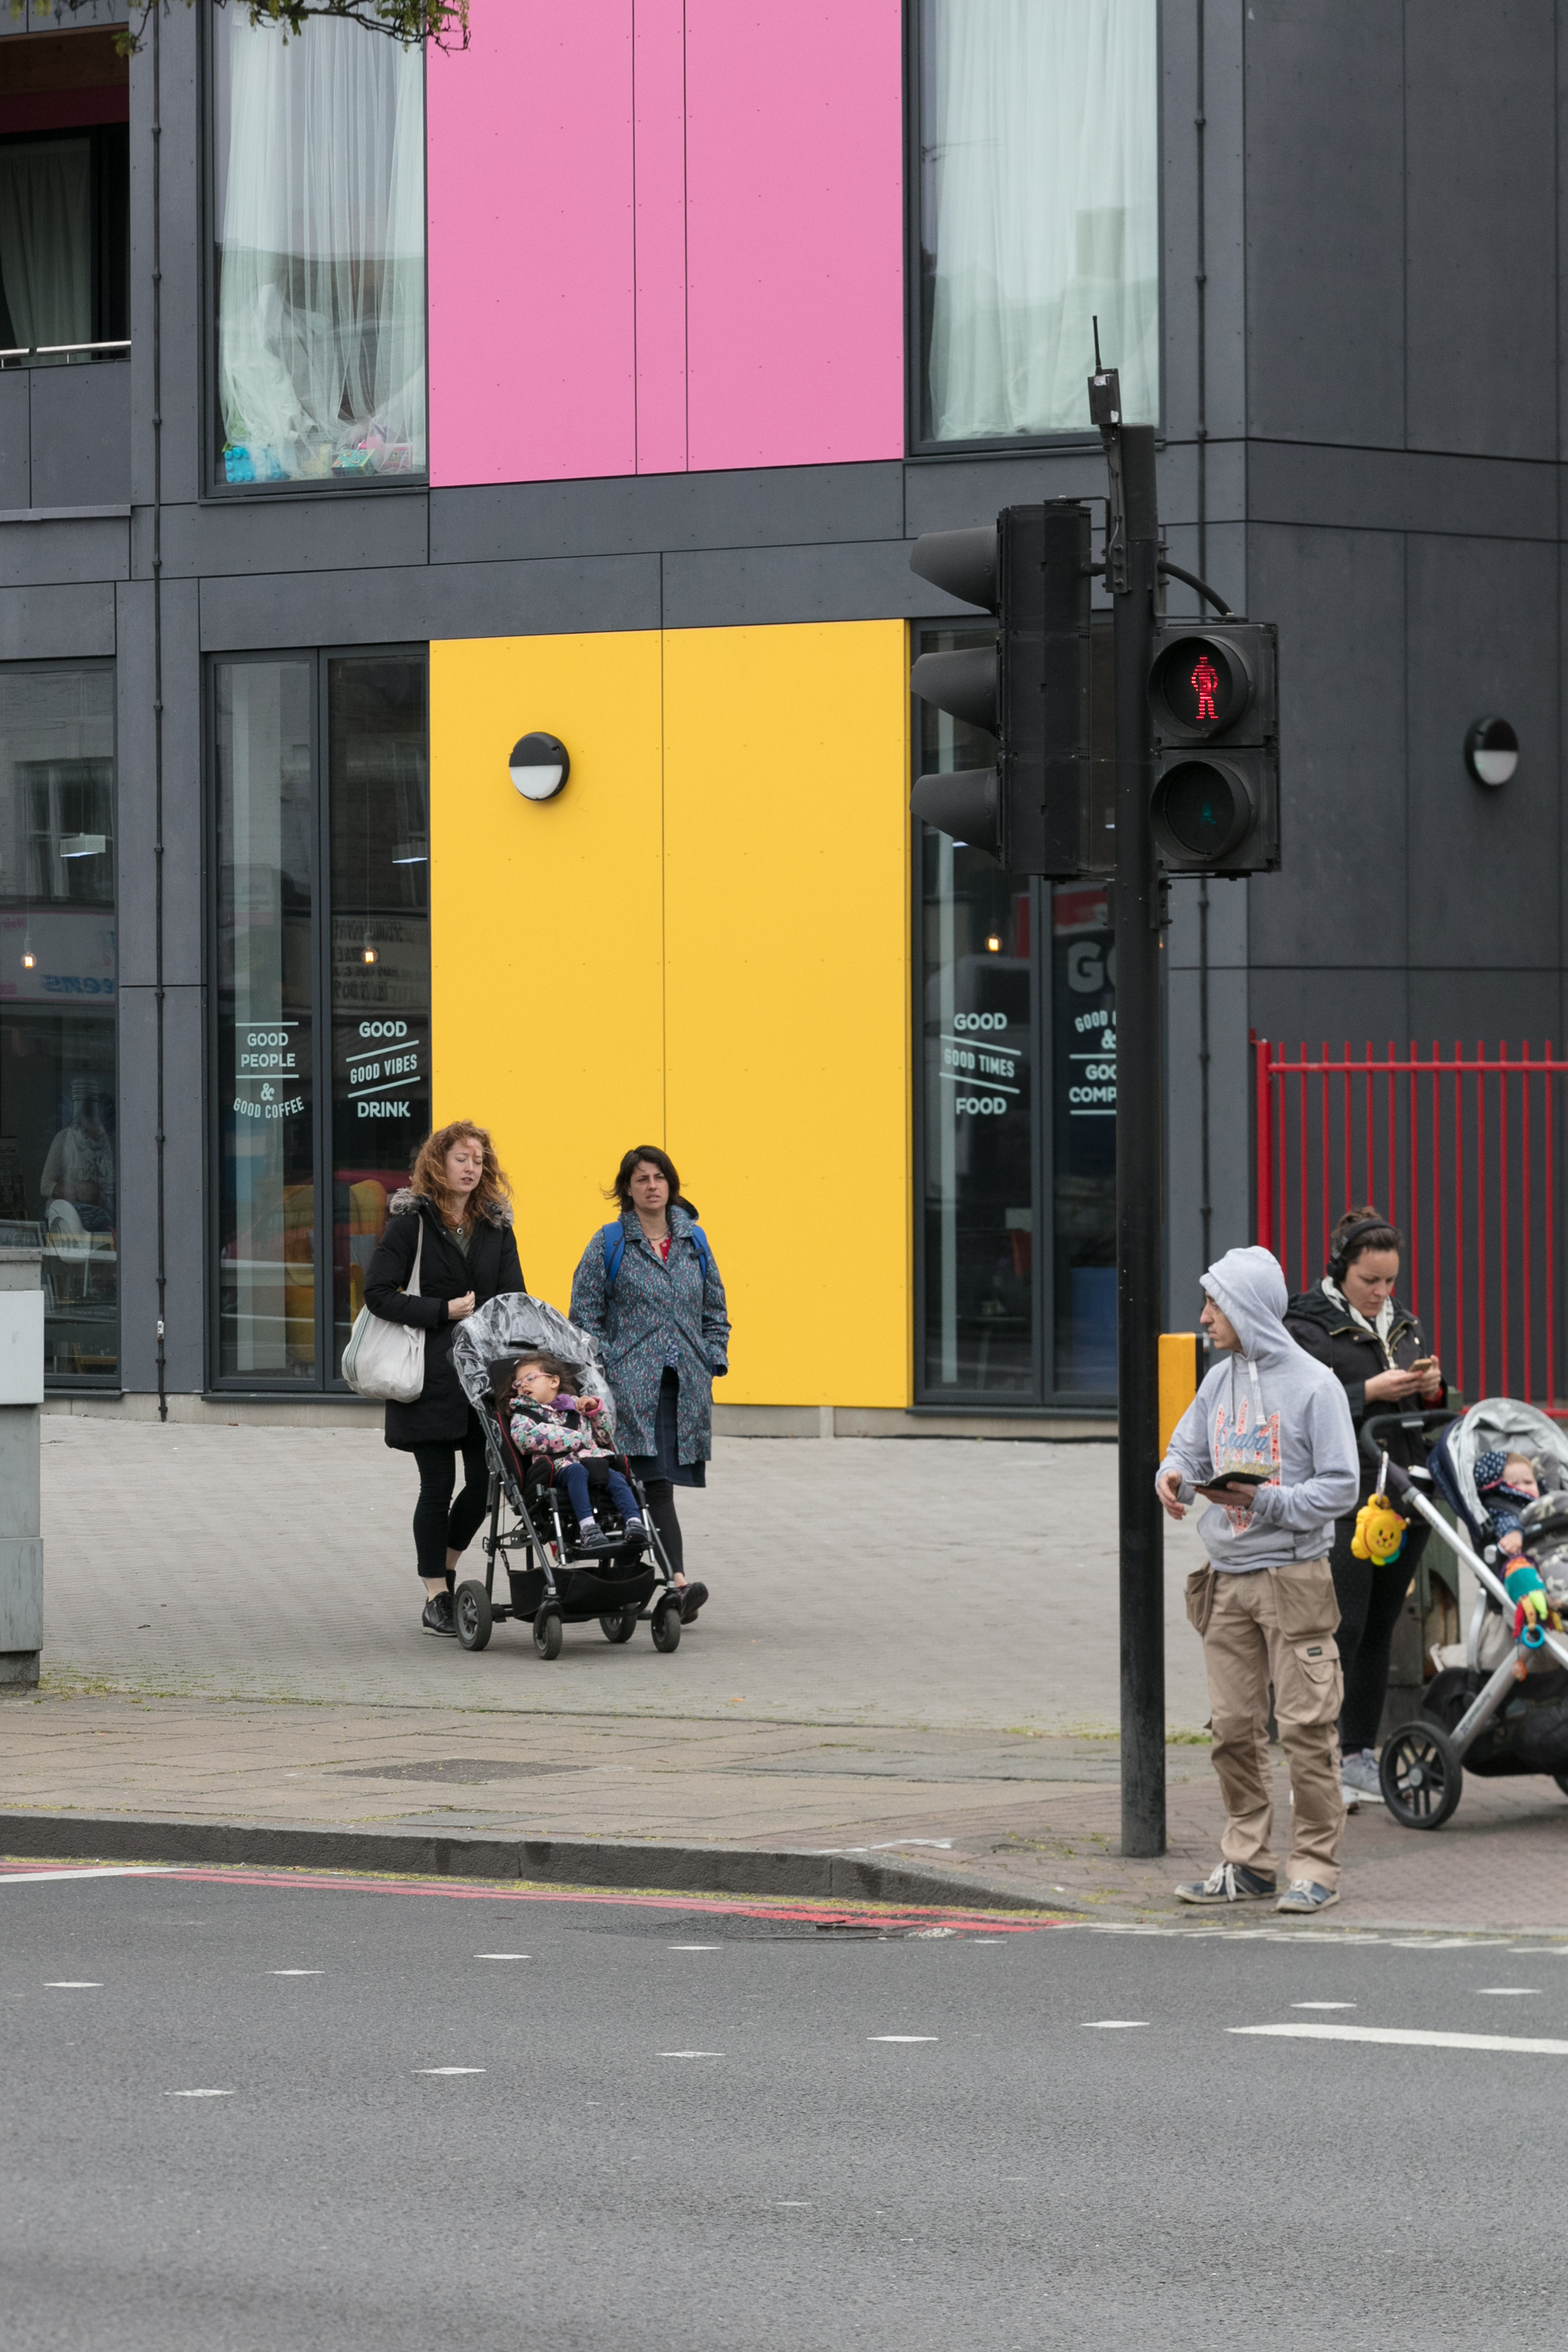
Targets
TfL DRAFT - RESTRICTED
The Plan has three new walking targets that focus on the benefits of walking to the health of all Londoners, and to children in particular:
Increase the proportion of London residents aged 20 or over walking a minimum of 20 minutes per day from 41 per cent in 2024/25 to 50 per cent by 2035/36
Increase the average hourly flow of pedestrians in central London to 10 per cent above pre‑pandemic levels, by 2035
Increase the proportion of journeys to school that are walked by five-10-year-olds, from 63 per cent in 2024/25 to 68 per cent by 2035/36; and by 11‑16‑year‑olds, from 44 per cent in 2024/25 to 48 per cent by 2035/36

Slide 16
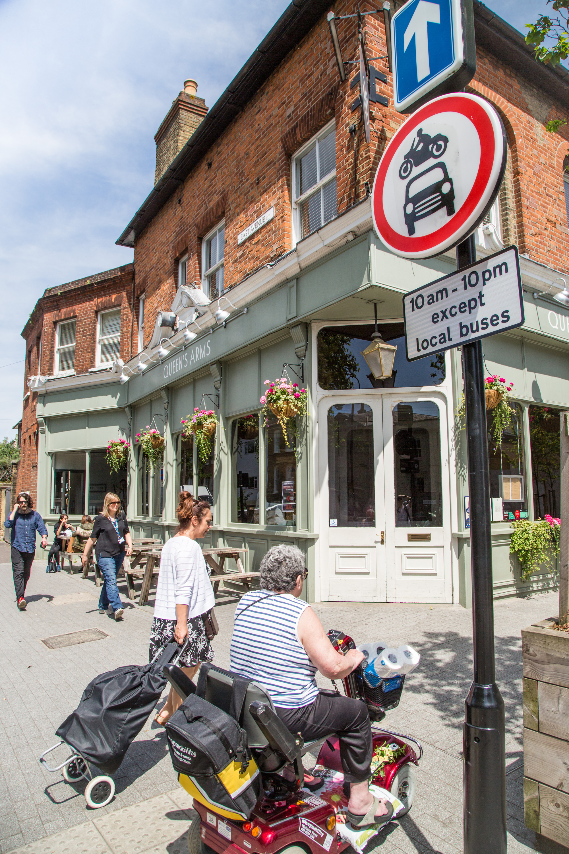
Publication and next steps
TfL DRAFT - RESTRICTED
Publication on 27th May
Programme for monitoring deliverables is in development
Promotion of the plan and ongoing engagement with stakeholders is continuing

