Slide 1
Better Health-Every Mind Matters (BH-EMM)
Guide for potential partners Contact us: partnerships@dhsc.gov.uk

Slide 2
Background and strategy

Slide 3
Poor mental health is a growing issue
Much of the population is facing challenges with their mental health and wellbeing: 66% of adults in England report having either a clinical or sub-clinical mental health problem (Internal OHID research).
Official data shows almost 17 million working days were lost to stress, anxiety and depression in 2019/20 – over half the total (32.5 million).
Mental ill-health is the single largest cause of disability in the UK, and accounts for 21% of the burden of disease in England.
Mental ill-health is also associated with lower life expectancy, with some conditions associated with reductions in life expectancy of 10 to 20 years
Modelling suggests that, in England, up to 10 million people will need either new or additional mental health support as a direct consequence of the COVID-19 pandemic.
Perceptions of mental health have changed rapidly over recent years, and may still be in flux

Slide 4
BH-EMM overview
Launched in 2019, Better Health-Every Mind Matters is an NHS-endorsed digital resource and campaign designed to empower people to take action to protect and improve their mental wellbeing, to help prevent common mental health concerns escalating into mental health disorders that require NHS intervention
Website
Mind Plan
Email Programmes
Annual campaign delivered around World Mental Health Day weighted towards those struggling with mental health problems.
Runs nationally across owned, earned and paid channels.
Campaigns have delivered impact:
strong digital engagement, reported behaviour change and improved outcomes in mental health and wellbeing

Slide 5
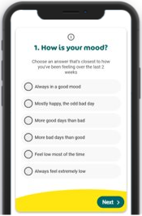
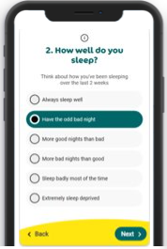
BH-EMM digital tools
Website
Offers a range of articles and videos that provide NHS-approved advice, practical tips and support to help people protect and improve their mental health.
Condition pages covering the 4 most common sub-clinical problems: anxiety, stress, low mood & poor sleep
Wellbeing hub with tips to pro-actively manage your mental wellbeing based on ‘5 ways to wellbeing’
Life’s challenges - addresses drivers of poor mental health (e.g., financial worries) with practical tips and advice
Helping others facing mental health problems
Urgent support - signposts to NHS Talking Therapies, NHS emergency, key third and public sector services
Mind Plan
Answer 5 simple questions to get a free, personalised mental health action plan offering practical tips
Also available on Amazon Alexa
Email programmes
3x email programmes provide ongoing support and drive longer term behaviour change (third available from mid Sept)
Email programme #1: an extension of the ‘Mind Plan’ including further information on maintaining wellbeing and tips for incorporating positive actions into routines
Email programme #2 - provides advice and practical tips to help deal with anxiety and making these part of their routines
New sleep programme in progress
Can be embedded into existing digital platforms

Slide 6
Coming soon...new sleep programme
Objective
To encourage people who are suffering from poor sleep or struggling to sleep to build good sleep habits that will improve their sleep and therefore their mental health.
Strategy
We will do this by:
Educating people about good sleep habits with practical tips
Building habits using habit building behaviour change techniques and contacting them over a period of time rather than just once.
"Put sleep first"
Your sleep matters, so put sleep first
Content includes:
Sleep time routines
Your sleep environment
Relaxation before bed including “beditation” and meditation
Beyond the bedroom- how to set up a good day in order to have a good night.
Separate your work and home life
Do you have insomnia?
Tips for shift workers, parents & carers, new parents
Sign up by answering a quiz about your sleep
[Option to seek clinical help for serious disorders at this stage]
4 weeks of free, NHS-assured content with hints, tips and videos
Every email recaps with a habit-building reinforcement section
Finish the programme by repeating the quiz to see what difference has been made
Notes:
Why do we need something on sleep?
Poor sleep is not a mental health disorder but we know that sleep plays a critical role when it comes to maintaining positive mental wellbeing
Long-term sleep loss can lead to issues such as anxiety and depression.
Ideally adults need between 7 and 9** hours sleep a night but 2-5% of the U.K. population are long sleepers and sleep more than this, while 18-26% are short sleepers having less sleep than their recommended 7 hours. Both short and long sleep can contribute to poor physical and mental health.
Poor quality sleep can also impact negatively on your health.

Slide 7
BH-EMM impact
4.6 million Mind Plan completes since launch
2 out of 3 of those who complete the Mind Plan email programme report better mental health and wellbeing than when they started
Just over half (55%) of those who complete the anxiety email programme see a decrease in their reported levels of anxiety
4 in 5 Mind Plan and anxiety email programme completers agree that they have now made looking after their mental health part of their regular routine
4 in 5 programme Mind Plan and anxiety email programme completers agree that they have noticed a positive change in the way they feel when using advice from these programmes

Slide 8
BH-EMM audience
BH-EMM targets those with a sub-clinical mental health problem and is looking to further support, where possible, those that are Undiagnosed (see diagram below).
This year's (FY23/24) campaign is aiming to target:
25-54 adults living in England
Female skew
Black/Black British and South Asian/South Asian British communities
Those living in areas of deprivation
%'s based on adult population in England

Slide 9
BH-EMM audience insight
Those who are struggling with their mental health do not believe that they have the ability to take action to improve their mental health, or that self-care action will work for them.
Our target audience’s low self-efficacy (belief) is primarily driven by negative imaginal experience: people struggle to imagine themselves taking positive action and it working for them.

Slide 10
BH-EMM audience
Therefore, we want to
GET
Those that are struggling. They are anxious, stressed and suffer low mood several times a week.
WHO
Recognise the importance of taking action for their mental health but don't believe they have the ability to help themselves and that actions will work for them
TO
Believe they can help themselves (self-efficacy) and take a small positive step to improve their mental health with
BH-EMM digital tools
BY
Helping them to imagine how doing one small thing every day can help them feel a lot better.

Slide 11
BH-EMM audience actions
The actions we want them to take include:
Get physically active
Manage your feelings (with the help of CBT)
Talk to someone you trust
Get the most from your sleep
Get closer to nature
Plan something nice to look forward to

Slide 12
How you can get involved with the 2023 campaign Better Health Every Mind Matters - Campaign Resource Centre

Slide 13
Campaign planning guide
Help to EMPOWER target audience to undertake preventative actions using Every Mind Matters (EMM) content.
Preventative actions:
1. Be physically active 2. Manage feelings with CBT 3. Talk to someone you trust 4. Get the most from your sleep 5. Get closer to nature 6. Plan something nice to look forward to.
2. Signpost to EMM content to help RESPOND to those who finding it difficult to cope.
Life triggers: 1. Relationship break-up 2. Grief/bereavement
3. Job change 4. New baby 5. Money concerns.
Enhance your resident/patient and employee experience by supporting people to take small steps to improve their mental health.
1
2
3
Use World Mental Health Day
(11th Oct) as a hook to promote the EMM tools:
EMM website
My Mind Plan
Sleep improvement programme
Physical activity offer
Consider products and services that you offer that indicate a potential life trigger where EMM content can be served up.
E.g. Housing services (moving home)
Registrar service (births, bereavements)
Consider linking services as solutions to improving mental health (linking to EMM):
Leisure & physical activity services
Green spaces and cultural opportunities
Libraries
4
Employees Providing EMM tools for your employees and building them into your HR response

Slide 14
What channels could you use?
Staff
Intranet
Newsletters
Digital screens or posters in staff areas
Team meetings
Events
Residents
Website
Social media
Newsletters
Digital screens/posters in service settings
Street events/community drop-ins/health trainers
Patients
Digital screens/posters in waiting rooms & other public areas
Website
Newsletters & social media

Slide 15
Campaign preview and how we'll support you

Slide 16
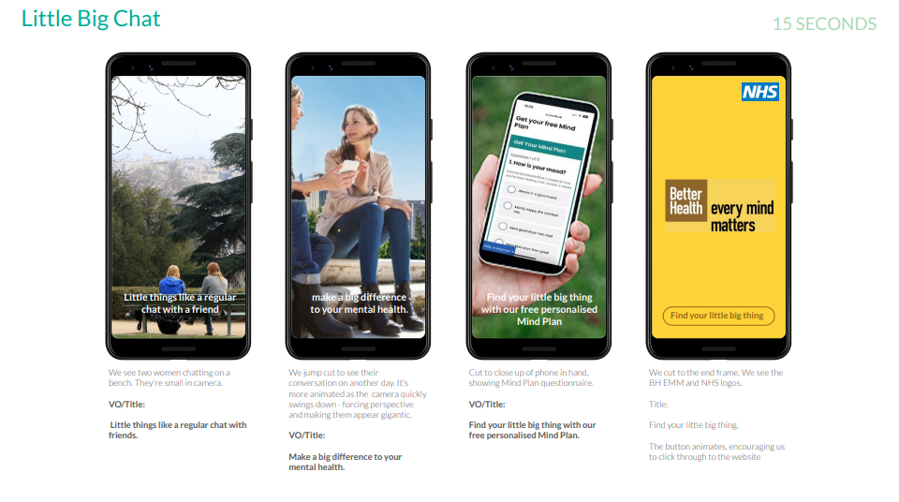
BH-EMM campaign / Your toolkit (in development)
Little Big Things
In this campaign we’ll show how the small things people do every day can make a big difference to their mental health and wellbeing.
Example copy
Little things like a regular chat with friends can make a big difference to your mental health. Find your little big thing at
Every Mind Matters
Digital screen
example
Assets available from
w/c 2nd October via the
CRC
Social
example

Slide 17
BH-EMM campaign – Zoomed in – DRAFT CREATIVE
Digital screen
NOT FINAL
STILL DRAFT

Slide 18
BH-EMM campaign – Zoomed in – DRAFT CREATIVE
Social example
NOT FINAL
STILL DRAFT

Slide 19
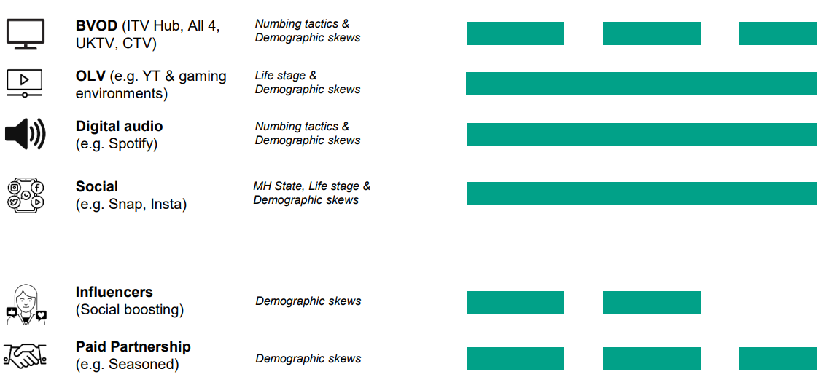
BH-EMM media plan
October '23 – March '24
Drive self-efficacy
+
Brand awareness and ad recall
Drive traffic to
BH-EMM digital tools

Slide 20
BH-EMM low/no cost plans
Earned channels
Organic influencers
Leverage trusted voices to drive self-efficacy and social norming amongst target audience.
Commercial partnerships
Work with contextually relevant brands which address mental distress life triggers, e.g., financial and job search services, to promote the campaign to their customers. Build holistic partnerships in physical activity, beauty and sleep sectors.
Public and third sector partnerships
Leverage support from ~120K supporters from other Govt Depts, Local Authorities, NHS organisations, charities and community organisations to promote campaign to their staff, residents, patients and customers.
Owned channels
Email
Drive engagement with our digital tools amongst BH-EMM's c.1m database.
In-app promotion
Create mental health features, functionality and content within NHS Couch to 5k and Active 10 (fitness) apps to drive self-efficacy and action among 900k+ monthly active users. Examples include pop-ups to encourage doing 'your little big thing'
Social media support
Drive self-efficacy and engagement with BH-EMM's digital tools via Better Health, DHSC and NHS social channels.

Slide 21
BH-EMM "always on" assets
These are more content-driven social posts that you can use at any time of the year to share hints and tips with your followers and encourage them to discover more from Better Health – Every Mind Matters.
Supporting mental health problems
Anxiety
Poor sleep
Stress
Low mood
Top tips to help support mental wellbeing including self-help CBT techniques
Calendar moments
Drive to BH-EMM website and email programmes
These assets are available as JPEGs in 1x1 and 9x16 for use as in-feed or story posts with the following structure:
Intro frame
Tips
Outro frame

Slide 22
BH-EMM always on assets (mental health concerns)
Assets available for: anxiety, sleep, low mood and trouble sleeping

Slide 23
BH-EMM always on assets (wellbeing)
Assets available for: connecting with others, keeping learning, taking notice and being more mindful, giving to others and self-help CBT on the Campaign Resource Centre

Slide 24
Capitalising on calendar moments – coming soon
Assets available for:
World Kindness Day - 13th November 2023
National Self Care Week - 13th-19th November 2023
World Mental Health Day - 10th Oct 2023
National Work Life Week - 2nd-6th October 2023
Samaritans Brew Monday - 15th January 2024
Time to Talk Day - 1st February 2024
Children’s Mental Health Week - 5th-11th February 2024
World Sleep Day - 15th March 2024
Stress Awareness Month - April 2024
Mental Health Awareness Week - 13th-20th May 2024
Bike to Work Day - 17th May 2024
Pride Month - June 2024
Volunteers' Week - 1st-7th June 2024
Better Health Every Mind Matters Campaign Resource Centre

Slide 25
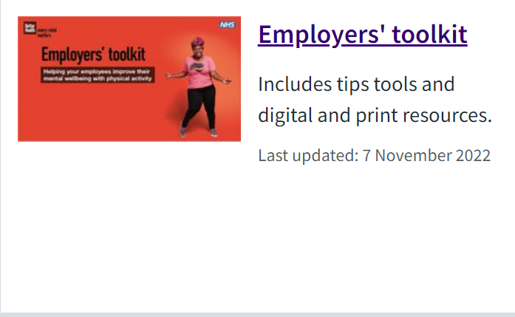
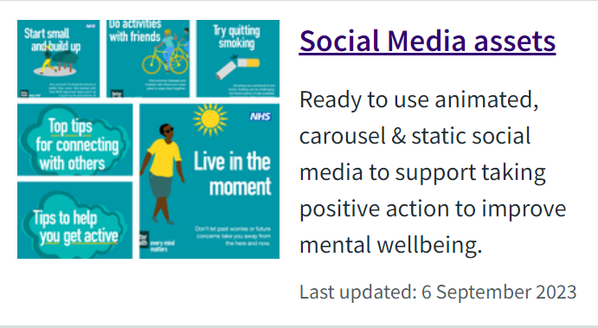
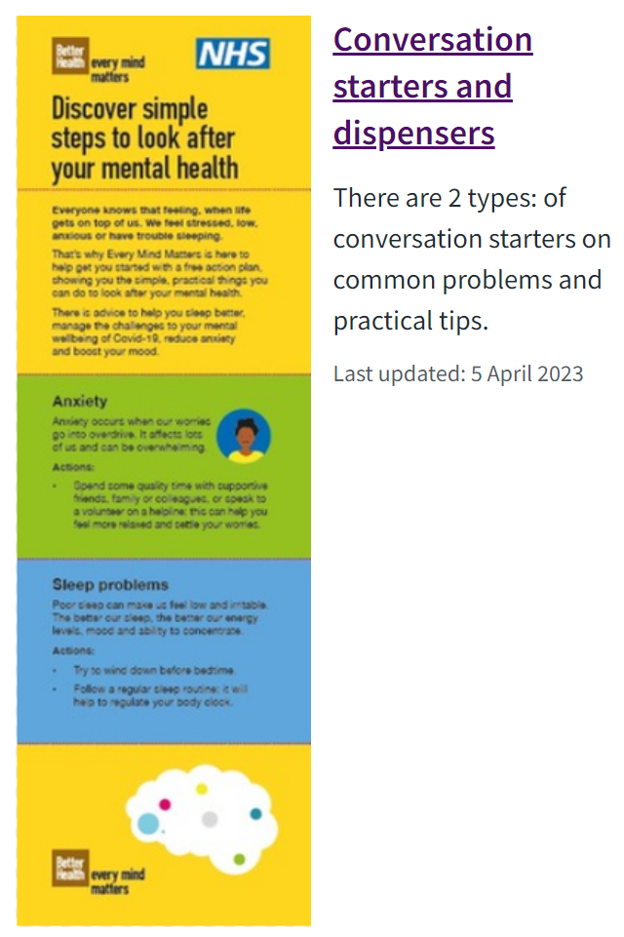
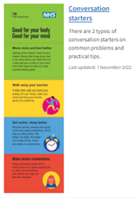
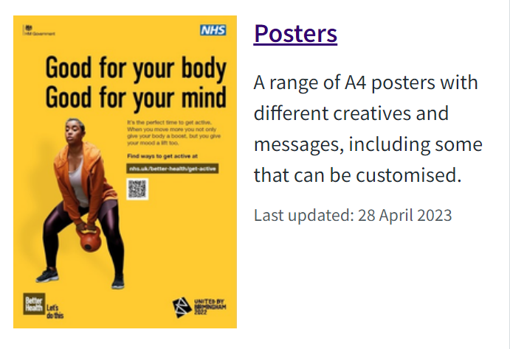
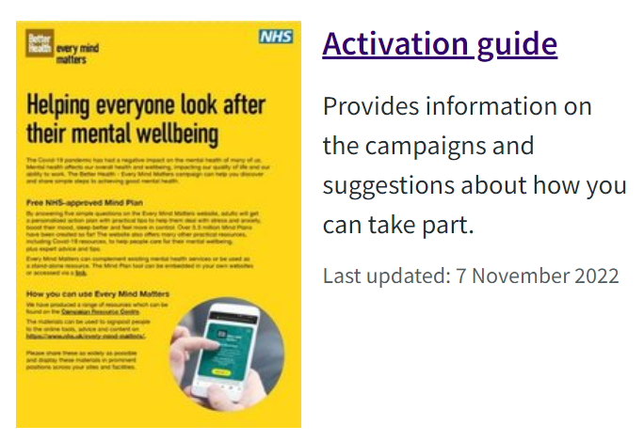
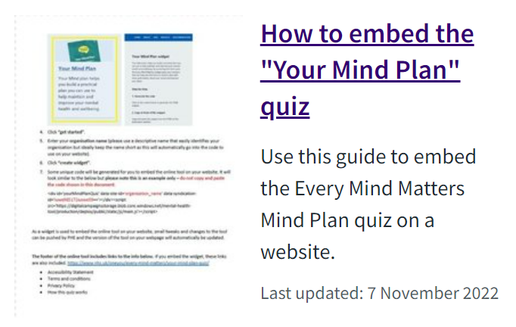
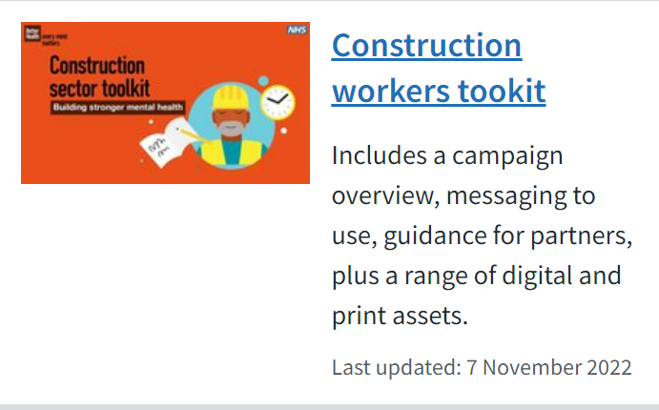
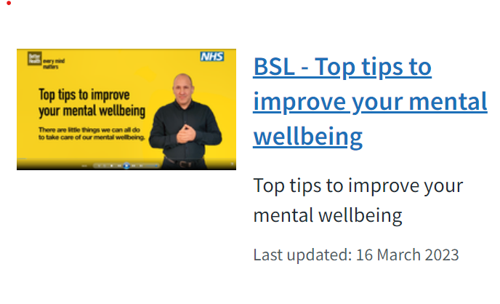
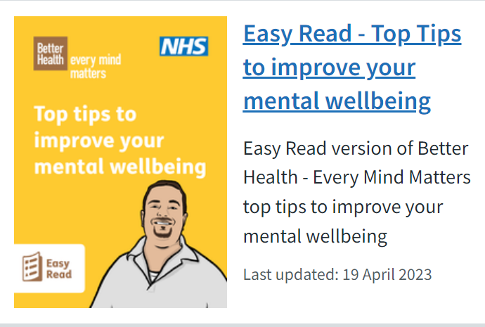
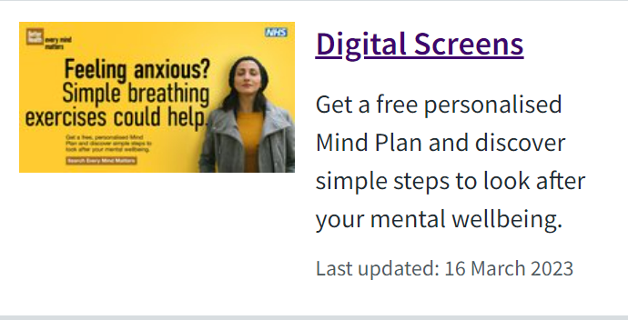
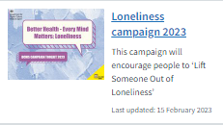
Partner Resources on the Campaign Resource Centre
Find these & more on the Campaign Resource Centre and/or click the images above
Notes:
Posters: mainly physical activity but one on top tips to improve your wellbeing. Some posters are available to order – best to check website as we may not be able to replenish stocks
Conversation starters: 2 versions – physical activity-inspired one and one on the main mental health concerns – anxiety, sleep etc. These 2 conversation starters can also be ordered in packs. There are 25 conversation starters in 1 pack, so make sure to enter the number of packs you want, for example if you would like 50, you would need to order 2 packs of 25.

Slide 26
Every Mind Matters
School mental wellbeing offer
September 2023

Slide 27
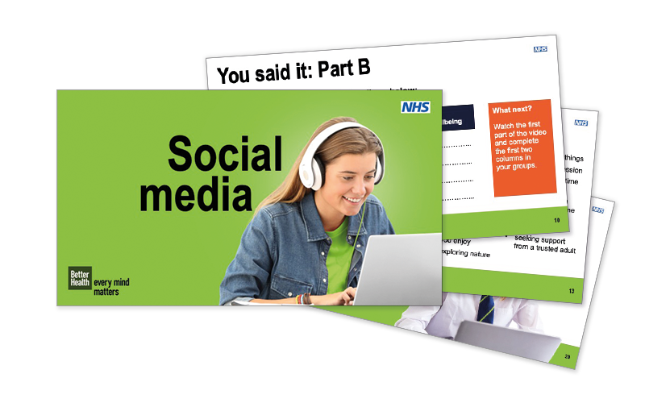
Current school mental wellbeing offer
Written and reviewed by teachers, flexible easy to use curriculum linked resources to help teach Year 6, KS3 and KS4 pupils
Featuring films co-created with young people to help empower students to take positive action to look after their mental wellbeing.
Endorsed by the NHS and PSHE Association.
Topics for secondary pupils include Positive Friendships, Vaping and Unhelpful Thoughts
Year 6 topics include Transition to Secondary School, Social Media and Worry
The School Zone website hosts the full range of teaching resources.
Notes:
Helping you teach PSHE, RHE and RSHE to Upper KS2, KS3 and KS4 students, with flexible, ready-to-use content co-created with teachers, and young people.

Slide 28
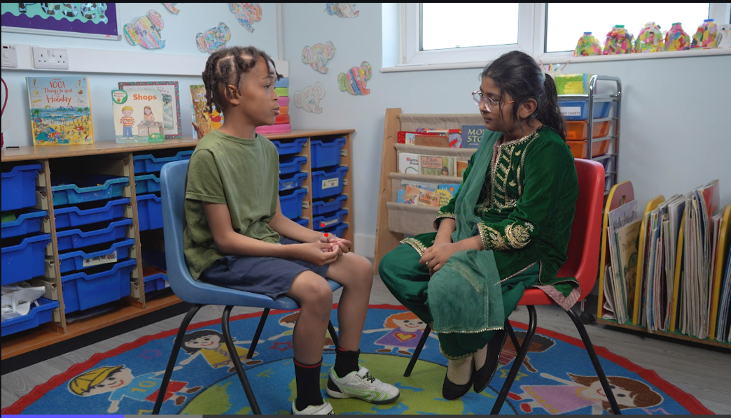
New primary mental wellbeing resources
New resources on emotions, self-care and kindness. Each theme will be differentiated for KS1 and KS2, creating six lesson plans in total.​
A whole school assembly introduces the concepts and lesson plans will feature films with primary aged pupils, helping to make the topics feel relevant for students.
All elements of the primary mental wellbeing Health Education statutory guidance will be incorporated, supporting teachers in implementing this new area of the curriculum.
Available from October on the School Zone
Assembly
Lesson plans
Films
Intro to wellbeing
whole school
What is wellbeing and why is it important?
Emotions
KS1 & KS2
Exploring the range and scale of emotions and equipping pupils with vocabulary to discuss their emotions.
Self-care
KS1 & KS2
Practical self-care actions, linking to the five ways to wellbeing (connect, physical activity, learn new skills, giving, mindfulness), where appropriate.
Kindness
KS1 & KS2
Self-kindness and light-touch bullying content. Whole-school compassion exercise, random acts of kindness and reflection exercise on how it makes pupils feel.
Youth voice films
Peer-to-peer films modelling positive behaviours.

Slide 29
Thank you

Slide 30
Appendix - Embedding the Mind Plan on your site

Slide 31
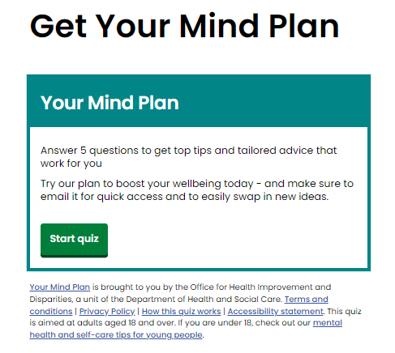
Embedding the Mind Plan
The Mind Plan is the NHS-endorsed 2 minute, 5 question quiz that is at the heart of Every Mind Matters
Available free on the Every Mind Matters website. By answering five short questions people get a personalised mental health action plan, providing practical tips to help them deal with stress and anxiety, boost their mood, sleep better and feel more in control.
People can also join a 4-week email programme where they can get reminders, swap in new tips and are encouraged to make looking after their mental wellbeing part of their everyday routine.
For anyone wanting to host a Mind Plan on their website there embedding instructions on how to do this on the Campaign Resource Centre.

