Slide 1


Measles Response
(14th July 2023)
-
Regional communications toolkit

Slide 2
What is the background?
Overview
Measles cases are rising in England this year. There were 128 cases from 1st Jan – 30th June, of which the majority are in London. The vaccination rate is lower than the 95% target set by WHO and as low as 60% in some areas of London.
UKHSA have predicted that the risk in London is high this year and cases could rise to between 40k and 160k due to low uptake of the MMR and the number of cases being imported and spread.
The overall risk to England is low, but there are cases of measles in every region and numbers are rising. UKHSA suggest that without intervention cases will continue to rise in all regions.
UKHSA are announcing their predictions and modeling paper outlining the risk of measles in England as low and London as high on 14th July 2023, which is expected to gain much media interest.
Here is a pack to support that announcement.

Slide 3
What are the next steps?
With the number of cases rising UKHSA are to declare there is a public health risk and the NHS will be pushing for the uptake of the MMR vaccine as a response to the risk.
An NHSE national comms and marketing campaign will be launching on 14th July with a specific focus on low uptake communities in London where there is the biggest risk highlighted. However, with all regions being affected by cases the campaign launch will be a national approach hitting all national media.
The national campaign and key messages will be pushed to stakeholders, charities and health care practitioners.
Community outreach will be taking place in the London area targeting the key audiences known to have low uptake of MMR. The national launch will also target other regions through radio channels and on social media.
Where possible please can regions and ICBs share the pack assets with media, stakeholders and on social media to amplify the key messages.
Press activity and social to start no earlier than 14th July 2023

Slide 4
Objectives/Aims
Increase the awareness of the seriousness of measles in the community. It is not just a rash and can make children seriously unwell. There is no medical treatment for measles.
Educate communities of the benefits of the MMR vaccine to prevent children becoming seriously unwell.
Inform the public that measles cases are on the rise in England and across Europe, encouraging the uptake of the MMR vaccine
Where suitable, educate that there is no link between the MMR vaccine and autism. (National Autism Society state ‘There is no link between autism and vaccines.’)
Remind people the MMR vaccine needs 2 doses in childhood starting from one1 year old

Slide 5
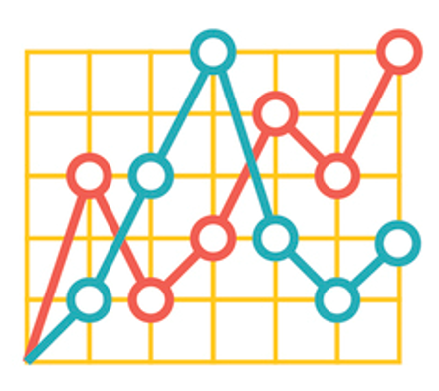
Audience and insights
Audiences
General public (including parents/carers of pre- and school age children).
Healthcare professionals
Stakeholders and children's charities
Key stats and insights
Over 1 in 10 children are unvaccinated and unprotected against Measles, Mumps, Rubella (MMR) in England
Vaccination for MMR has been in decline for over a decade and is well below the 95% WHO target needed to achieve and sustain measles elimination.
London has an increased risk due to as low as 2 in 5 children unvaccinated and higher case numbers of measles this year
All regions of England have measles cases
The WHO has advised that measles cases are on the rise across Europe
UKHSA modelling suggests London could sustain 40k – 160k measles cases

Slide 6
Key messages
General
Measles cases are rising in England and across Europe
Measles can make children seriously unwell with one in five needing a hospital visit
One on 15 children develop serious complications from a measles infection, which can include meningitis and blindness
There is no medical treatment for measles; vaccination is the best protection against becoming seriously unwell
The Measles, Mumps and Rubella (MMR) vaccine is safe and has been used since the early 1980s.
Over 20 million cases of measles have been prevented since the start of measles vaccination in the UK. Over 4,500 lives have been saved as a result (81 lives per year) *source is UKHSA blog.
MMR vaccination is free on the NHS with the first dose being offered when a child is one and the second at 3 years and 4 months old. This provides long lasting protection against measles, mumps and rubella which can cause long term health conditions such as blindness and asthma.
Vaccination is the best way to protect a child from becoming seriously unwell from preventable diseases such as measles
The evidence is clear; there is no link between the MMR vaccine and autism
Call to action
If your child has missed their first or second dose of MMR vaccine contact your GP practice to book an appointment.
If you are unsure if your child is due a vaccination or has missed a vaccination check their red book or contact your GP practice.
For adults, it is never too late to catch up on their MMR vaccinations, contact your GP practice to book an appointment
For more information visit the NHS website

Slide 7
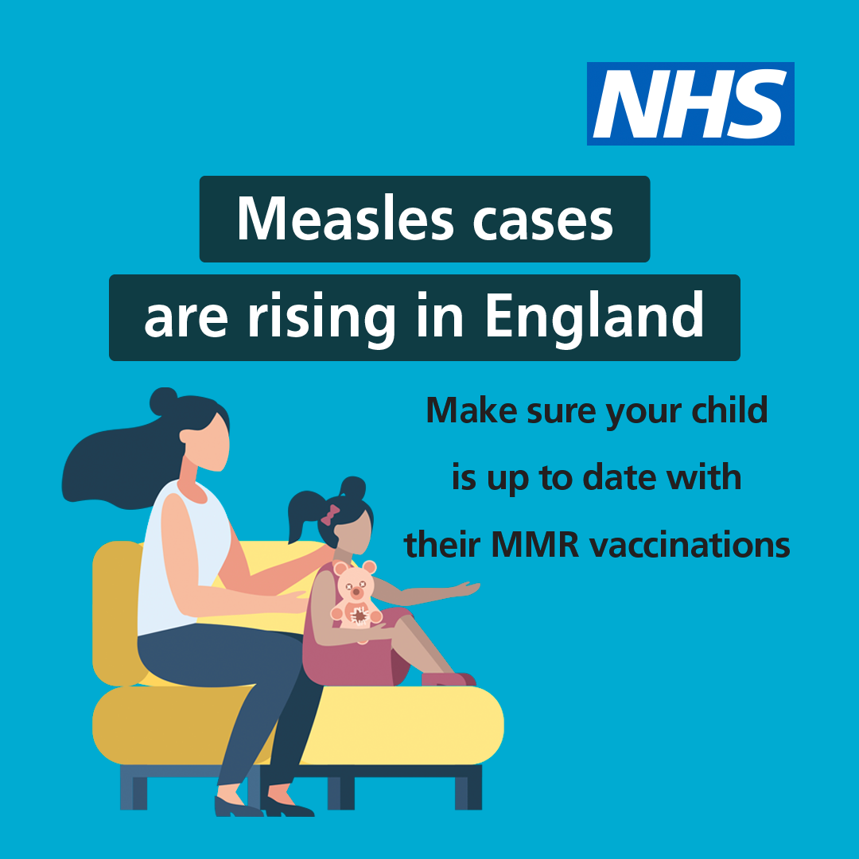
Assets for use & sharing
New social media assets have been created for this measles campaign and to support the UKHSA announcement. These can be found here
Please share resources with colleagues, local communications networks, community organisations for use
National call / recall assets are available for use here including translated materials
Recent communication from UKHSA and NHS to Head of Public Health regarding the WHO resurgence predictions and call / recall action is here

Slide 8



Example social media posts
Twitter
Cases of measles are rising in England. Measles is more than just a rash with one in five children needing a hospital visit. Make sure your child is up to date with their MMR vaccination to give them the best protection again becoming seriously unwell. Find out more here.
Facebook
Measles cases are rising in England. Make sure your child is up to date with their MMR vaccinations.
For more information visit nhs.uk/mmr
Instagram
Two doses of the MMR vaccinations can help stop your child becoming seriously unwell with measles.
For more information on how to check your child’s vaccination record, visit nhs.uk/mmr

Slide 9
Useful links
Use your own social media channels and create your own posts or like and share social content posted from:
Social Media Handles
NHS England
Facebook account: @NHSWebsite
Twitter account: @NHSuk
Department of Health and Social Care
Facebook account: @DHSCgovuk
Twitter account: @DHSCgovuk
UK Health Security Agency
Facebook account: @UKHealthSecurityAgency
Twitter account: @UKHSA
Weblinks
NHS vaccination schedule
Quarterly Childhood Vaccination Coverage – 2020/21 (Source: Gov.uk)

Slide 10
Example copy
This can be used as a basis for bulletins/websites/fact cards/ depending on your activity.
Measles cases are on the rise in England and across the whole of Europe. Make sure you and your family are protected against becoming seriously unwell with measles by checking you are up to date with the MMR vaccine.
Across England, on average one in ten children are not up to date with their MMR vaccinations, with some areas of the country as low as two in five, putting thousands of children at risk of catching measles and the disease spreading in unvaccinated communities.
Just two doses of the MMR vaccine gives you and your family lifelong protection against catching measles. The first vaccine is given at age one year and the second at age three years and four months old. If you’ve missed any doses it’s not too late to catch up. Contact your GP Practice today to book an appointment to get up to date.
If you are unsure if you or your child are up to date, check your child's red book or GP records and make an appointment to catch up any missed doses.
For more information on the NHS vaccination schedule, please visit.

