Slide 1
ADPH Policy Workshop & AGM
13th June 2014

Slide 2
TACKLING THE GROWING OBESITY CRISIS
>>A HEALTHY WEIGHT CAMPAIGN ON BEHALF OF THE NORTH WEST DIRECTORS OF PUBLIC HEALTH<<

Slide 3
INTRODUCTION
Abdul Razzaq
Chair, Food Active
Director of Public Health, Trafford Council

Slide 4
FOOD ACTIVE
Aims
The introduction of a 20 pence per litre duty on sugar sweetened beverages (being a significant step toward achieving a reduction in refined added sugar intake in the UK and ensure that it does not contribute more than 5% of total energy intake).
A local authority pledge that will ensure that commercial interests do not influence food and nutrition policy.
The introduction of tighter regulatory controls on the advertising and marketing of junk food to children and young people.

Slide 6
MASTERCLASS: COMMERCIAL DETERMINANTS OF HEALTH
Thursday 8th May, City Tower, Manchester.
There is a need to address the commercial, as well as the social and political determinants of health.
Kickstarted discussions around a Local Authority pledge on commercial determinants.
High profile speakers and delegates from across the UK and Europe.
Areas for effective campaigning action highlighted.

Slide 7
MASTERCLASS FEEDBACK
“Excellent information for supporting a wider engagement of Local Authority colleagues in the obesity agenda and opportunities to influence political and service delivery”
“Increased understanding of commercial impact of obesity”
“Raised issues about consumerism and what needs to be done to understand the impact of this”

Slide 8
WHAT NEXT FOR FOOD ACTIVE?
Robin Ireland
Director, Food Active
Chief Executive, Health Equalities Group

Slide 9
KEY CAMPAIGNING ACTIONS
20 pence per litre duty on Sugar Sweetened Beverages
Call for local action on the commercial determinants of health (Local Authority Pledge)

Slide 11
NEXT STEPS FOR THE LA PLEDGE
Begin a dialogue with key stakeholders and form collaboration.
Follow local authority pledge on tobacco control template.
Compose pledge and stress test.
Identify pilot authority.
Launch and market.

Slide 12
KEY PARTNERS
Currently in discussion with…
ADPH
LGA
PHE
FPH
Action on Sugar
Sustain / Children’s Food Campaign
UK Health Forum

Slide 13
QUESTIONS AND DISCUSSION

Slide 14
CONTACT
Food Active Chair Food Active Director
Abdul Razzaq Robin Ireland
abdul.razzaq@trafford.gov.uk robin.ireland@hegroup.org.uk
@Nudge2health @robinHEG
www.foodactive.org.uk

Slide 15
ADPH Policy Workshop & AGM
13th June 2014

Slide 16
Electronic Cigarettes What should ADPH be saying?
Andrew Furber
DPH
Wakefield

Slide 17
What’s happening?
Use is exploding (>2m UK vapers)
Main use amongst smokers, and dual use
Emerging evidence on quitting
Little evidence e-cigs are a gateway
Regulation is coming – slowly
Marketing needs controlling
Big tobacco involvement
ASH briefing http://www.ash.org.uk/files/documents/ASH_715.pdf

Slide 18
Issues for ADPH
Much more to tobacco control than e-cigs
Is the use of e-cigs in smoke free areas OK?
What about niche areas (hospitals, prisons)?
Policy on MHRA approved products?
Use within commissioned SSS services?
Controls on marketing and availability?
Harm reduction vs. renormalisation?

Slide 19
ADPH Position on Electronic Cigarettes
Is the use of electronic cigarettes in smoke free areas OK?
Could electronic-cigarettes have a role in niche settings, e.g. enabling mental health/acute trusts to become smoke free?
Should Stop Smoking Services offer electronic-cigarettes?
Should GPs prescribe electronic-cigarettes once licenced by the MHRA from companies owned by the tobacco industry?
Should ADPH be lobbying for stronger limitations on marketing and availability?

Slide 20
ADPH Policy Workshop & AGM
13th June 2014

Slide 21
PH Workforce
It is time to start thinking about what workforce we need for the future to deliver the outcomes we need in relation to health and wellbeing:
What are the skills that are needed for the future workforce?
With integration across the public sector in the future, do you agree that we are more likely to need more hybrid (new) professionals in health and social care, more generalists and fewer traditional professions?

Slide 22
ADPH Annual General Meeting
13th June 2014

Slide 23
ADPH Annual Review & President’s Report to AGM
13th June 2014

Slide 24
ADPH - Collective voice for DsPH
2013 Annual Conference on Reducing Health Inequalities
Annual Policy Workshop for all Members
ADPH networks, supporting strong local DPH groups and sector led improvement
New e-forum development
Executive policy workshop: priorities & key policy topics;
Topic teams
President’s meetings with members
DPH Peer support service to members
e-DPH newsletters, communications and briefings to members & stakeholders

Slide 25
DPH development
ADPH Master Classes:
Strategic marketing of public health to LAs
new Master Classes on Local Government Law
new Master class programme being planned
DPH Annual Report Competition and survey of members
Collaborations on Sector-led Improvement/Improving PH Practice programmes
Joint work with LGA and others on Public Health conferences
Joint ADPH/CMO (England) conference for DsPH

Slide 26
Advocacy
Relationship building
PHE
LGA
DH
Government/Politicians
Collaborations with PH organisations/third sector
Directed advocacy
ADPH members represented on a wide range of national groups
Media responses

Slide 27
Policy
Member input through workshops, conference and surveys
Range of PH policy areas including: tobacco control; alcohol ; active travel/travel & health ; children & young people; sexual health; commercial determinants of health
Lobbying on PH system areas including: PH workforce – DPH vacancies, planning for wider PH workforce; PH funding
Development of ADPH policy topic teams and new e-forums;
Consultation responses on topics relevant to DsPH and their work;
High level of interest for DPH input – co-ordinating requests from external organisations for DPH input to a wide range of PH policy areas

Slide 28
Infrastructure and governance
Surplus budget with sufficient reserves; subscription system developed to ensure future financial stability
New ADPH office established; embedded within new organisational host (UK Health Forum); planning for transition to Charity status in 2014
New staff appointed to support organisational, policy and member services development
Constitutional amendments approved at 2013 AGM and further amendments proposed to 2014 AGM
Election processes completed for Board Members; full cohort of Constituency Representatives in place
Regular Board and Executive meetings; refinement of Board and Representative roles/responsibilities.

Slide 29
ADPH Annual Report Competition 2013-2014
Nicola Close, CEO
Janet Atherton, President

Slide 30
Class of 2013-2014
Largest entry yet - 49
Most aimed at public – many exclusively
Finally lost the 3-D pie charts!!
Disappointing – some taking easy route
Notes:
Difficult to shortlist
Plenty of good practice but spread across many reports

Slide 31
Some tips for improvement
Some still word heavy
Still a lot of jargon
Recommendations not specific
Vary graphics
Notes:
Jargon –
“Being outdoors has a strong correlation with physical activity” – in a report clearly aimed at the public
Recs
Work with partners to improve………
Increase engagement with………..
BAD – “Continue to invest in services that can assist people to manage any risks identified”
BAD - “partnerships should continue to pursue poverty prevention programmes”
?? – “NHSE and PHE must learn from past experience and good practice ….. to ensure we deliver excellent imms rates…..
GOOD – “set up a multi-agency steering group”
GOOD – “health equity audit to be undertaken of falls” – DEVON
Infographics
Wakefield – bus routes p19

Slide 32
Single topics
Not about making report smaller!
Not just a health promotion campaign
Deep dive; different lens; wider issues
Notes:
deep dive - offender health, tobacco, alcohol etc etc
Different lens – Suffolk – children through movement
Bringing in wider issues – Suffolk – planning; RTIs etc

Slide 33
Survey responses (34)
Adding value?
Impact?
Independence?
Anything else?

Slide 34
Adding value?
From survey:
Easier to read / engage with
Highlight specific areas / single topic
Different – vision; tips; progress; contributions; achievements
How about:
Data presentation

Slide 35
Impact?
From survey:
Most thought proportionate to use of resources
Raising awareness / engagement
Good for internal reflection

Slide 36
Independence?
From survey:
Most had no interference – some positive political interest
Some had wide consultation in draft
Quite a few had to compromise
How about:
Comparing with CMO report

Slide 37
Brighton
Varied approach & input
Readable
Nice infographics
Case studies and quotes
No clear recommendations

Slide 38
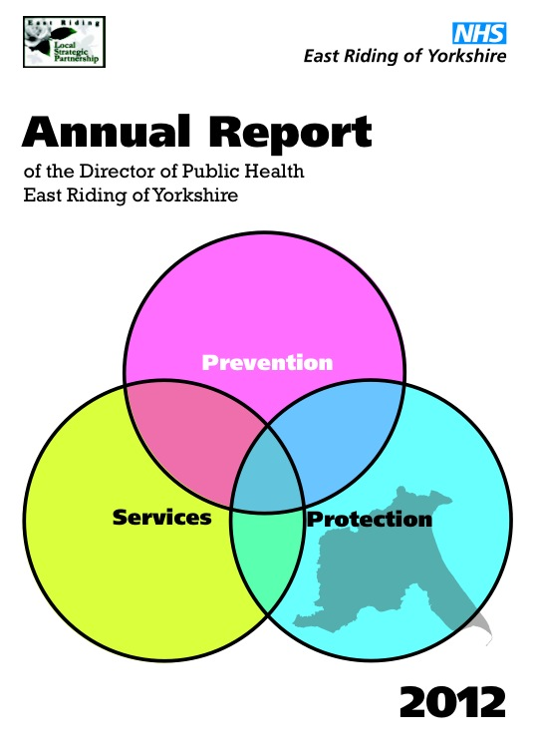
East Riding
Clear and concise
Suggested further reading
Specific recommendations + progress
Walks & recipes!
Limited in scope

Slide 39
Leeds
Recommendations and progress
Interesting infographics
References for further work
Historical context
Very busy

Slide 40
North Yorkshire
Good coverage of Health Protection
Nice summary pull-out
Case studies, facts & numbers
Recommendations
Somewhat wordy

Slide 41
Sandwell
Ward based profiles
CD with real detail
Achievements
No clear recommendations

Slide 42
Results
Clear winner but others very close
3rd – Sandwell – for great ward data
2nd – Leeds – for fabulous infographics
1st – Brighton and Hove – for engaging readers
Next year – make it a 10th anniversary special

Slide 43
ADPH Policy Workshop & AGM
13th June 2014

Slide 44
Improving Public Health practice - sector-led improvement
Janet Atherton

Slide 45
Principles
responsible for our own performance and improvement
primarily accountable to local communities (not government or the inspectorates)
collective responsibility for performance of the sector as a whole
www.adph.org.uk

Slide 46
LGA HWB improvement offer 14/15
Leadership and mentoring programmes for Chairs and Vice-Chairs of HWBs
Support to regional partnerships for activities such as Chairs Networks and other local priorities
Health and Wellbeing peer challenge programme (up to 20 per year)
Bespoke peer support – accessed through LGA Principal Advisers
Revised Self-Assessment Tool and other products
National post to coordinate support to local commissioners of Healthwatch
Monthly electronic bulletin
www.adph.org.uk

Slide 47
ADASS & ADCS
Regional programmes
Peer challenge and support
Benchmarking information
Managing risk of under performance

Slide 48
Public Health
ADPH working in partnership with PHE and LGA
local priorities, peer approach
support from PHE – finance, data, expertise
joint protocol LGA/ADPH/PHE for areas needing support

Slide 49
Public Health
ADPH working in partnership with PHE and LGA
local priorities, peer approach
support from PHE – finance, data, expertise
joint protocol LGA/ADPH/PHE for areas needing support

Slide 50
Feedback from Exec members
Focus around regular DPH meetings – collective leadership, space for peer challenge and support
Priorities – behaviour change, sexual health, alcohol, health protection, health checks etc
Support – admin, sharing assessment tools, best practice
Getting well established in London and Greater Manchester
Scotland National Service Improvement Network

Slide 51
ADPH Policy Workshop & AGM
13th June 2014

