Slide 1
ADPH Annual Conference & AGM
15th May 2012

Slide 2
Connecting with Purpose
Dr Janet Atherton
15 May 2012

Slide 3
Having a sense of greater purpose in life can protect our brains from mental decline and help us live longer.
Source: Action for Happiness, Twitter
May 2012

Slide 4
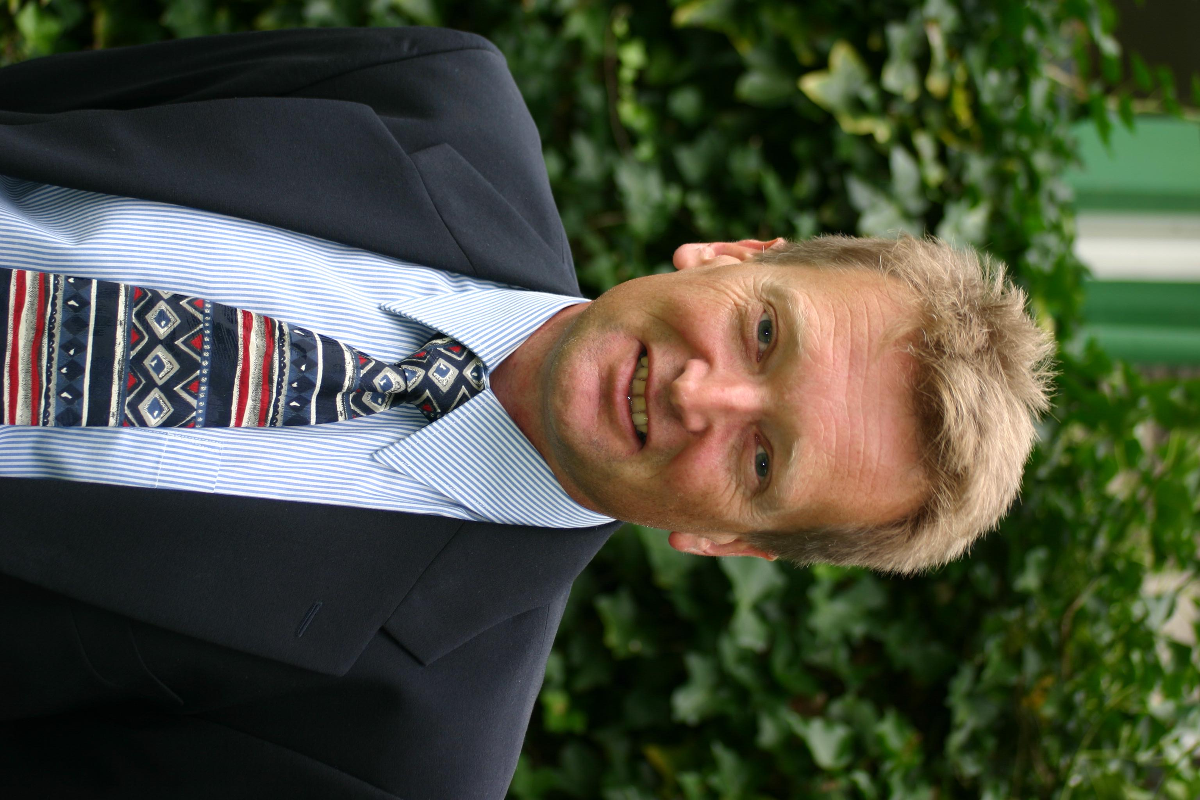

Slide 5
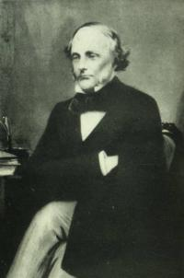

Slide 6
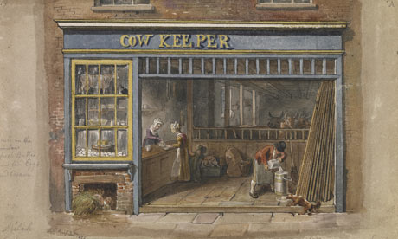

Slide 10
ADPH – Aims and values
Collate and present the views of Directors of Public Health on public health
policy to national governments, the media and other organisations; influence
legislation and policy at a local, regional, national and international level;
facilitate a support network for Directors of Public Health to share ideas and good
practice and support problem-solving; identify and fulfil the development needs of
Directors of Public Health where practicable and appropriate; in collaboration with
others, further the development of comprehensive, equitable public health policies
through relevant statutory and other bodies.

Slide 11
Has only been ADPH that has kept me sane as a jobbing DPH
Source: A real DPH, Twitter
March 2012

